Slide 1

E-DADS: Early detection of Alzheimer’s disease subtypes
Daniel C. Alexander
Centre for Medical Image Computing (CMIC)
Dept. Computer Science
UCL

Slide 2
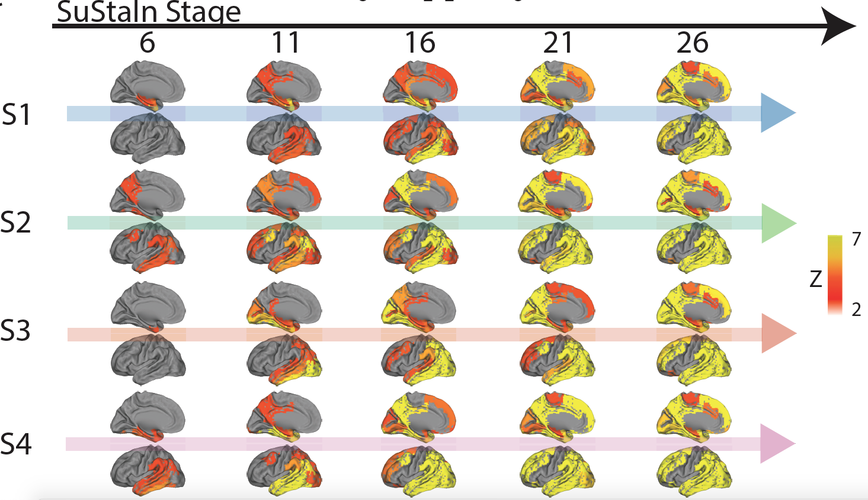
AD imaging manifestations
Vogel Nature Med. 2021

Slide 3
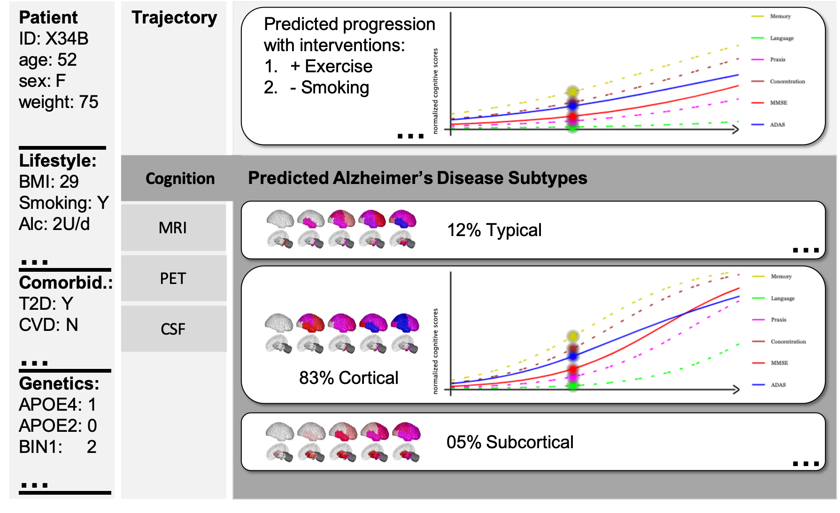
E-DADS vision

Slide 4

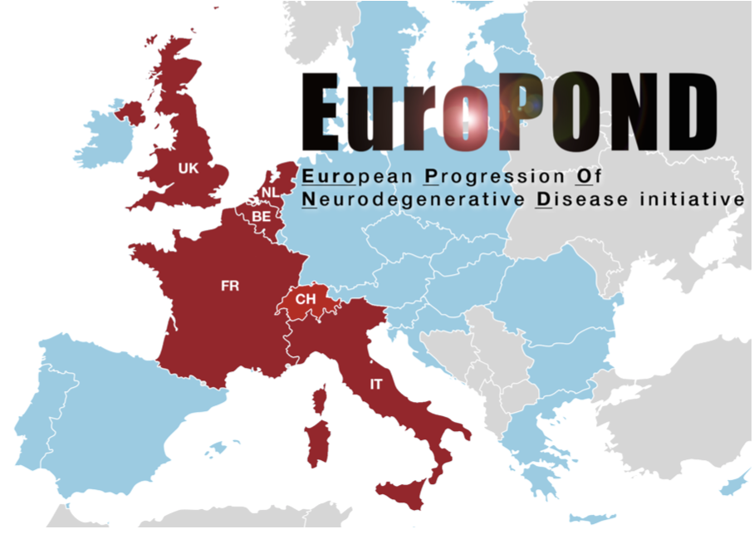
EuroPond 2016-2021
http://www.europond.eu
European Progression of Neurological Disease consortium.
  www.europond.eu
4 year H2020 project: Jan 2016 to Jan 2021
Partners from 7 sites across Europe:
  Computer science
  Statistics
  Image analysis
  Neurology
  Radiology
  Epidemiology

Slide 5
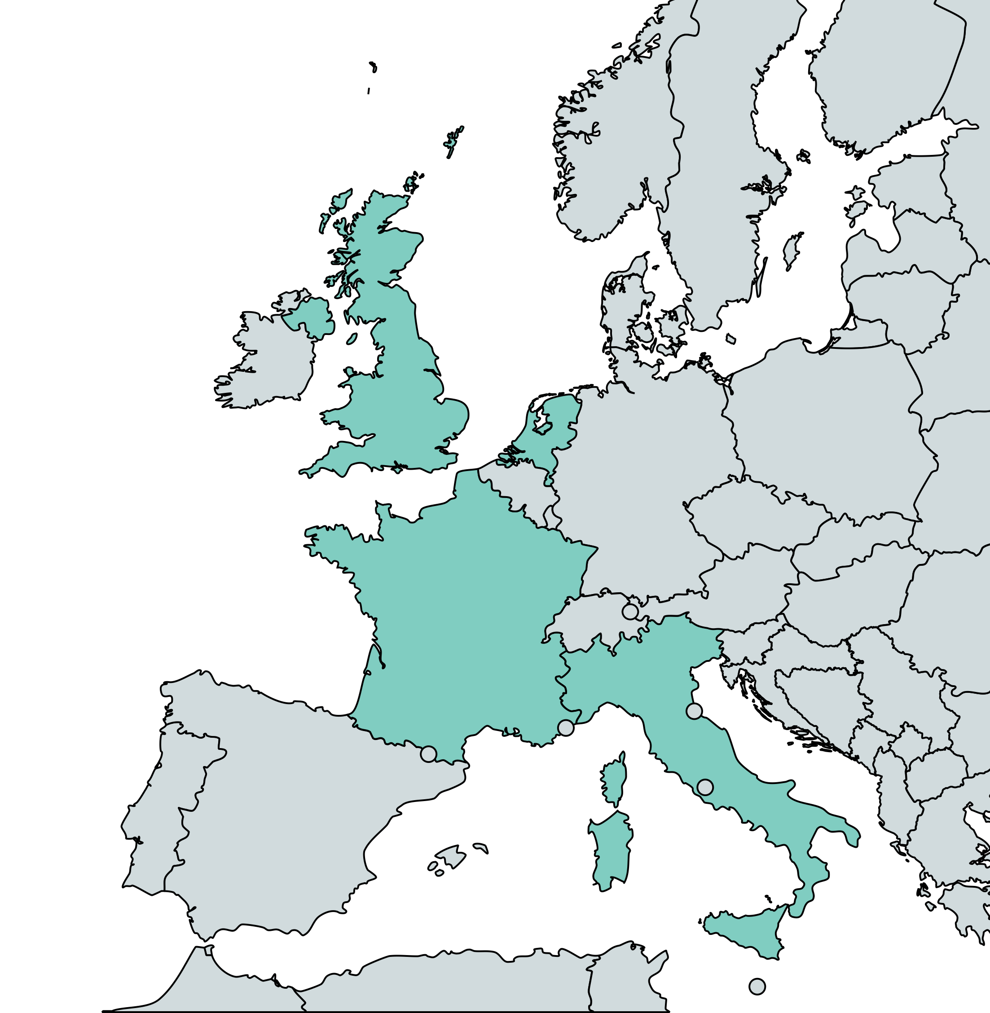

E-DADS consortium
University College London
Alexander, Altmann, Oxtoby
VUMC Amsterdam
Van der Flier, Tijms, Barkhof
INSERM, Paris.
Durrleman
Fatebenefratelli, Brescia.
Redolfi
CSIRO, Melbourne, Australia.
Burnham, Laws

Slide 6
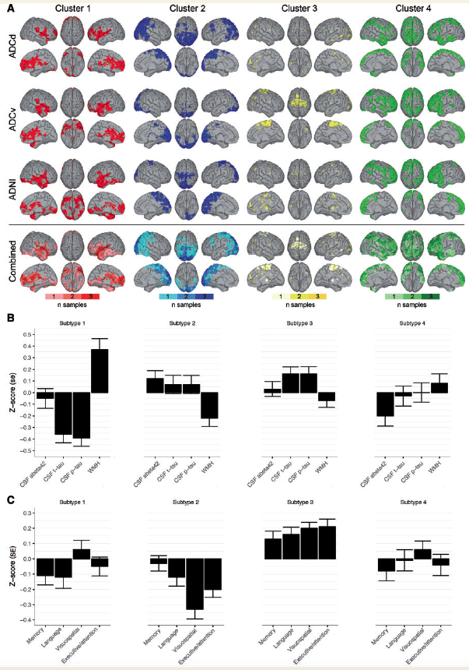
Non-negative matrix factorisation
Ten Kate Brain 2018

Slide 7
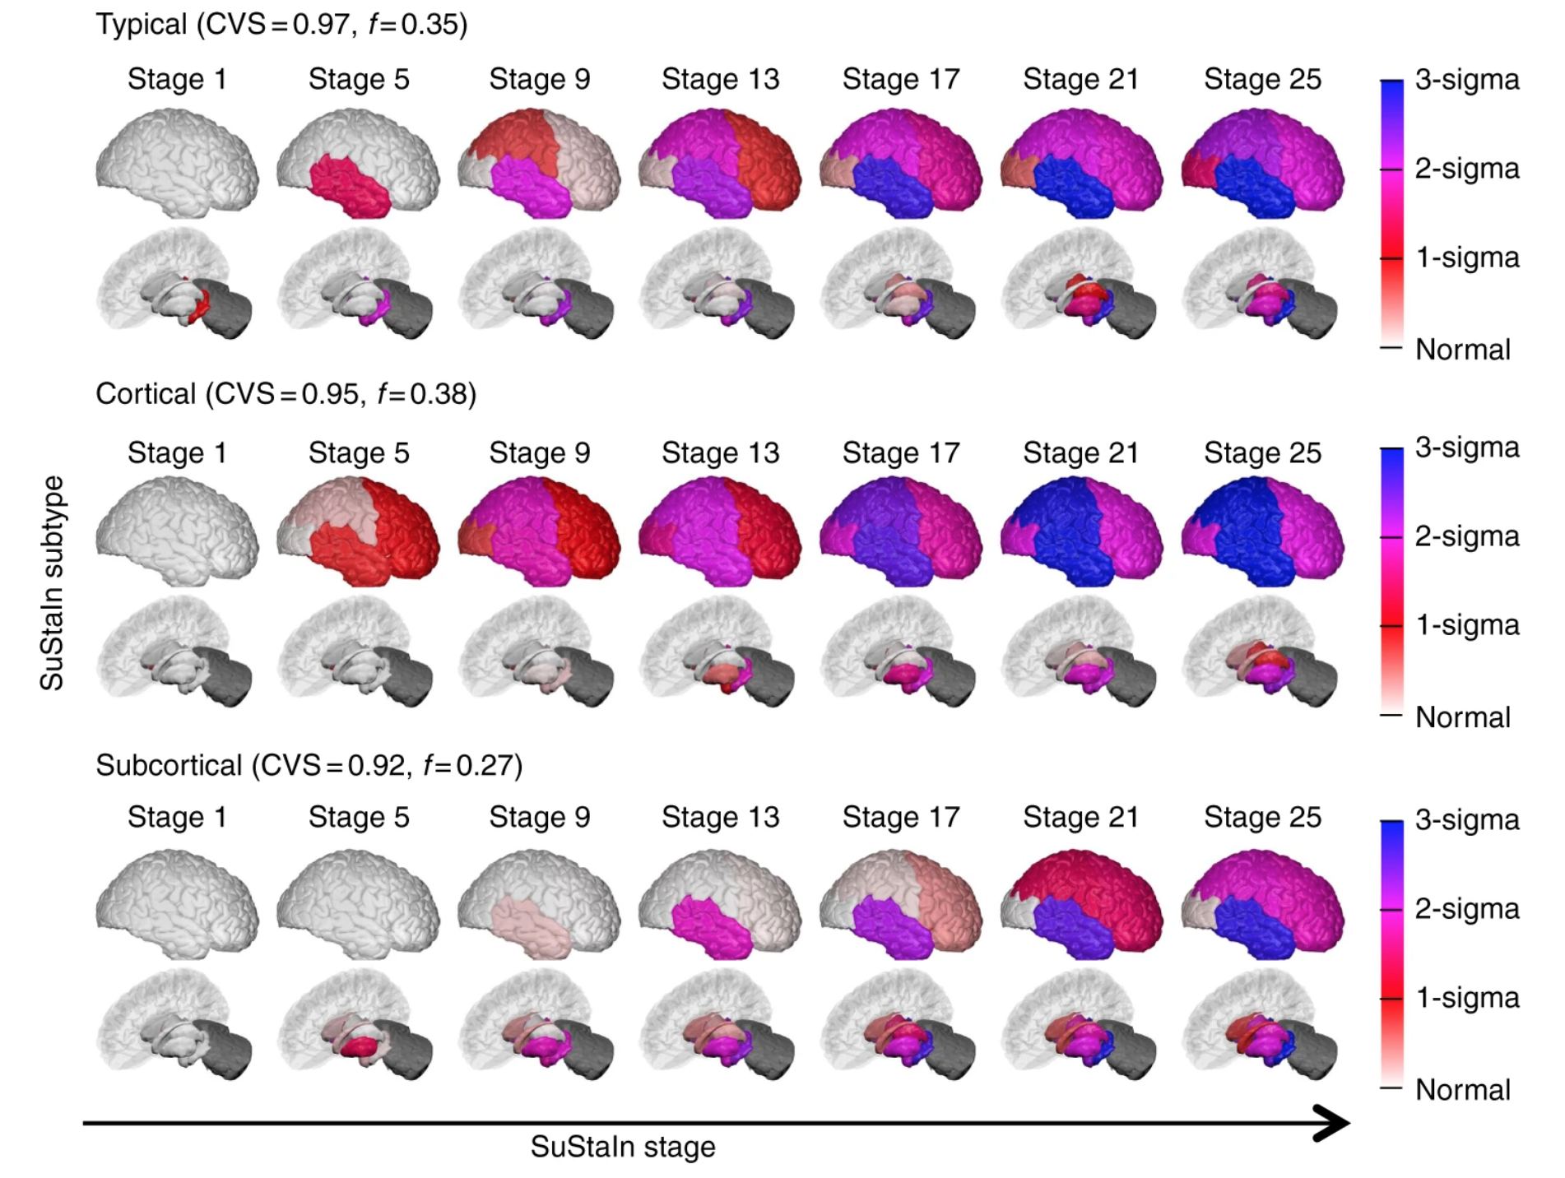
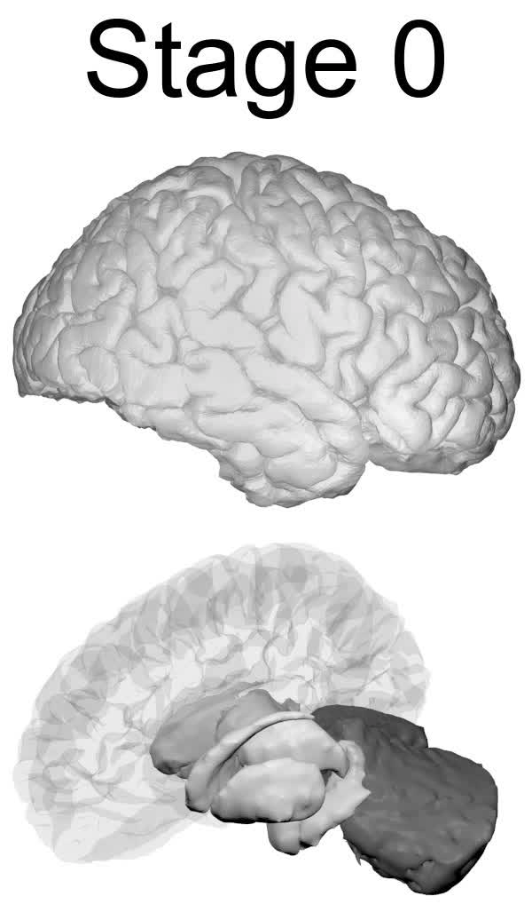
SuStaIn AD subtypes (ADNI 3T)

Slide 8
Subtype assignment
Young Nat. Comms. 2018

Slide 9
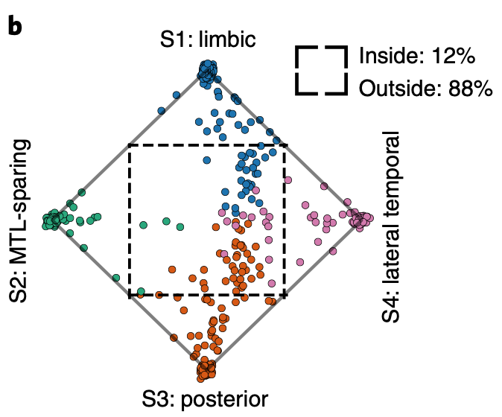
Patterns of tau deposition
Vogel Nature Med. 2021
Limbic
MTL sparing
Posterior
Lateral temporal

Slide 10
Digital Brain / Leaspy
Koval Sci. Rep. 2021
Poulet IPMI 2021

Slide 11
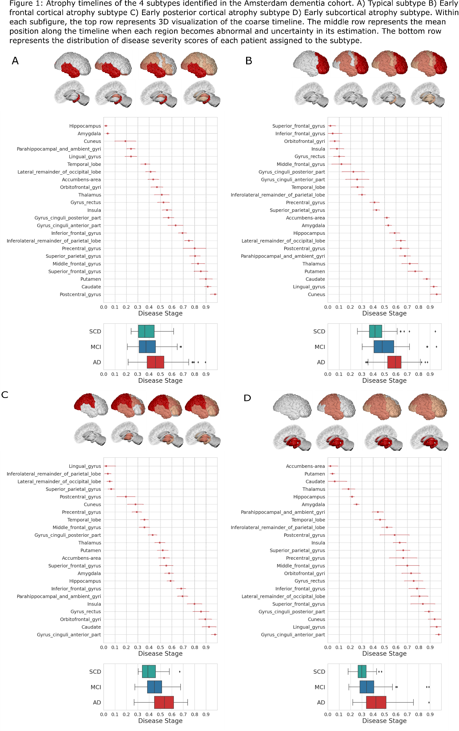
E-DADS: NMF-DEBM
Venkatraghavan AAIC 2022

Slide 12
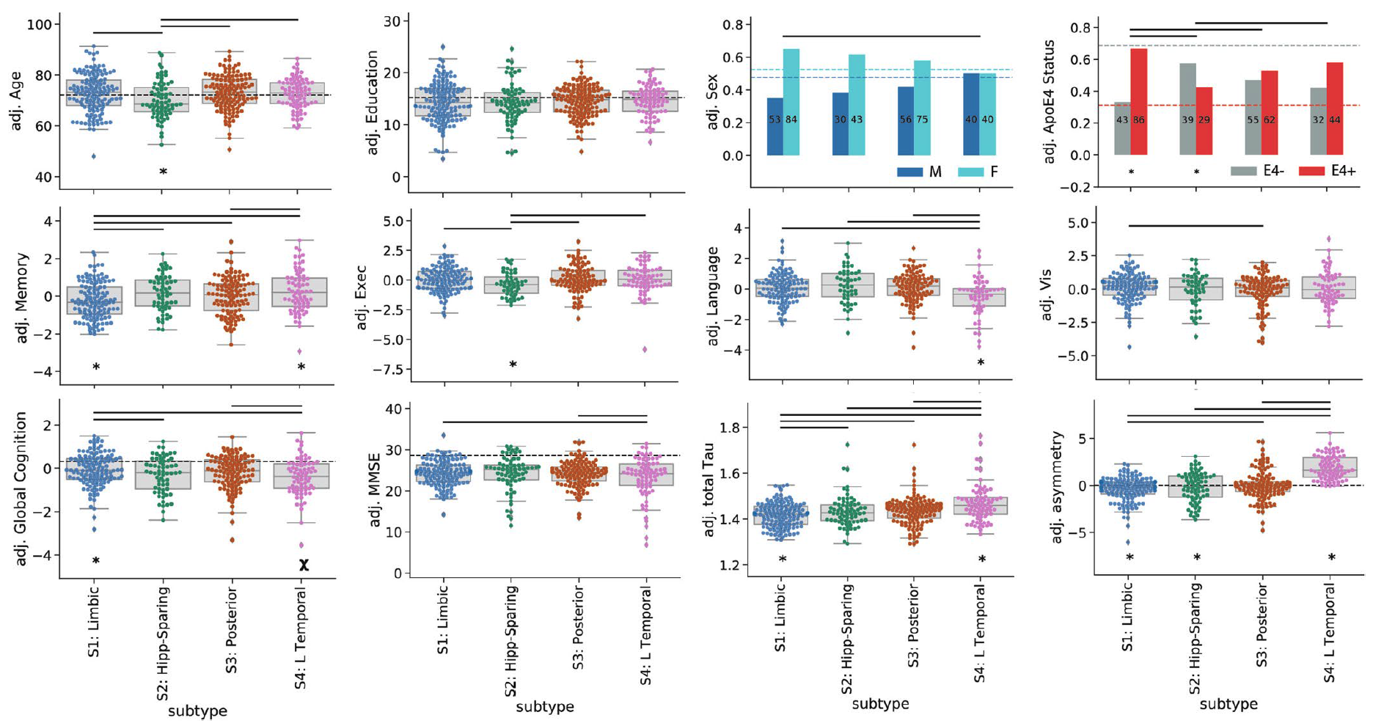
E-DADS: subtype associations
Vogel Nature Med. 2021
Young AAIC 2018: Association of SuStaIn subtypes with fixed factors.

Slide 13
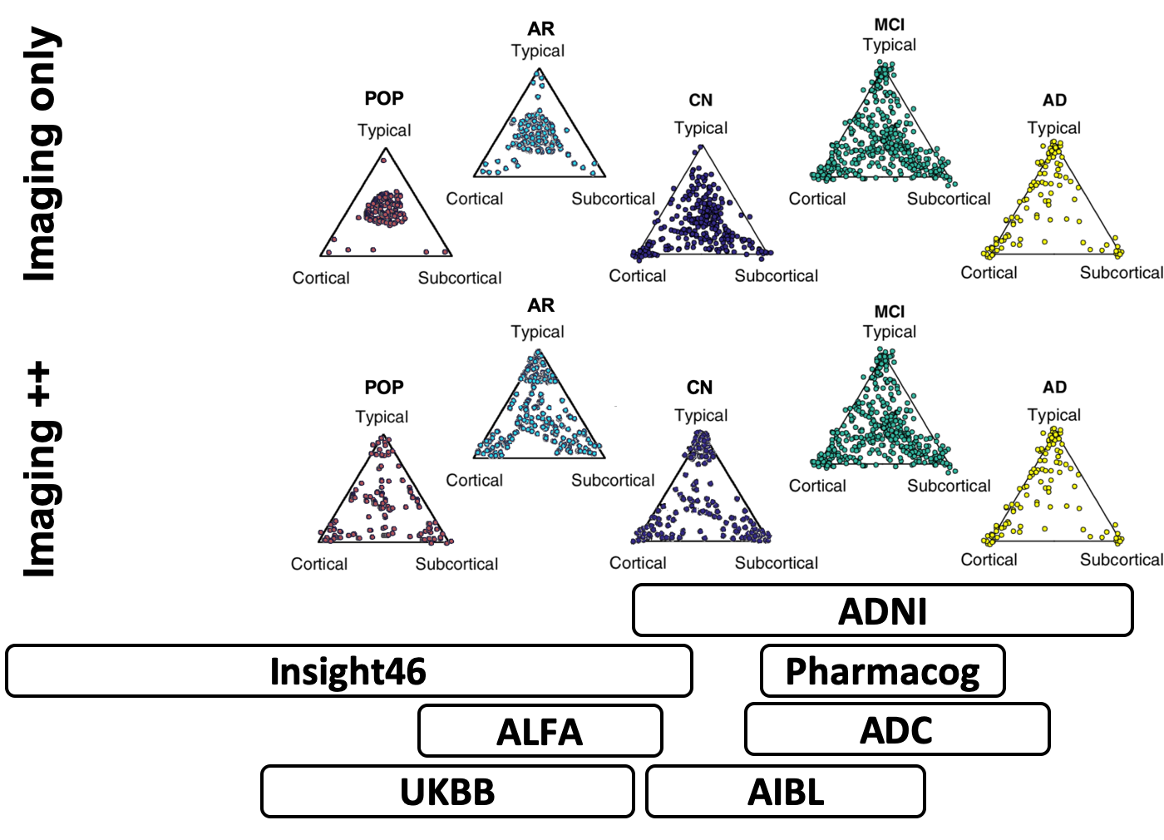
E-DADS: Early detection

Slide 14
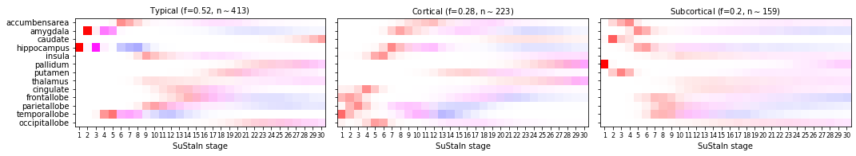
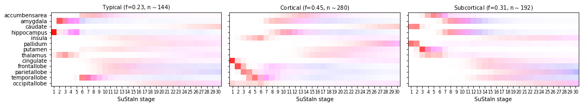
E-DADS: Preclinical SuStaIn
Chen, In revision, 2022
Three SuStaIn atrophy subtypes from ADNI
Three SuStaIn atrophy subtypes from UK Biobank

Slide 15
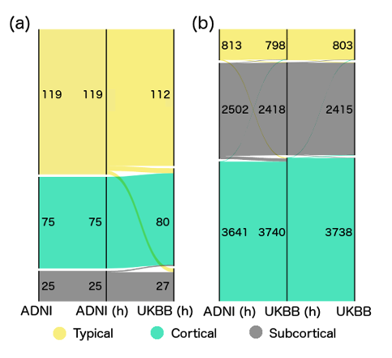
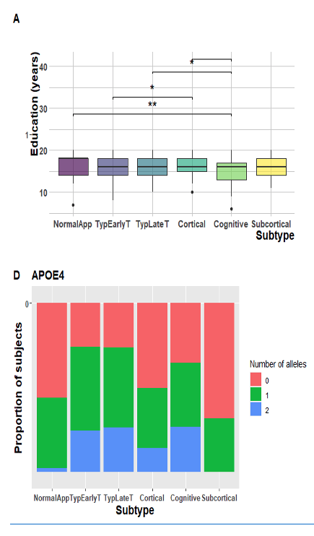
E-DADS: Preclinical SuStaIn
Chen, in revision, 2022
Estarellas-Garcia AAIC 2020

Slide 16
E-DADS vision

Slide 17


Acknowledgements
Thanks to the E-DADS consortium: https://e-dads.github.io.
Thanks to JPND!

