Slide 1
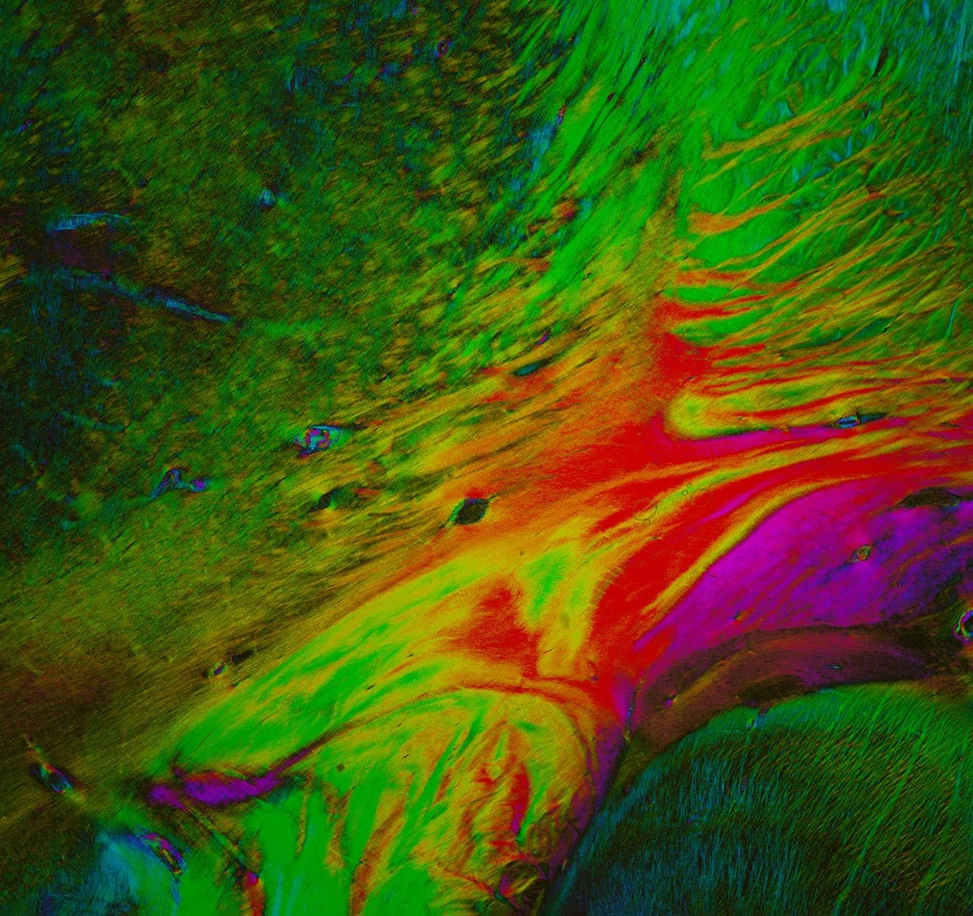

A key enabler to advance brain science
A view of the complexity of the human brain, revealing its fiber architecture of the internal capsule by means of 3D Polarized Light Imaging. Nerve fibers are colored according to their spatial courses, and connect far-distant regions

Slide 2

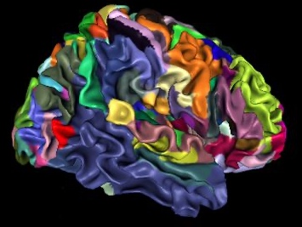


EBRAINS’ mission:
Enabling brain research advances and innovation
It builds on the work of the Human Brain Project and
takes it to the next level
Human Brain Project
HBP scientific work
HBP infrastructure: EBRAINS
2023

Slide 3
EBRAINS’ mission:
Enabling brain research advances and innovation
It builds on the work of the Human Brain Project and
takes it to the next level
EBRAINS offers the science community state-of-the art
Brain data and atlases
Simulation and modelling tools
Access to (super) computing resources
Human Brain Project
HBP scientific work
HBP infrastructure: EBRAINS
2023

Slide 4



EBRAINS Focus areas
Neuroscience
Brain Medicine
Brain-inspired technologies

Slide 5
What EBRAINS brings to the scientific community
Interoperable
Data and Knowledge
Atlases
Navigate, characterise and analyse information on the basis of anatomical location
Online solutions to facilitate sharing of and access to research data, computational models and software
Simulation
Solutions for brain researchers to conduct sustainable simulation studies and share their results
Brain-Inspired Technologies
Understand and leverage the computational capabilities of spiking neural networks
Medical Data Analytics
The Medical Data Analytics service provides two unique EBRAINS platforms, covering key areas in clinical neuroscience research
Co-developed by and with researchers

Slide 6
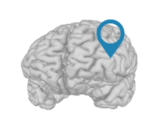


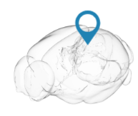










An integrated platform with cutting-edge workflows
Curation
Integrated modelling and simulation tools and workflows
Knowledge Graph
Data
and access to HPC resources

Slide 7



Ensuring the best service for the communities
Three key elements
Supporting researchers with data management and modelling tools and offering compute and storage solutions
Accompanying research projects in
addressing scientific
questions
Co-Developing specific customized solutions

Slide 8

Example of support: providing researchers with data sharing facilities

Slide 9
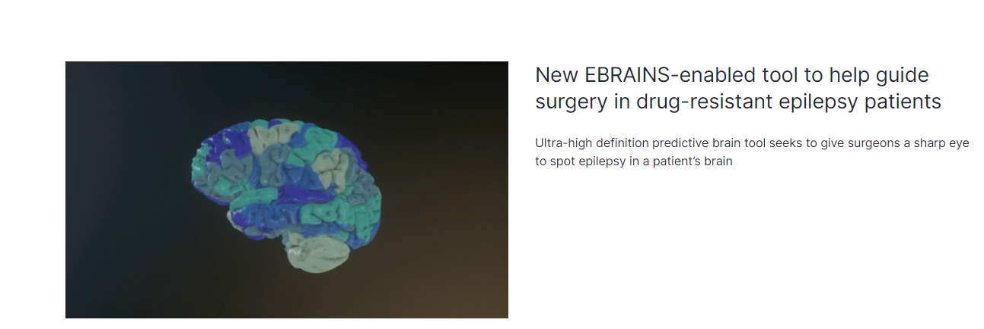
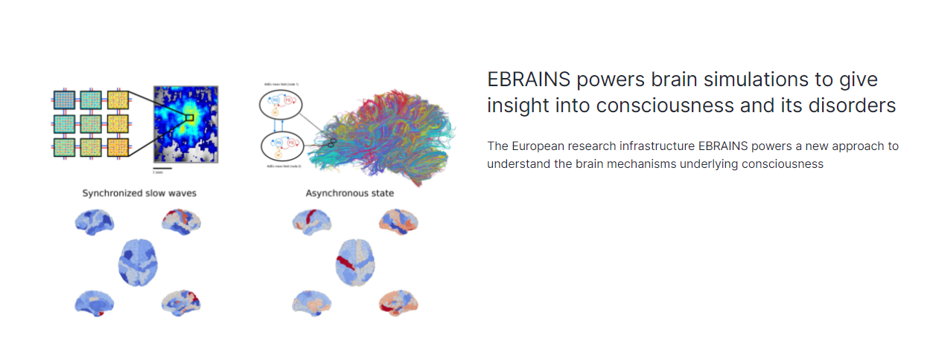
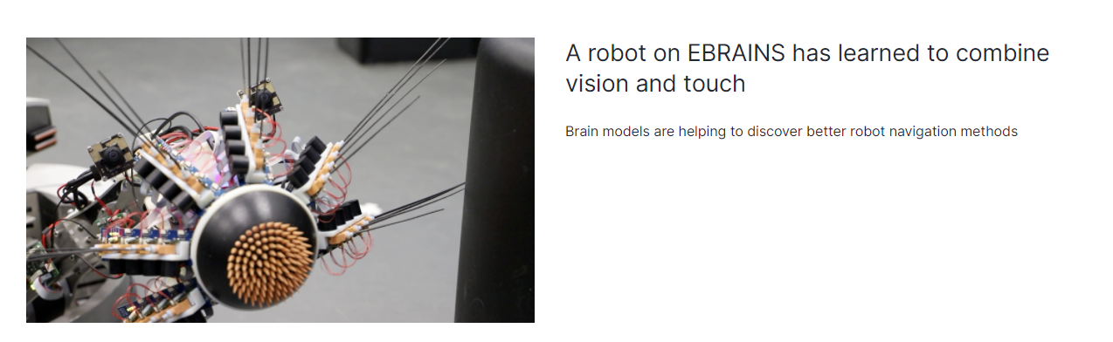
Examples of customized solutions

Slide 10



EBRAINS: a distributed research infrastructure
Distributed RI
EBRAINS services are provided by best-in-class academic centers across Europe and are coordinated by a central hub
Nodes
Central hub

Slide 11
Governance transition plan
Design
2021
2023
Operation
Preparation and Implementation
HBP
EBRAINS
Cohesion and continuity ensured:
Transfer of coordination staff to EBRAINS AISBL – 1 June 2021
EBRAINS Board of Directors Members are also Members of the HBP Stakeholder Board
HBP Director General is also EBRAINS CEO
HBP SIB Chair is also EBRAINS Chief Scientific Officer
Notes:
representa

Slide 12
Governance transition plan
Design
2021
2023
Operation
Preparation and Implementation
EBRAINS
General Assembly
National Nodes representatives
Board of Directors
Steering Committees
Management Board
Stakeholder Forum
Representation of non-neuroscientists
Ensured in Steering Committees
Ensured in Stakeholder Forum
Notes:
representa

Slide 13

EBRAINS-France node : associated partners
List of Institutions
CEA (full member)
Associated members
INRIA
Inserm
CNRS
Brain Institute (Paris)
Aix-Marseille Université
Univ. Grenoble-Alpes
Univ. de Lyon
Univ. de Bordeaux
Univ. Paris-Saclay
Sorbonne Univ.
Univ. Paris-Cité
….

Slide 14
Timeline
September
2023
Today
Application
Approval
Agreements
Comms
Membership
French case
National Nodes
Partnership or Consortium
Service definition
National Node Agreement
Service Agreements
Comms
EoI
Phase 1
Phase 2
Phase 3
EBRAINS RI Transition
Powered by:

Slide 15
EBRAINS RI Transition
Phase 1
Phase 2
Jan-Mar 2022
Intensification of dialogue between HBP service providers and EBRAINS Central Hub via National Node leads. Ends with an overview of services committed in the National Nodes.
Apr-Jun 2022
Dependency capture of HBP committed services and establishment of base infrastructure needs.
Work on Service Delivery Plans with National Nodes in preparation of Service Level Agreements with Service providers.
Jul-Dec 2022
Phase 3
Commitments of National Nodes: translation into National Node Agreements and Service Agreements
Map requirements and needs into platform and infrastructure service
Identify required component, tools and services to complete the solutions
Powered by:
27 April 2022 15

Slide 16
EBRAINS commitment
Open science
FAIR principles
RRI
Co-design
Impact
Collaboration

Slide 17


EBRAINS commitment
Open science
Excellence
FAIR principles
RRI
Co-design
Impact
on the ESFRI road map since 2021-07-05
Collaboration

Slide 18






Follow
www.ebrains.eu
Discover EBRAINS
linkedin.com/company/ebrains-eu
twitter.com/EBRAINS_eu
facebook.com/Ebrains_eu-112559066821827
instagram.com/ebrains_eu
Satellite meeting of the FENS Forum :
EBRAINS, an EU infrastructure empowering brain research
Paris, 8 July 2022

