Slide 1
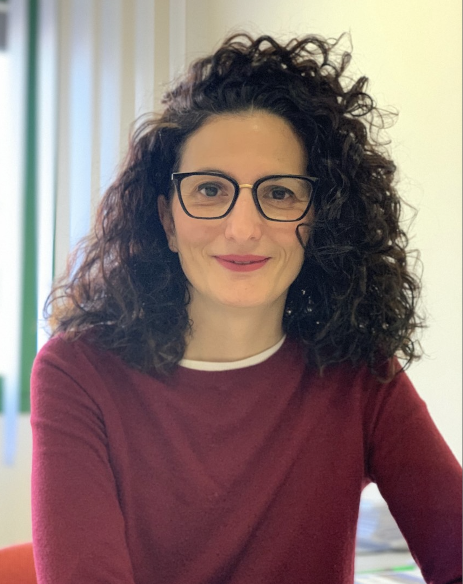
Thomas Sandström
Katja Kanninen
Tarja Malm
Arfan Ikram
Jan Topinka
Anna Oudin
Rosalba Giugno
Andras Dinnyes
This is an EU Joint Programme - Neurodegenerative Disease Research (JPND) project. This research was supported by the ADAIR project (grant #JPND2019-466-037).

Slide 2
Major societal challenges
The WHO reports that:
9 out of 10 people in cities breathe polluted air
4.2 million deaths occurs as a result of exposure to air pollution annually
Environmental factors contribute to 40 % of dementias and air pollution has now been added to the list of the 12 risk factors
Air pollution exposure exacerbates brain pathology associated with Alzheimer’s disease (AD)
The fundamental cellular and molecular processes of the air pollutant effects on the brain, and their link to dementia, remain elusive.
Understanding how the environment can affect AD progression is important to inform policy, and to develop new mitigation strategies.
This is an EU Joint Programme - Neurodegenerative Disease Research (JPND) project. This research was supported by the ADAIR project (grant #JPND2019-466-037).

Slide 3
Working hypothesis of
The pollutant exposure environment of an individual alters cellular mechanisms and functions, resulting in the expression of measurable biomarkers.
By identifying biomarkers, the individuals with increased AD risk can be stratified prior to the disease onset and preventive measures can be targeted to the specific at-risk populations in order to be most effective.
This is an EU Joint Programme - Neurodegenerative Disease Research (JPND) project. This research was supported by the ADAIR project (grant #JPND2019-466-037).

Slide 4
Aims of
To unravel the link between air pollution and AD by:
Omics-based identification of biomarkers of air pollution exposure in
humans subjected to controlled, acute pollutant exposures
longitudinal epidemiological studies
Assessment of air pollutant exposure induced mechanisms and cellular dysfunction in highly translational human cell culture models
Correlation of biomarkers to AD risk to identify subgroups of individuals with an increased susceptibility for air pollution effects and individuals at high risk of developing AD
Dissemination of the information on the impact of air pollutant exposure on brain health to the general public, patient organizations, caregivers, policy decision-makers and other stakeholder groups
This is an EU Joint Programme - Neurodegenerative Disease Research (JPND) project. This research was supported by the ADAIR project (grant #JPND2019-466-037).

Slide 5
Expected Outcomes of
Crucial mechanistic insight into the health effects of air pollutants in humans
Biomarkers for air pollution exposure
Stratification of individuals to subgroups for risk estimation and future AD prevention
Increased understanding on how the exposure environment is linked to AD, thus paving the way for future therapeutic approaches and preventive interventions to reduce the health care and socio-economic burden
This is an EU Joint Programme - Neurodegenerative Disease Research (JPND) project. This research was supported by the ADAIR project (grant #JPND2019-466-037).

Slide 6
Successes, Challenges and Lessons of
Successes:
Collaboration with experts in different disciplines
Challenges:
Human sample collections and research visits have been delayed due to COVID-19
Enthusiastic consortium working together towards a common goal
Lessons learned:
Discussion and more discussion is needed b/w partners in multidisciplinary projects
Online meetings have made it easier to communicate effectively
This is an EU Joint Programme - Neurodegenerative Disease Research (JPND) project. This research was supported by the ADAIR project (grant #JPND2019-466-037).

Slide 7
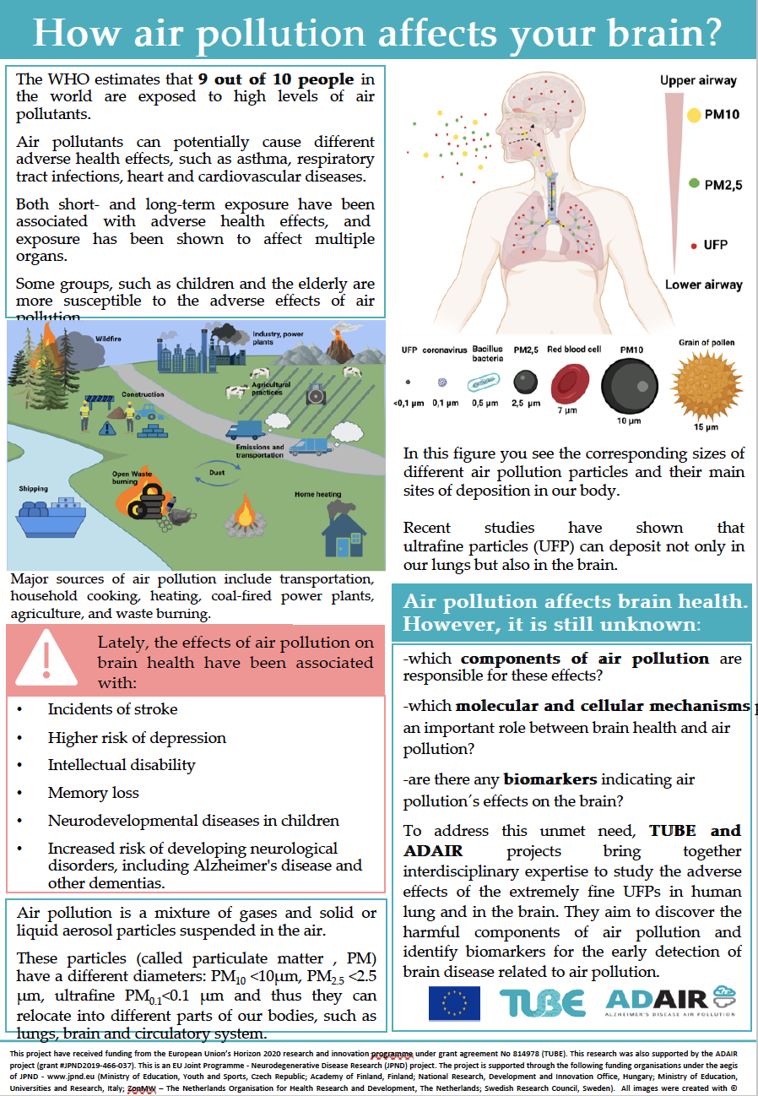
Dissemination activities of
Stakeholder analysis
Factsheet on air pollution effects on brain health
Article published in AE ‘Dementia in Europe’ magazine
Participation in 10 conferences
Workshop at the European parliament to share results with MEPs and EC
Stakeholder engagement in process
2 published scientific articles
Continued presentations of ADAIR at conferences
Kuopio Alzheimer symposium in August 2022: ‘PPI in brain disorders’
8 scientific papers in preparation
Website and social media
This is an EU Joint Programme - Neurodegenerative Disease Research (JPND) project. This research was supported by the ADAIR project (grant #JPND2019-466-037).

Slide 8
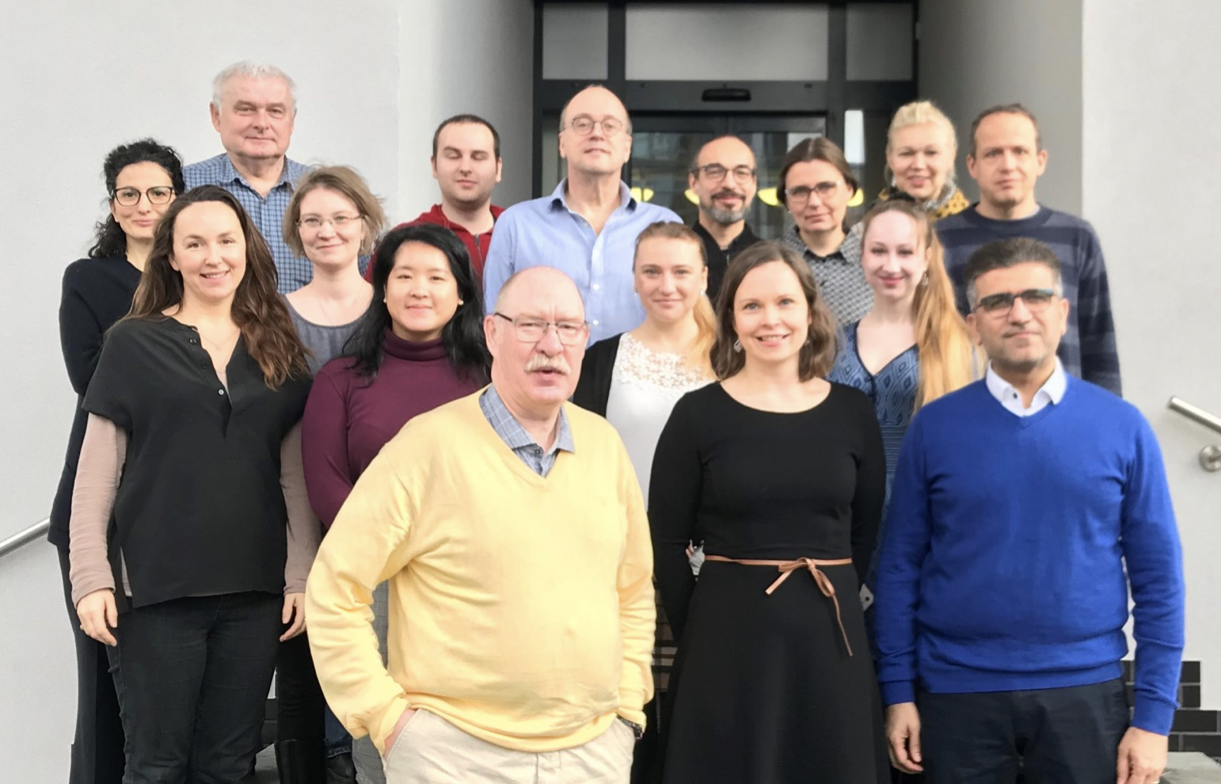
More information at:
ADAIR poster presentation of PhD student Liudmila Saveleva (UEF)
ADAIR website: https://adair-jpnd.eu
Welcome to Kuopio, Finland, for the 9th international Alzheimer Symposium, August 23-25.
https://blogs2.uef.fi/kuopioadsymposium/welcome
This is an EU Joint Programme - Neurodegenerative Disease Research (JPND) project. This research was supported by the ADAIR project (grant #JPND2019-466-037).

