Slide 1
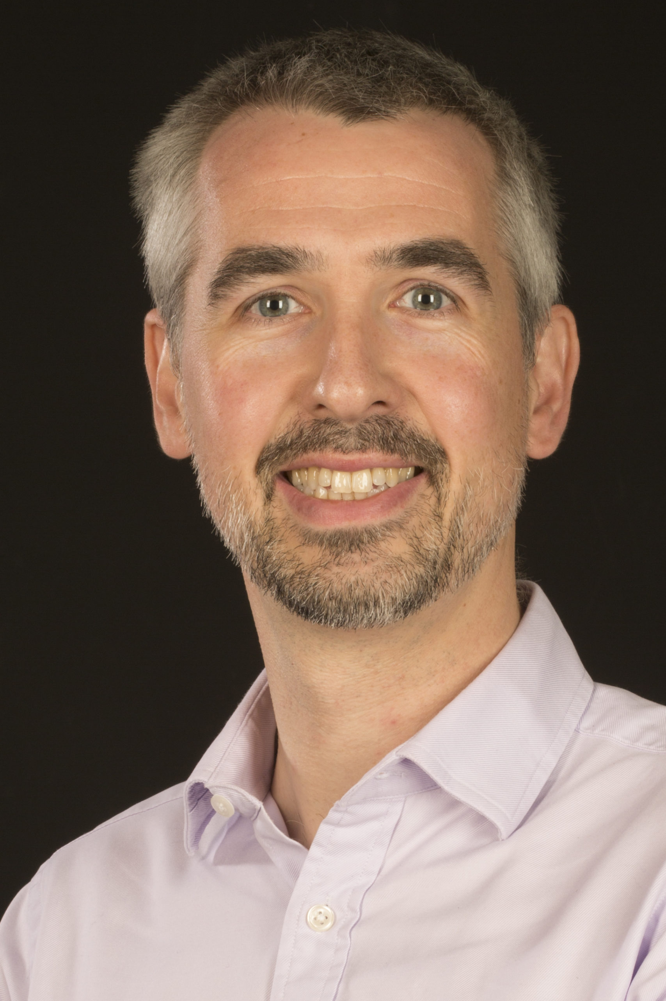
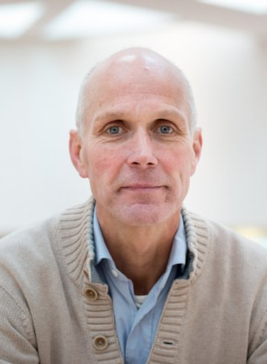
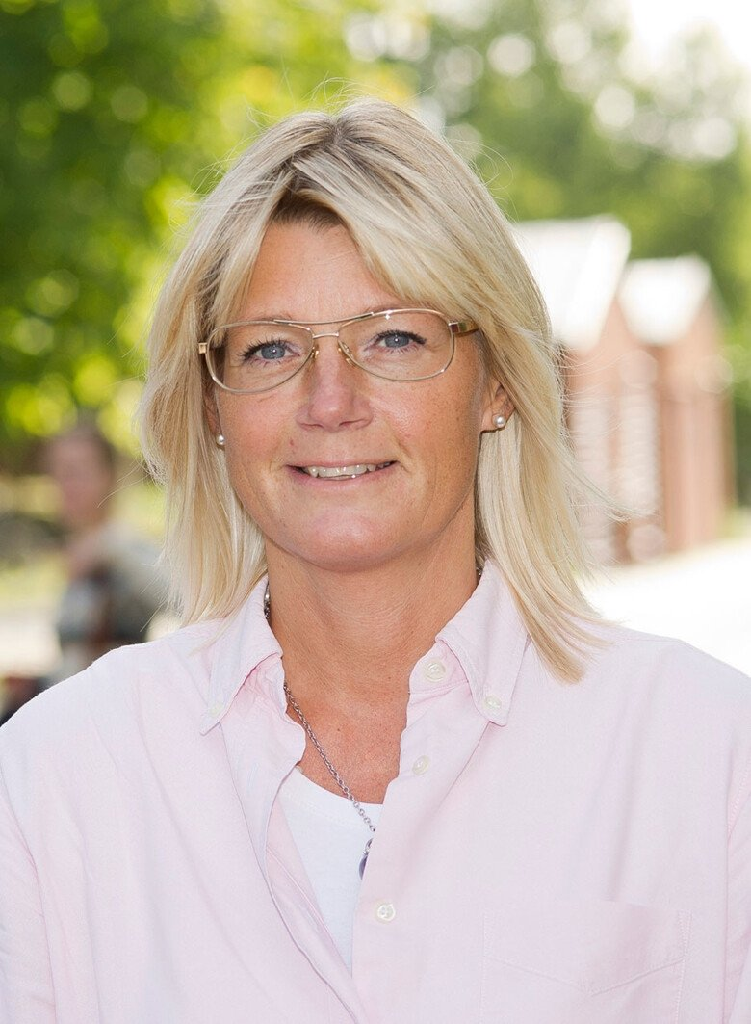
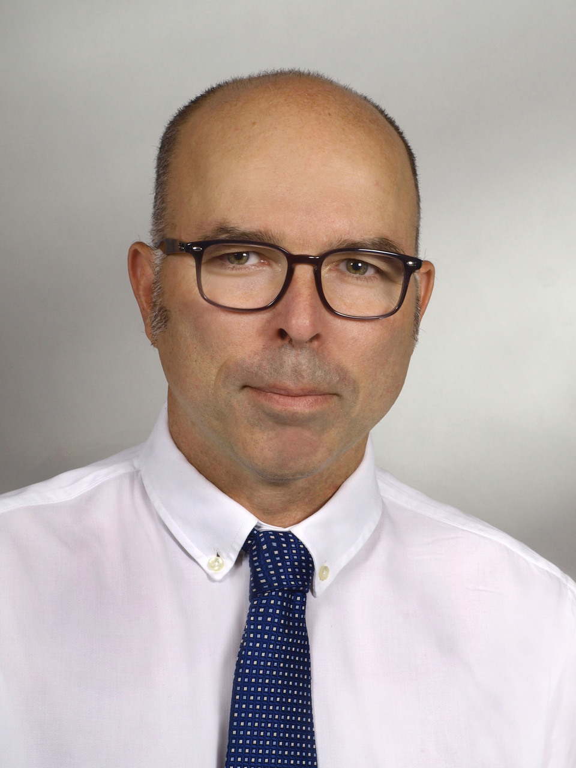
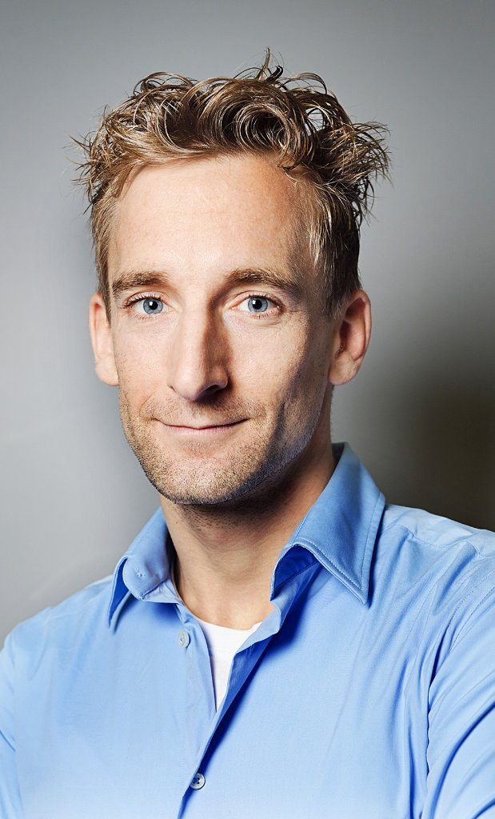
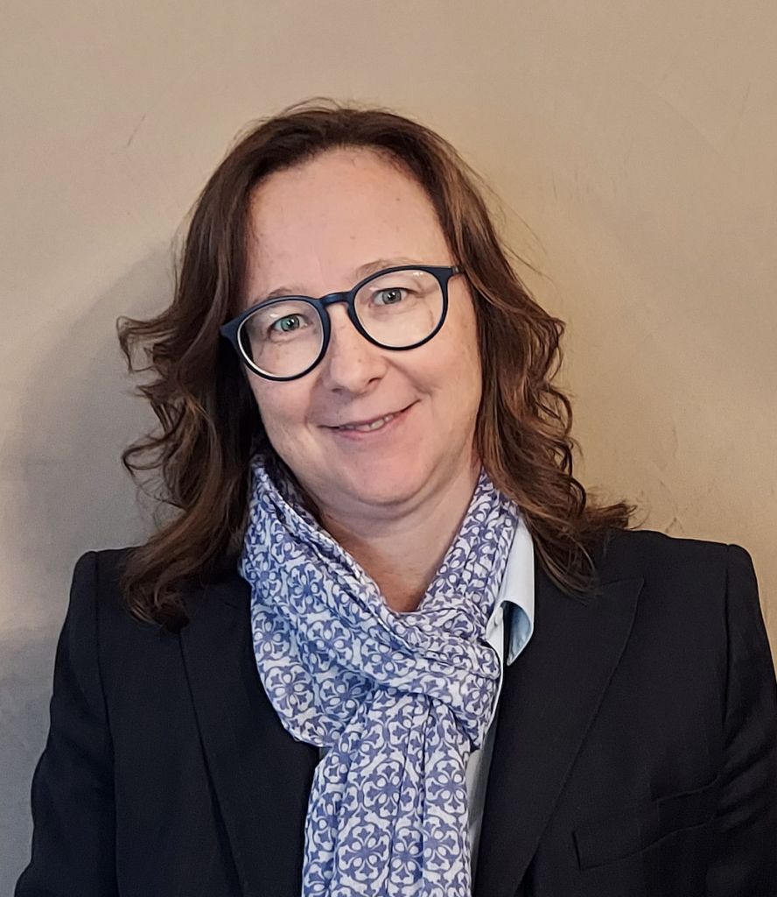
GENFI-Prox: Defining measures of proximity to symptom onset in the GENetic Frontotemporal dementia Initiative
Dr Lucy Russell, University College London on behalf of the GENFI-Prox investigators
Prof. Rohrer
University College London
Prof. van Swieten Erasmus Medical Centre
Prof. Graff
Karolinska Institute
Prof. Otto
University of Ulm
Prof. Synofzik
University of Tubingen
Prof. Borroni
University of Brescia

Slide 2

Rising to the challenge
The problem:
Complex and unclear pathophysiology
No current treatments
SQSTM1
Frontotemporal Dementia (FTD)
Familial FTD
GRN
behaviour
language
movement
neuropsychiatric
C9orf72
MAPT

Slide 3
The aims and hypothesis
AIM: Characterize prodromal genetic FTD, establishing
- cognitive
- imaging
- fluid biomarker measures
HYPOTHESIS: Specific genetic FTD biomarkers will have translational value by:
Stratification of presymptomatic carriers stages
Measurement disease progression in proximal period
Signalling individualized optimal times for initiating disease-modifying therapy
Providing candidate outcome measures for presymptomatic clinical trials

Slide 4

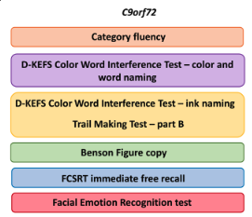
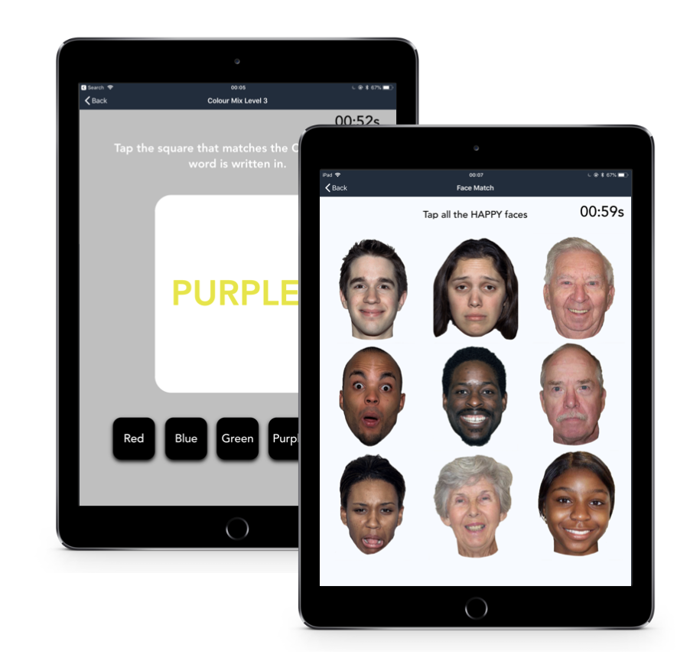
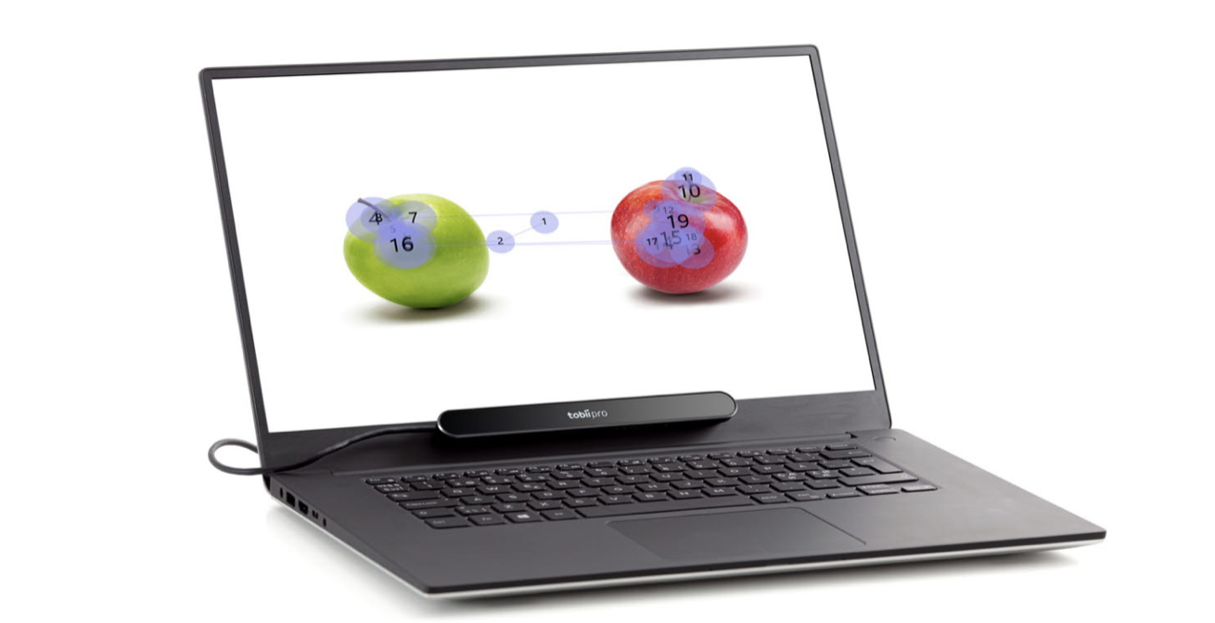
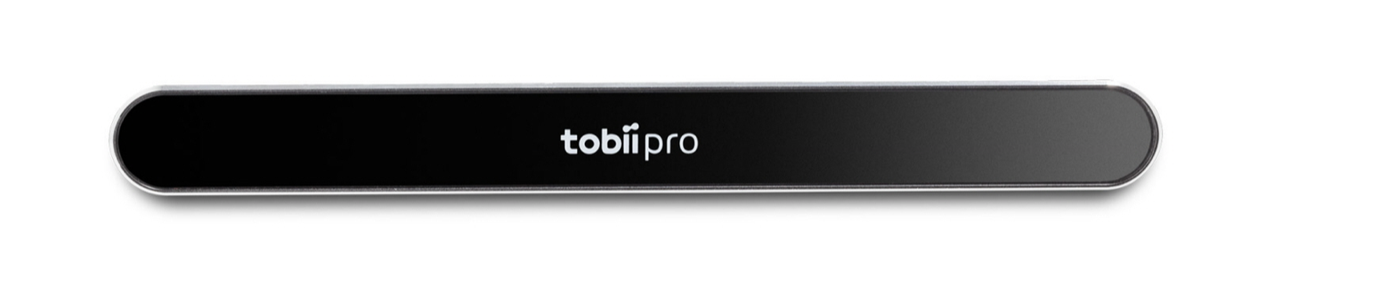
WP 1: Clinical and Neuropsychology Tests
Ignite
Mobile eye tracking
Composite
Patient impact: will increase the ability to perform remote testing; decrease amount of cognitive testing

Slide 5

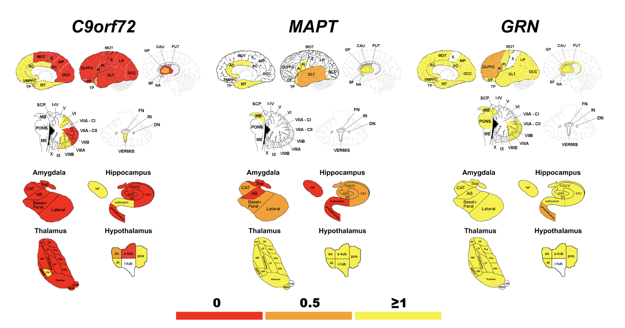
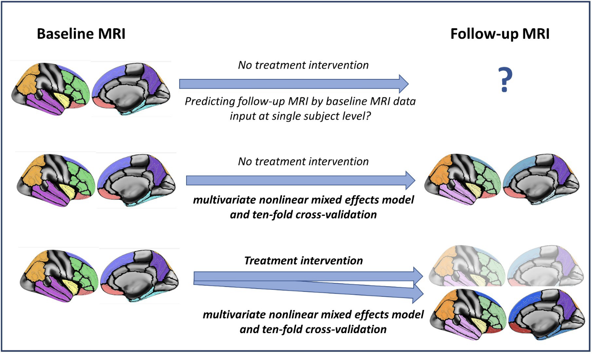
WP 2: MR Imaging
Cortical and subcortical volumes
Single subject automated toolbox
Ongoing work
Structural connectivity
  DTI
  NODDI
Functional connectivity
  Resting state fMRI
Patient impact: will help predict likely time to symptom onset for better future planning

Slide 6

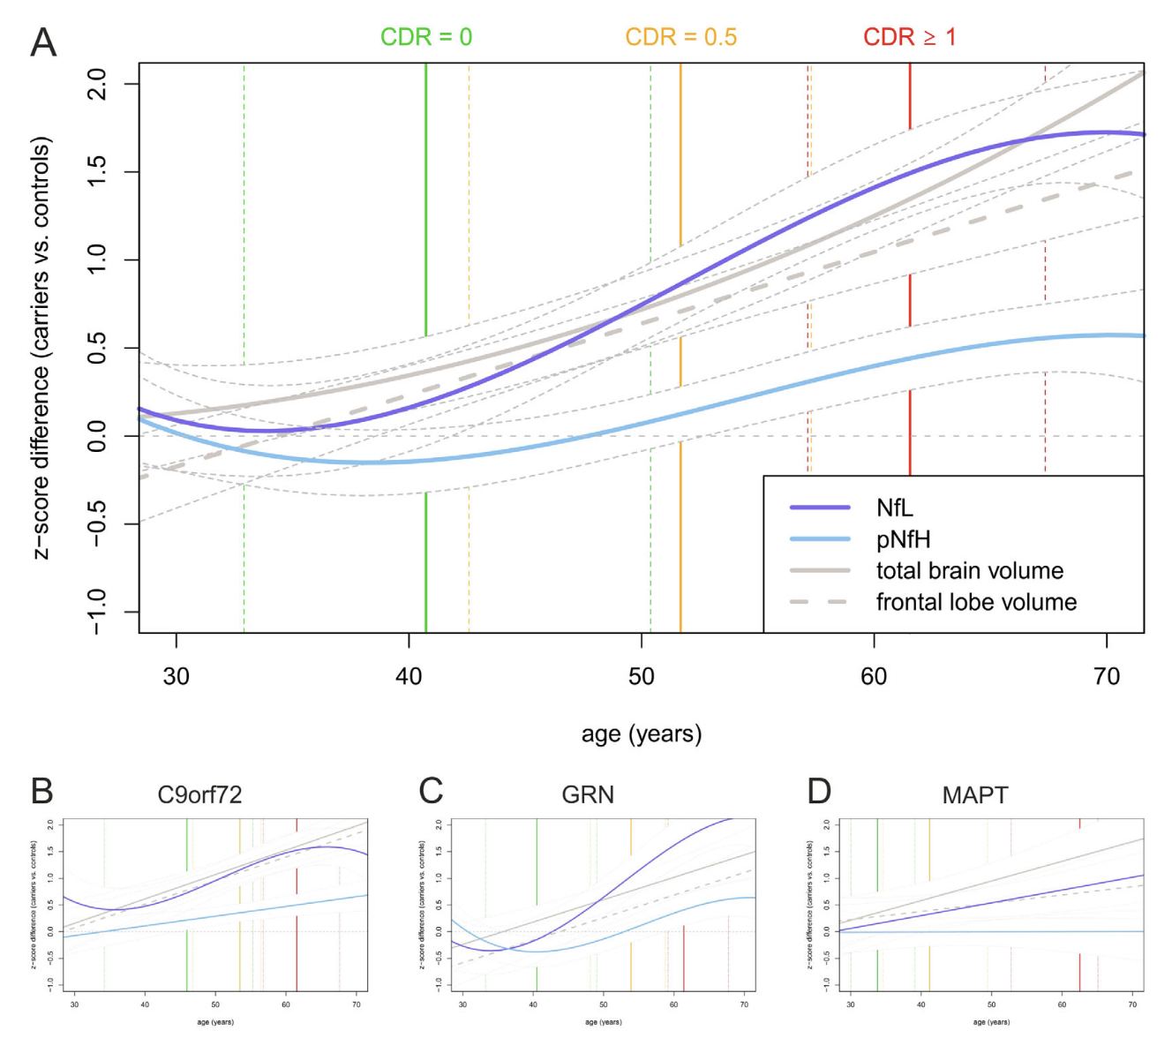
WP 3 & 4: Blood and CSF
Neurodegeneration
Neuroinflammation
Ongoing work
Targeted protein biomarker panels
Multi-omic profiling
  DNA
  RNA – transciptomics
  Combining -omics
Neurofilament light and heavy chain
Complement proteins
Patient impact: will increase ability to enter into clinical trials for potential therapies

Slide 7

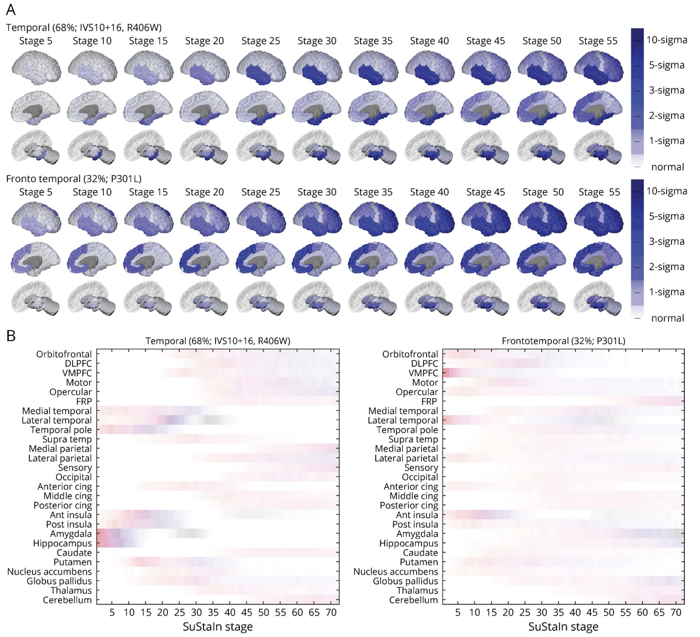
WP 5: Predictive modelling
Subtype and Stage Inference (SuStaIn) in MAPT
Patient impact: will improve understanding of where patients are in their disease trajectory

Slide 8



WP 6: Ethics
Clinical Trials Questionnaire
Qualitative Interviews
Patient impact: will help to improve the quality of clinical trial design from a patient-centred approach

Slide 9
Reflection
Successes:
Major review article published
Cognitive composite developed
Individualized imaging methods
Novel biomarkers
Published 8 papers
Challenges:
Covid 19:
Recruitment
Clinician availability
Delayed restart
Access to laboratories
Shipment issues (Brexit)
Collaborations:
Visiting researchers to UCL from Erasmus (cut short due to the pandemic)
Regular meetings
Participant engagement board

Slide 10

Acknowledgements
Cambridge: James Rowe
Brescia UNIBS: Barbara Borroni
Milano UNIMI: Daniela Galimberti
Milano INCB: Pietro Tiraboschi
Toronto: Mario Masellis
London Ontario: Liz Finger
Rotterdam: John van Swieten
Firenze: Sandro Sorbi
Stockholm: Caroline Graff
Quebec: Robert Laforce
Lisboa: Alexandre Mendonca
Leipzig: Matthias Schroeter
Oulu: Anne Remes
Manchester: Alex Gerhard
Oxford: Chris Butler
Barcelona: Raquel Sanchez-Valle
San Sebastian: Fermin Moreno
Paris: Isabelle Le Ber
Lille: Florence Pasquier
Lund: Maria Landqvist Waldo
Ulm: Markus Otto
Tubingen: Matthis Synofzik
Munchen: Johannes Levin
Leuven: Rik Vandenberghe
Montreal: Simon Ducharme
Coimbra: Isabel Santana
  Henrik Zetterberg
  Amanda Heslegrave
  Adrian Isaacs
  Pietro Fratta
  Jason Warren
  Nick Fox
  Jonathan Schott
  Cath Mummery
  Selina Wray
  Tammaryn Lashley
  Dave Cash
  Dave Thomas
  Martina Bocchetta
  Aitana Sogorb Esteve
  Mica Clarke
  Carolin Heller
  Caroline Greaves
  Rhian Convery
  Rachelle Shafei
  Will Scotton
  Kiran Samra
  Arabella Bouzigues
  Emily Todd
  Imogen Swift
  Hanya Benotmane
JPND Collaborators:
Professor Jonathan Rohrer
Professor John van Swieten
Professor Caroline Graff
Professor Markus Otto
Professor Matthis Synofzik
Professor Barbara Borroni
External collaborators:
Dr Adrian Danek
Dr Johannes Levin
Dr Mario Masellis
Dr Robert Jr Laforce
Dr Elizabeth Finger
Dr Simon Ducharme
Prof Peter Nilsson
To all the participants, carers and family members who take part in the familial FTD research.
OUR FUNDERS:
Joint Programming Neurodegenerative Disease (JPND)
Medical Research Council (MRC)
The Bluefield Project to Cure FTD
Alzheimer’s Research UK (ARUK)
Alzheimer’s Society

