Slide 1
Gums & Brains - Alzheimer‘s disease as a co-morbidity of chronic periodontitis with Porphyromonas gingivalis as a causative link between both diseases
Holger Cynis for the Gums & Brains Consortium

Slide 2
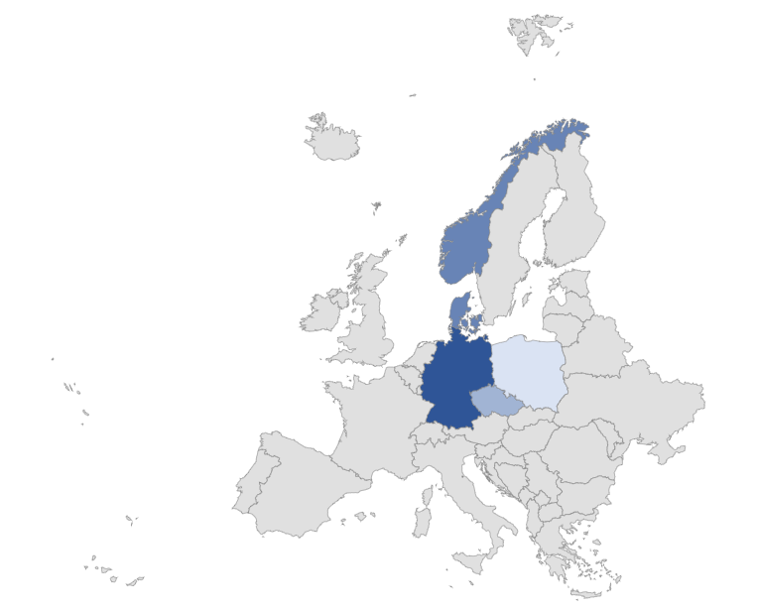
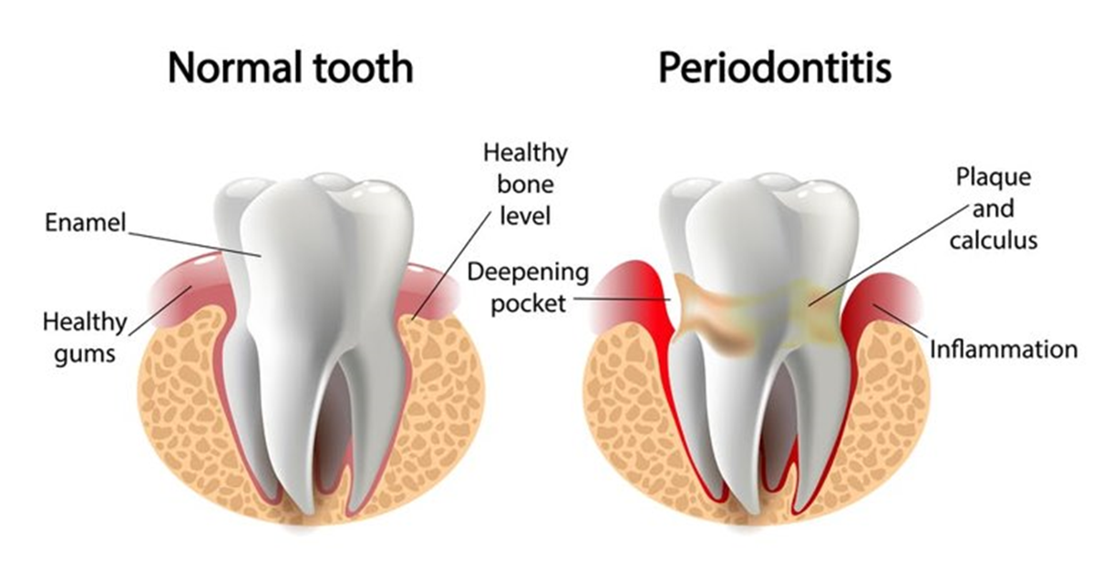
Gums & Brains Consortium
Poland: Jan Potempa (Coordinator)
Jagellonian University, Krakow
Norway: Piotr Mydel
University of Bergen
Denmark: Jan Enghild
Aarhus University
Czech Republic: Jan Konvalinka
IOCB, Prague
Germany: Holger Cynis
Fraunhofer IZI-MWT, Halle

Slide 3
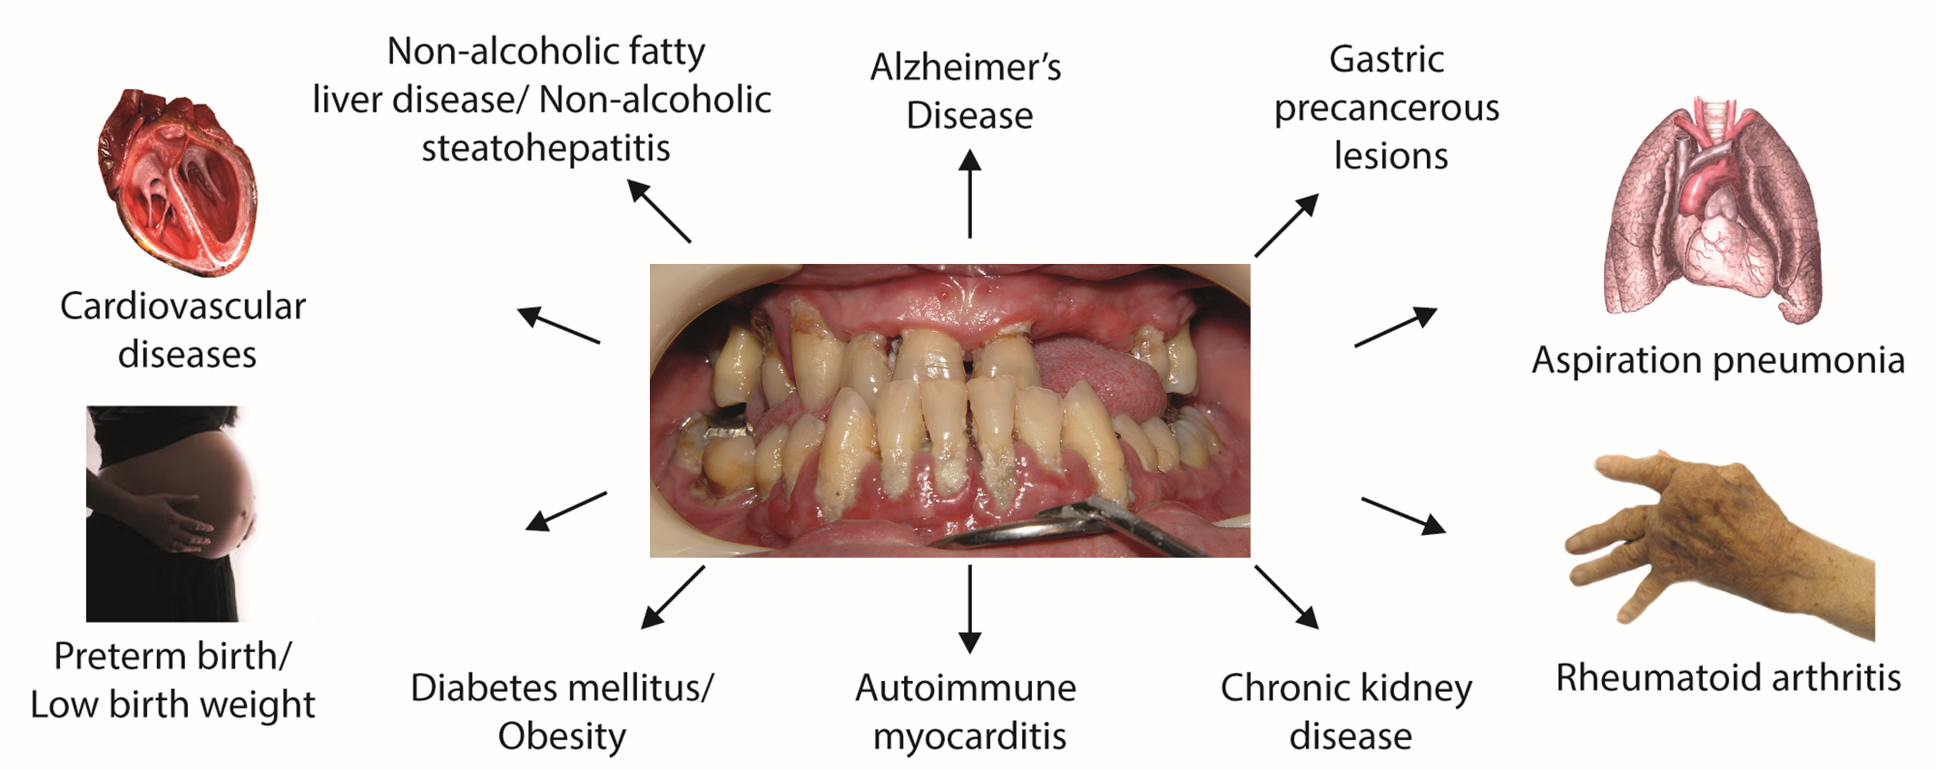
Periodontal disease as comorbidity in human chronic diseases

Slide 4
Relationship between periodontal disease and Alzheimer´s Disease
Dissemination of P. gingivalis and/or virulence factors into the brain via blood brain barrier
Oligomerization of Aβ,
formation of NFTs
Systemic inflammation
IL-1, IL-6, CRP, TNF α
Microglia activation
Sustained neuroinflammation, formation of Aβ plaques, brain atrophy

Slide 5
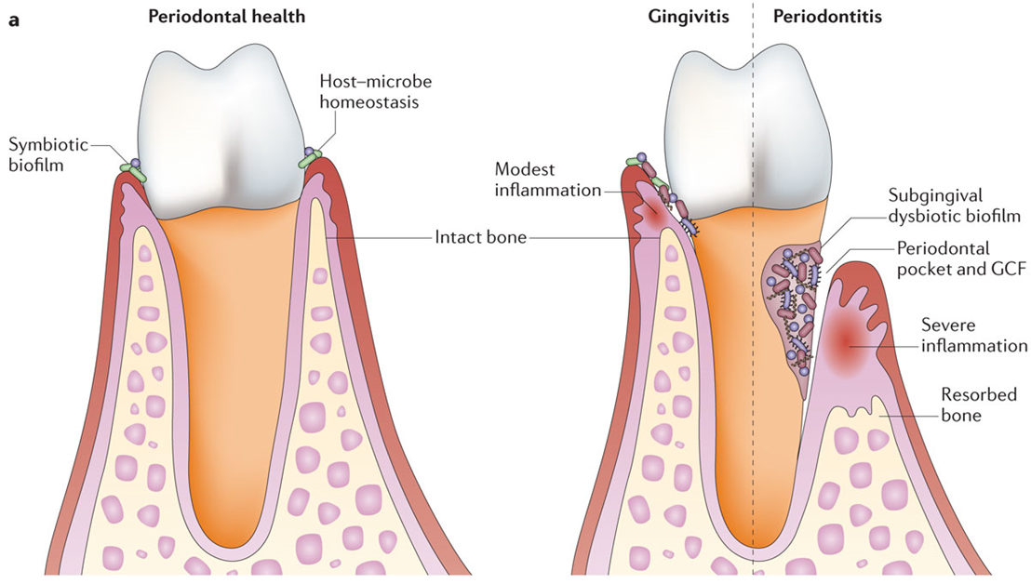
Aims of the research project
Aims:
Investigate link between chronic periodontitis and Alzheimer’s disease
Focus on Porphyromonas gingivalis as putative link between both diseases
Studies on virulence factors and bacteria in animal models and patient material

Slide 6
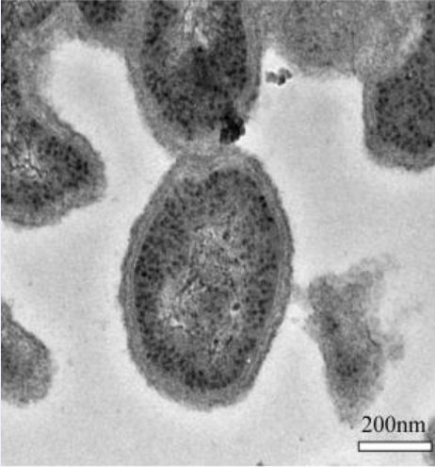
Porphyromonas gingivalis
Gram negative oral anaerobe
Component of the oral microbiome →“opportunistic pathogen“
Keystone pathogen in periodontitis
Virulence factors: gingipains, LPS and fimbriae → evasion of the host defense mechanisms
➔ 38 years after initial purification of beta-amyloid from brain by Glenner and Wong, no approved treatment for AD based on key hallmarks Abeta and tau in Europe (Aducanumab approved in US)
➔ P. gingivalis might represent an easier to tackle contributing factor than common molecular targets in CNS
Fujise K, Kikuchi Y, Kokubu E, Okamoto-Shibayama K, Ishihara K. Effect of extracytoplasmic function sigma factors on autoaggregation, hemagglutination, and cell surface properties of Porphyromonas gingivalis. PLoS One. 2017;12(9):e0185027. Published 2017 Sep 20. doi:10.1371/journal.pone.0185027

Slide 7
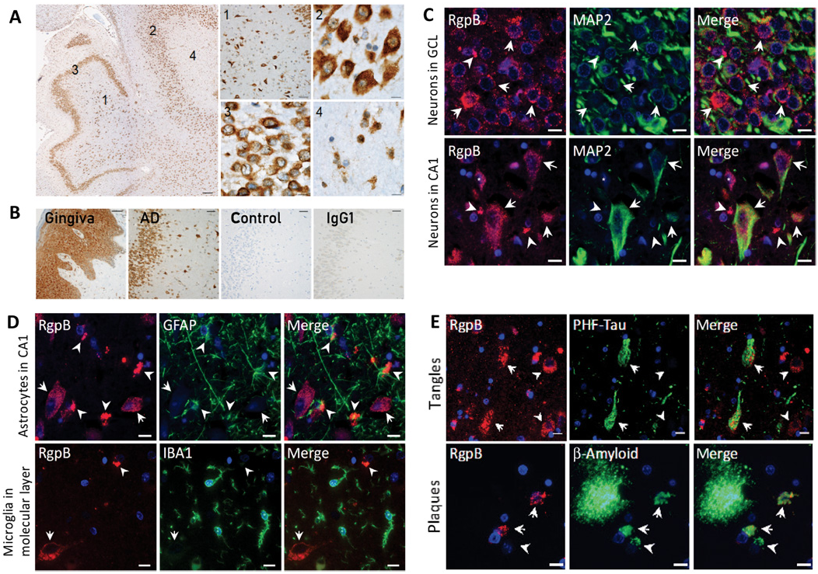
P. gingivalis virulence factors in human AD
Lynch et al. (2019) Science Advances 5 eaau3333

Slide 8
Selected fields of study
Murine models of AD infected with P. gingivalis
Infection of zebrafish larvae
Detection of P. gingivalis virulence factors

Slide 9
Thank you
for your
attention!
Special thanks to:
Jan Potempa
Piotr Mydel
Jan Enghild
Jan Konvalinka

