Slide 1

EURO-FINGERS
Multimodal precision prevention toolbox for dementia in Alzheimer’s disease
Coordinator: Prof. Miia Kivipelto, MD, PhD
Director of Research and Development
Karolinska Institutet, Division of Clinical Geriatrics
Karolinska University Hospital, Theme Inflammation and Aging, Stockholm, Sweden

Slide 2
Who we are - The Consortium
7 countries
11 partners
20+ years of experience
REGULAR PARTNERS (country, institution)
Sweden: Karolinska Institutet (KI) [Coordinator]
Finland: Finnish Institute for Health and Welfare (THL)
Germany: Saarland University (USAAR)
The Netherlands: The Alzheimer Center Amsterdam & VU University Medical Center (VUMC)
Spain: Barcelonabeta Brain Research Center (BBRC) & Instituto Mar de Investigaciones Médicas (IMIM)
Luxembourg: Alzheimer Europe
Hungary: National Institute of Clinical Neurosciences (NICN) & Semmelweis University
EXTERNAL COLLABORATORS (country, organization)
Finland: Combinostics Ltd
Luxembourg: University of Luxembourg
Spain: Fundación CITA-Alzheimer Fundazioa
2020-2022
https://eufingers.com/
Notes:
EU-FINGERS is a multinational interdisciplinary consortium that has been growing since its launch in 2020 and is part of the global World-Wide FINGERS® network of multidomain trials for dementia risk reduction and prevention.
EU-FINGERS includes research teams from several European countries, the advocacy group Alzheimer Europe and technical partners. The consortium gathers world-renowned experts in the field of Alzheimer´s disease and dementia, who are leading pioneering multidomain prevention trials.
Hungary – partner. Luxembourg and Spain added later

Slide 3
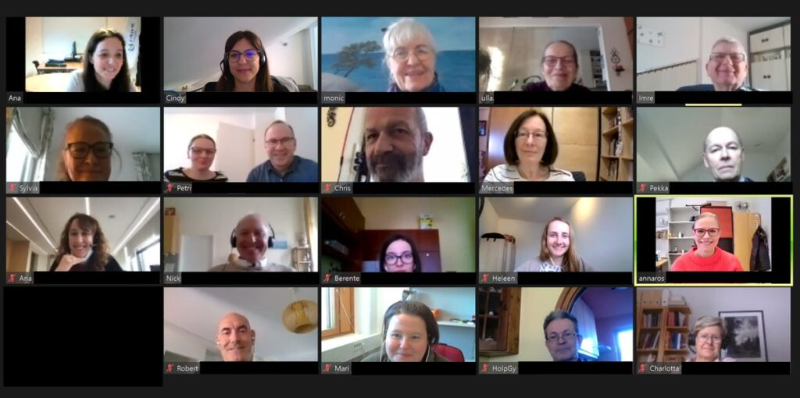








The Advisory Board
Public & Patient Involvement: 15 people from seven countries
PPI input
Regular meetings through virtual platform (so far) plus exchange of written info:
Feedback on key aspects of the project
Educational events
Social events
https://eufingers.com/
Notes:
EU-FINGERS Advisory Board is an active component of the consortium. It is composed by people at-risk of dementia (e.g., AD biomarkers positive) with or without cognitive problems (SCI, MCI) and subjects with mild dementia. Multilingual, we interact in English but constant support in each country from the local EU-FINGERS team to ensure translation when needed. AE coordinates the EU-FINGERS AB and did an amazing work in launching virtual PPI activities during the pandemic
PPI input helped shaping virtual meetings (format, content)

Slide 4
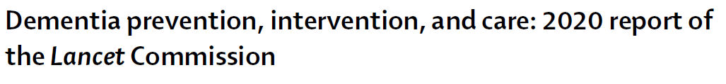
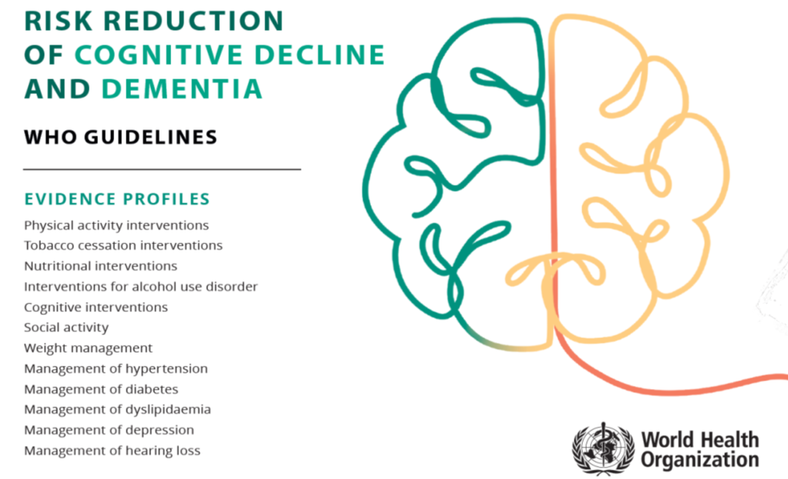
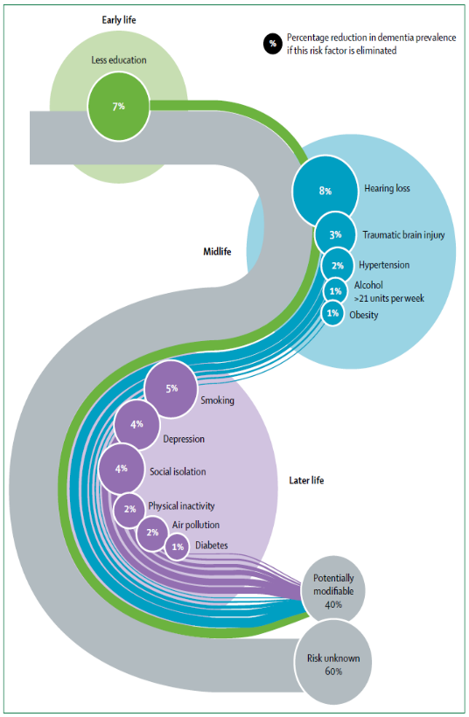

Prevention of Alzheimer´s disease and dementia
Modifiable risk factors for dementia
Prevention
Potential ≈ 40%
WHO 2019
Multidomain & tailored interventions
Livingston et al, Lancet Commission 2020

Slide 5








Prevention of Alzheimer´s disease and dementia
The FINGER model
MULTIDOMAIN INTERVENTION
Nutrition
Exercise
Cognitive training
Vascular risk monitoring
Cognitive benefits
20% lower risk cardiovascular events
30% lower risk for functional decline
60% lower risk of chronic diseases
Better health related quality of life
Health-economical benefits
N = 1260
Age 60-77 years
2 years
REGULAR HEALTH ADVICE
Extended 5- & 7-year follow-up completed
11-years follow-up in 2022
Lancet 2015; JAMA Neurology 2018, Eur Ger Med 2017, JAMDA 2017, JAGS 2019; Alzheimer’s Dementia 2021; European J Cardiology 2022

Slide 6
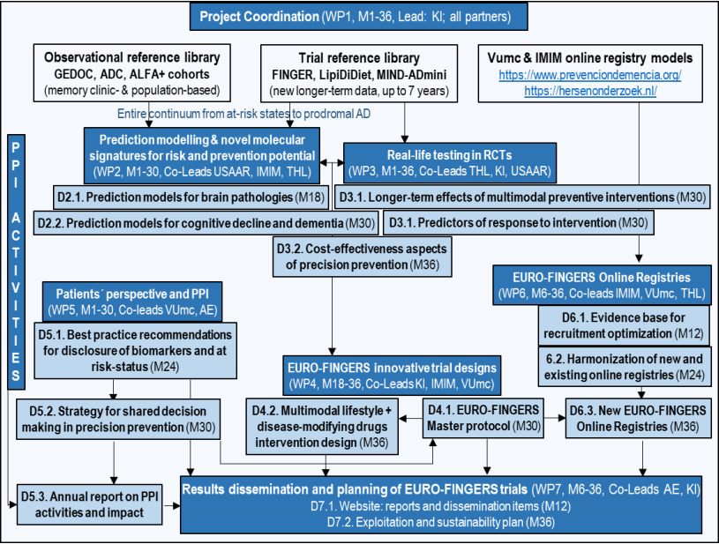
The Mission
Our mission is
to develop, test and validate methods and tools supporting Precision Prevention of Alzheimer´s disease and dementia through multidomain interventions, including both non-pharmacological and pharmacological interventions.
WP: Work Package
D: Deliverable
https://eufingers.com/
Notes:
Our mission is….
Graphic summary of project work packages (in dark blue, we have 7) and deliverables (in light blue)

Slide 7
Successes
PPI input
Consortium expansion in the post-grant phase
JPND widening approach: Hungary: National Institute of Clinical Neurosciences & Semmelweis University
Consortium pro-active work: Spain CITA Alzheimer Foundation; Luxembourg University (external collaborators, own fundings)
EU-FINGERS Cohorts: 5 RCTs (4 multidomain, N=2000+ subjects), plus 7 Observational Cohorts (N=16000+ subjects)
Scientific Activity: models for prediction of brain pathology and cognitive decline
Results from multiple cohorts (cross-validations planned: e.g., blood-based markers, EEG, Disease State Index) on predictors of neuropathology and cognitive changes
Scientific Activity: models for prediction of response to preventive interventions
FINGER and LipiDiet RCTs long-term follow-ups: Predictors of response include Adherence, Level of change in risk factors profile, Genetic make-up (AD PRS), Rate of brain structural change.
Efficacy of interventions: cognition, long-term maintenance of healthy lifestyle, improvement of non-cognitive outcomes (eg cardiovascular disease, multimorbidity), cost-effectiveness.
https://eufingers.com/
Notes:
More comprehemsive phenotyping of at risk people
More homogenious target populations for specific interventions
PPI: what terminology; to use risk and prevention, more stigma, differences between countries. Brain health. Easy to understand, not stigmataizing. (not prevention potential)

Slide 8


Successes
PPI input
Scientific Activity: RCT Master Protocol and Protocol for multidomain intervention based on non-pharma & pharma intervention
Delivered: Harmonization Guidelines for multidomain RCTs for dementia prevention (live document, version 1)
New multidomain prevention RCT started in The Netherlands: FINGER-NL
Delivered: MET-FINGER RCT protocol, Multimodal METformin and FINGER lifestyle intervention to prevent cognitive impairment and disability in older adults at risk for dementia
Scientific Activity: Patients Perspective, and Public & Patient Involvement
Two mixed method studies: i) exploring in memory clinic subjects the effects of communication about AD biomarkers and dementia risk; ii) survey investigating the perspectives of clinicians on (communicating about) early diagnosis of AD, dementia risk and prevention strategies (120+ participants from 19 European countries). Periodic meetings with the Advisory Board.
https://eufingers.com/
Notes:
Qualitative and quantitaive methodology
Earlies statges what does the biomarkers mean. What is the risk. Empowering patientes.
PPI: risk of taking the drug? Without the diagnoses (at risk persons). Risk/benefit? Informed concnent; clear discription.
Social part of the intervention important.

Slide 9
Successes
PPI input
Scientific Activity: Online Registry for population recruitment in prevention trials
Definition of a minimal dataset of informatics processes for EU online registries (based on existing registry in Spain and The Netherlands), which can support the development of well-phenotyped cohorts for AD/dementia precision prevention research and streamlining recruitment into RCTs.
Scientific Dissemination
Publications in peer-review international scientific journals: 40+ publications
Presentation of project aims, status and updates in international conferences: 50+ oral presentations
Media-related events
PhD thesis: 4 PhD theses
Website plus social media channels (EU-FINGERS LinkedIn, Twitter and YouTube channel)
Mobility of young researches
One postdoctoral fellow from Amsterdam Medical Center: 18 months at Karolinska Institute
https://eufingers.com/
Notes:
Sweden, Finland (2), Hungary
PPI has been giving feedback online register: trust worthniness, info on internet. Information safe. Get access to information you trust (lot of information in in the internet)
We are shaping the reserach and protocols according to this feedback

Slide 10

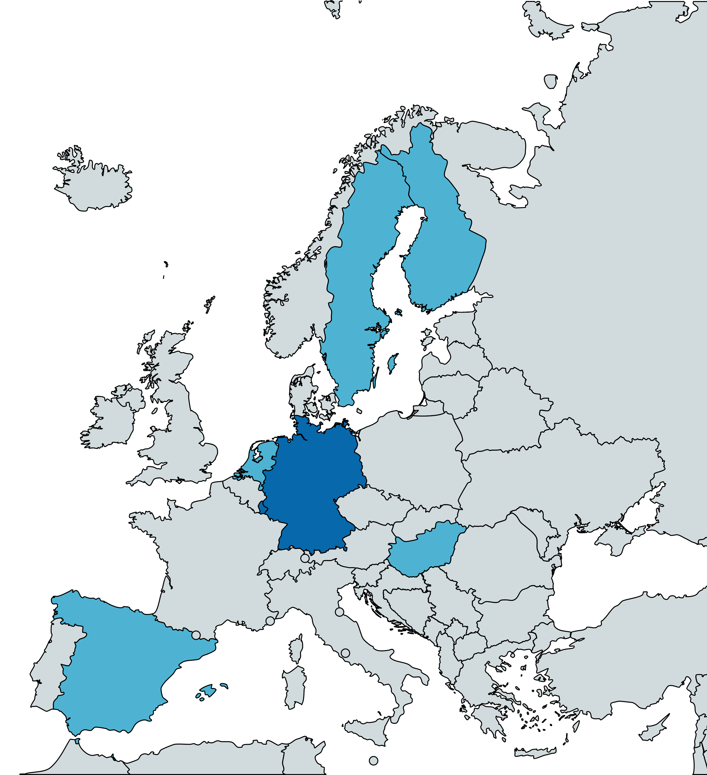
Challenges: our COVID-19 pandemic response
PPI input
WW-FINGERS-SARS-CoV-2 survey (30+ countries): measure pandemic direct/indirect effects on older adults -> Lifestyle;
Medical care of chronic disorders;
Mental wellbeing
Preliminary findings:
Less physical activity
~30%
Increased intake of unhealthy snacks ~25%
More sleeping problems
~25%
Experience of loneliness
~ 40%
Memory decline (self reported)
~ 15-25%
Country | Setting | N participants | Age (yrs) | Sex
Finland | FINGER RCT participants | 735 (86% resp. rate) | 70-88 | 47% F
Hungary | Community | 492 | 60+ | 55% F
Spain | Community | 410 | Mean 62 | 54% F
Sweden | Clinical | 72 | 55+ | 66% F
Sweden | Community | 6800 | 50+ | 58% F
The Netherlands | Community | 4029 | 50+ | 75% F
Total |  | 12538
EU-FINGERS countries participating in the WW-FINGERS-SARS-CoV2 survey
EU-FINGERS countries not participating in the WW-FINGERS-SARS-CoV2 survey
Notes:
PPI input on survey questions: grief due to loss during the pandemic added to the questionnaire

Slide 11


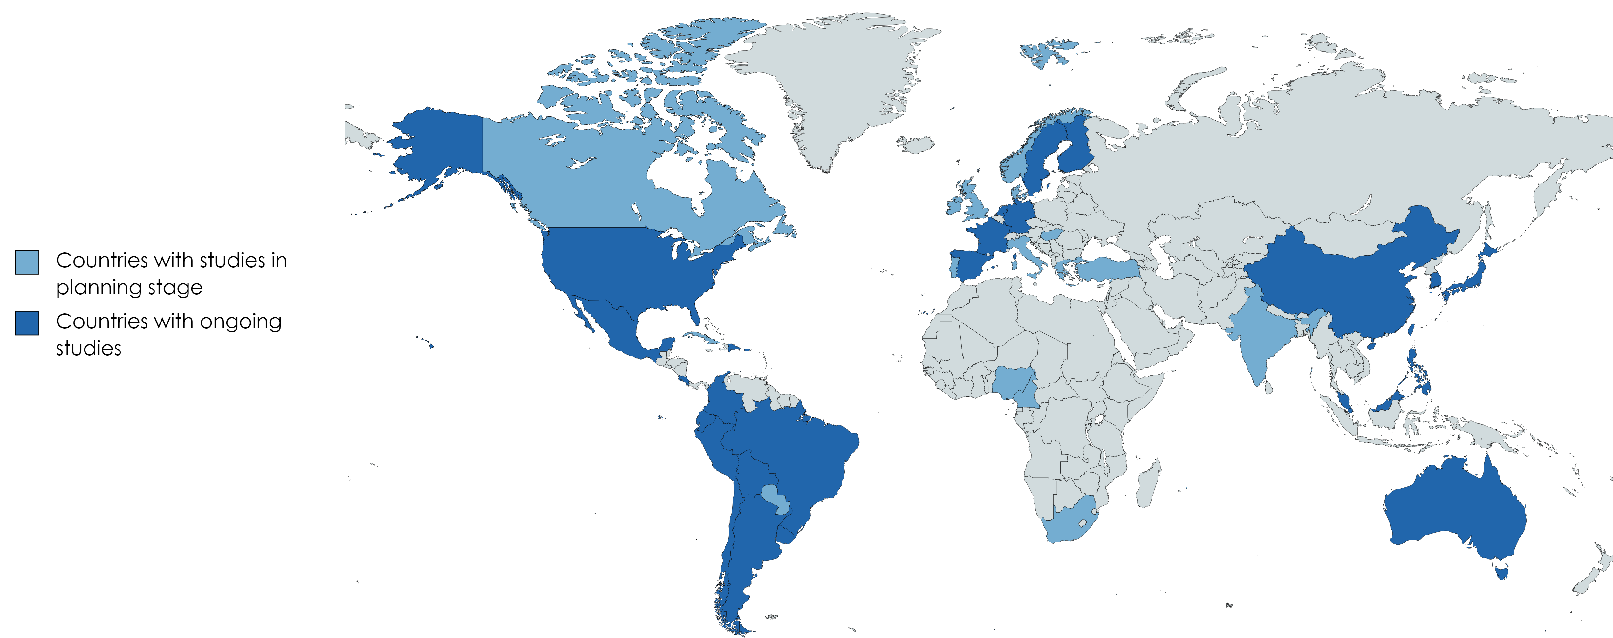
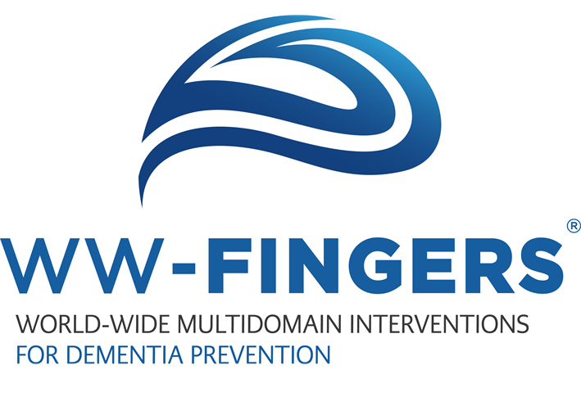



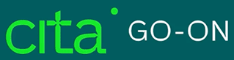




EU-FINGERS in the big picture
WW-FINGERS Network
NOR-FINGER
eFINGER PRINT
CAN-Thumbs-UP
Brain-Diabetes Ireland
AgeWell.de
GOID-ZAINDU
IzmirFINGER
DemenPrev
GINGER
MIND-CHINA
SUPERBRAIN
THISCE
INDIA-FINGER
FINOMAIN
SINGER
AGELESS
Mo-FINGER
MYB
Engine for next generation of clinical trials:
Precision prevention, combination therapies and global strategies
AU-ARROW
Participating countries 2022: 45+
Notes:
PPI input on survey questions: grief due to loss during the pandemic added to the questionnaire

Slide 12












Thank you!
EU-FINGERS is supported through the following funding organisations under the aegis of JPND: Finland, Academy of Finland; Germany, Federal Ministry of Education and Research; Hungary, National Research, Development and Innovation Office; Luxemburg, National Research Fund; Spain, National Institute of Health Carlos III; Sweden, Swedish Research Council; The Netherlands, Netherlands Organisation for Health Research and Development.
Contact info miia.kivipelto@ki.se francesca.mangialasche@ki.se
https://eufingers.com/

