Slide 1
TRIAGE: TRanslating Individual Alzheimer GEnetic risk into disease phenotypes
JPND Mid-term symposium
Brussels, 28 April 2022
Annerieke Sierksma, PhD (VIB – KU Leuven)

Slide 2
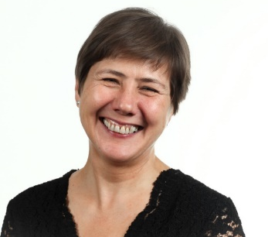
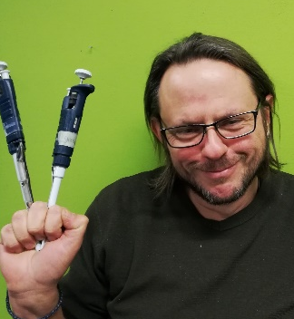
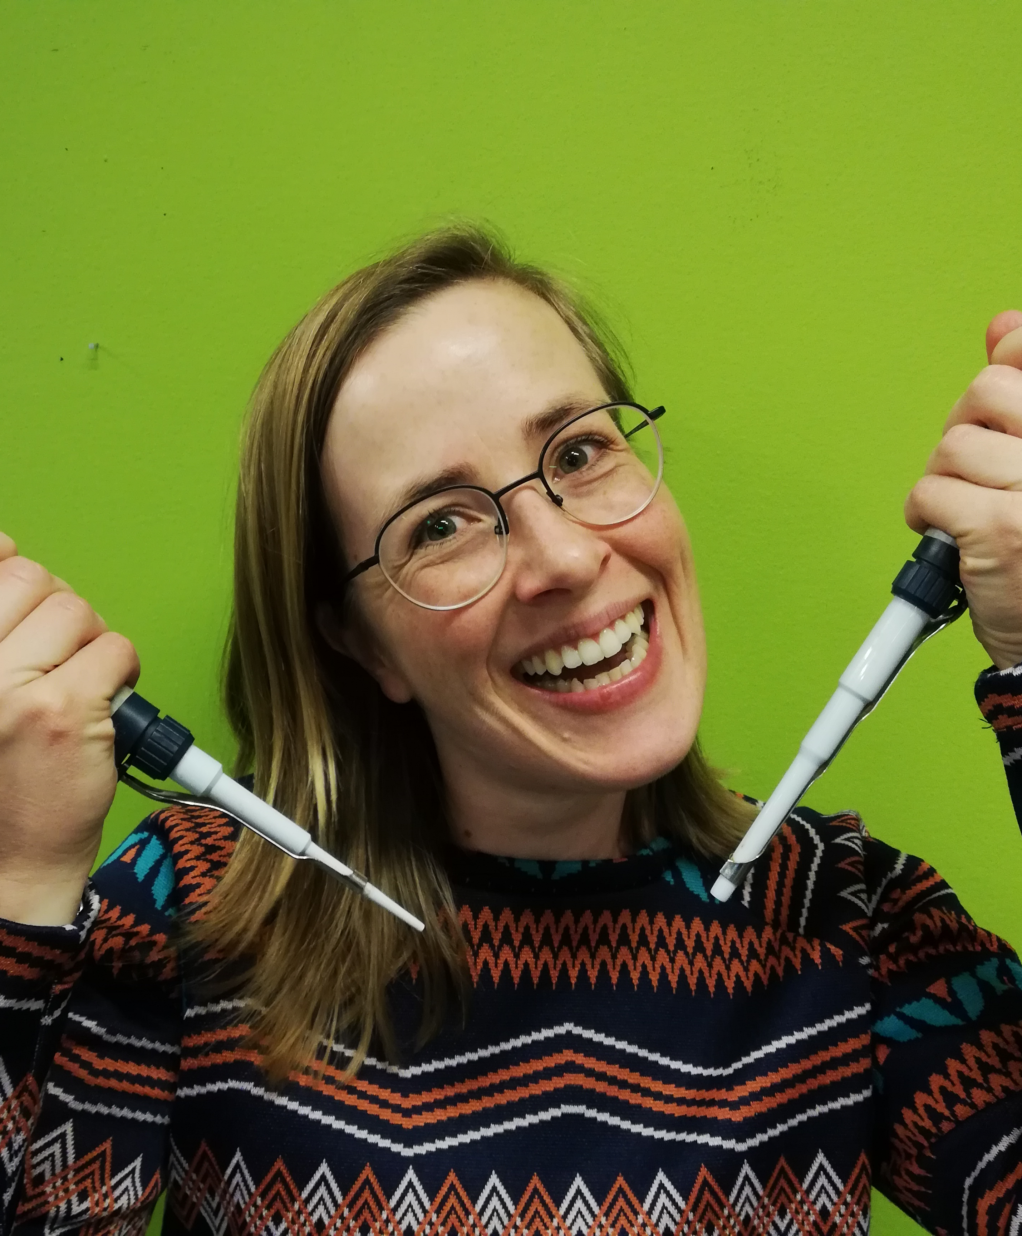
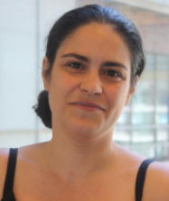
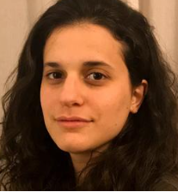
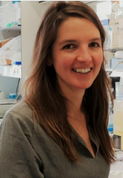
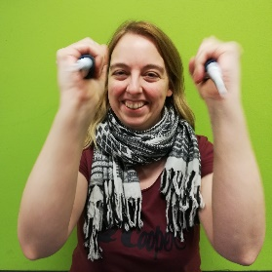
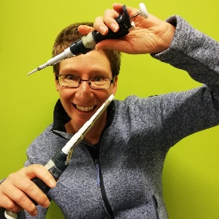
Meet the team:
iPSC-derived microglia,
Xenotransplantation models,
scRNAseq
Prof. Valentina Escott-Price
Joshua Stevenson-Hoare, PhD
Polygenic risk assessment
Prof. Bart De Strooper
Prof. Mark Fiers
Annerieke Sierksma, PhD
Sarah Borrie, PhD
Emanuela Pasciuto, PhD
Prof. Jeroen Pasterkamp
Marta Canizares-Luna, MSc
Prof. Rik Vandenberghe
Prof. Stephanie Humblet-Baron
Emma Luckett, MSc
An Snellinx, BASc
Nicky Thrupp, MSc
Cerebral organoids,
iPSC-derived microglia
Cohort characterization & follow-up,
Immune phenotyping

Slide 3
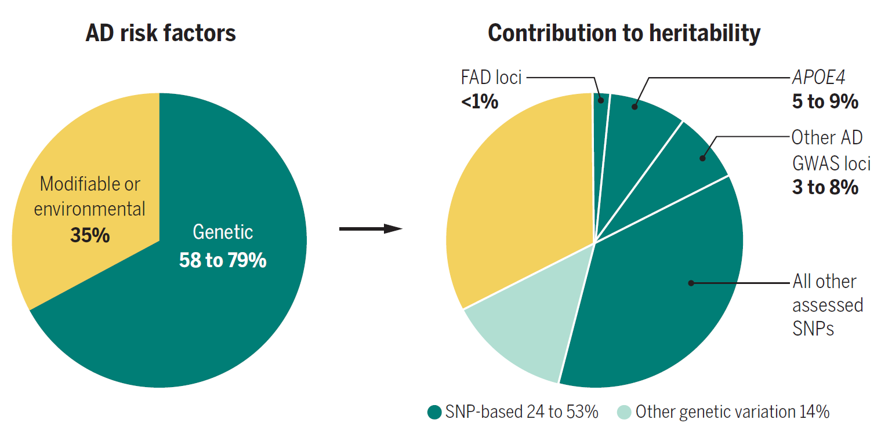
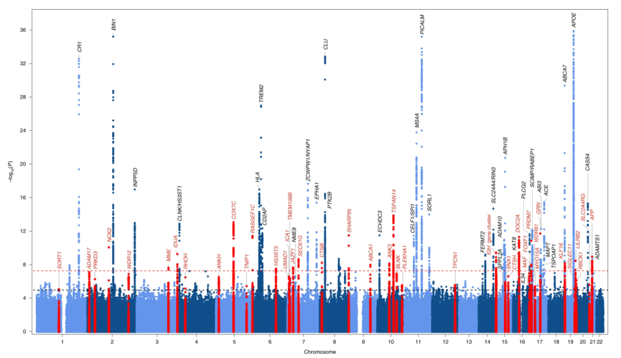
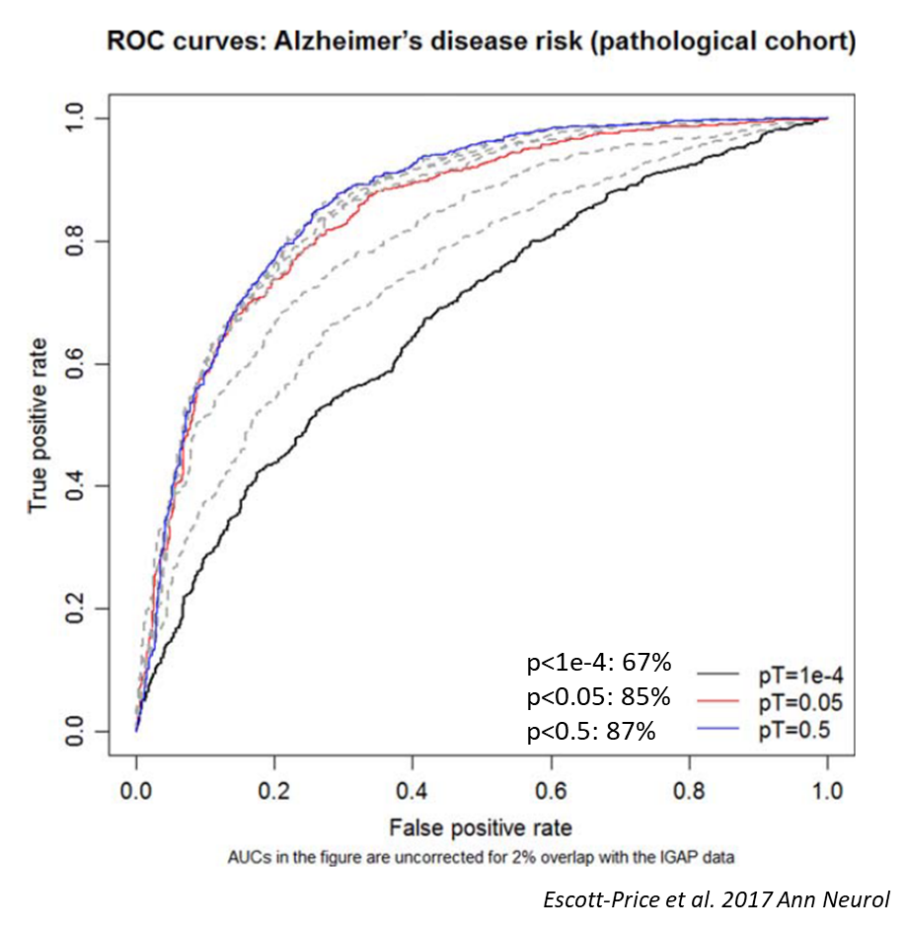
Understanding genetic risk for Alzheimer’s disease
- 4-5 million SNPs compared to reference genome: how does that affect your risk for AD?
‘Polygenic risk’ significantly increases the prediction accuracy for AD
Sierksma et al. 2020 Science
Bellenguez et al. 2022 Nat Genet
Small effect sizes...
p < 5x 10⁻⁸
p < 0.1

Slide 4
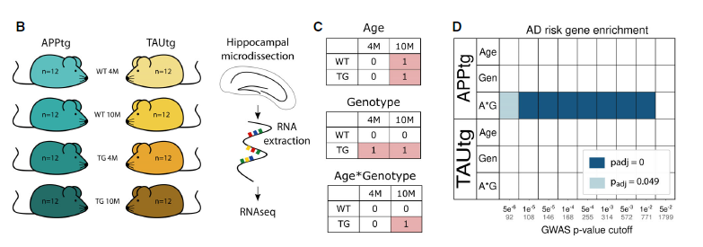
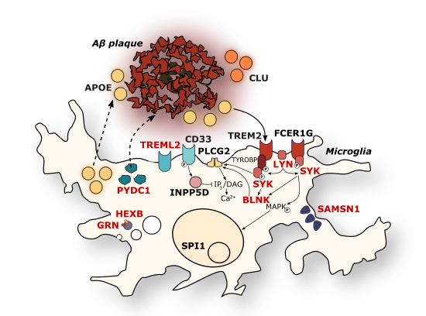
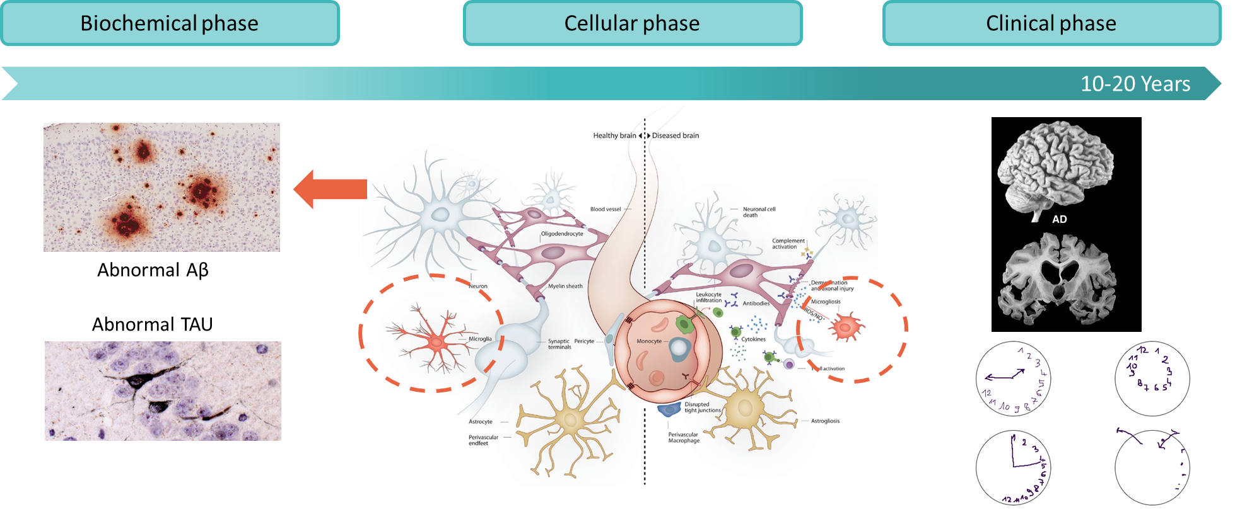
Functional consequence of polygenic risk
Polygenic risk for Alzheimer’s disease determines the microglial response to Aβ pathology
Sierksma et al. 2020 EMBO Mol Med

Slide 5
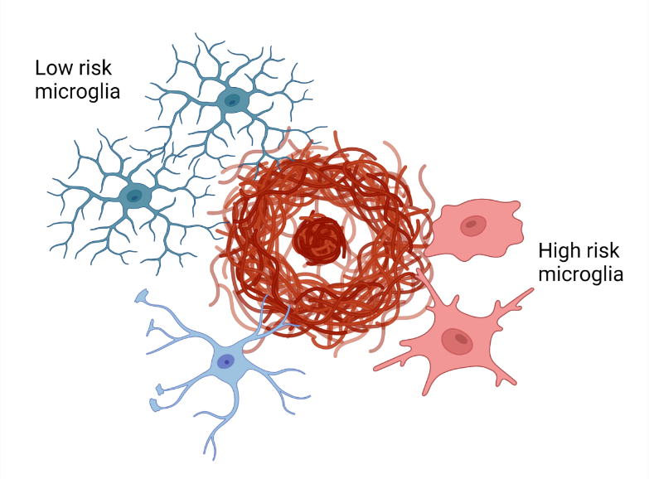
TRIAGE project:
Hypothesis:
Polygenic risk for AD determines the microglial response to amyloid-β pathology
How?
- Do microglia from people with high polygenic risk behave differently to Aβ pathology than those from people with low polygenic risk?
- Do microglia with high polygenic risk adopt specific cellular states & which pathways are commonly affected?
Can we find different subtypes of microglial responses?
- Can we link genotype to phenotype?
End goal:
Stratification of individuals on their polygenic risk for clinical trials and ultimately personalized treatments
Polygenic risk

Slide 6
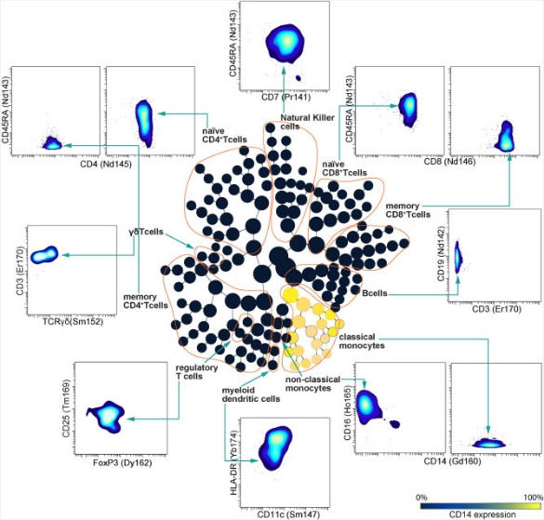
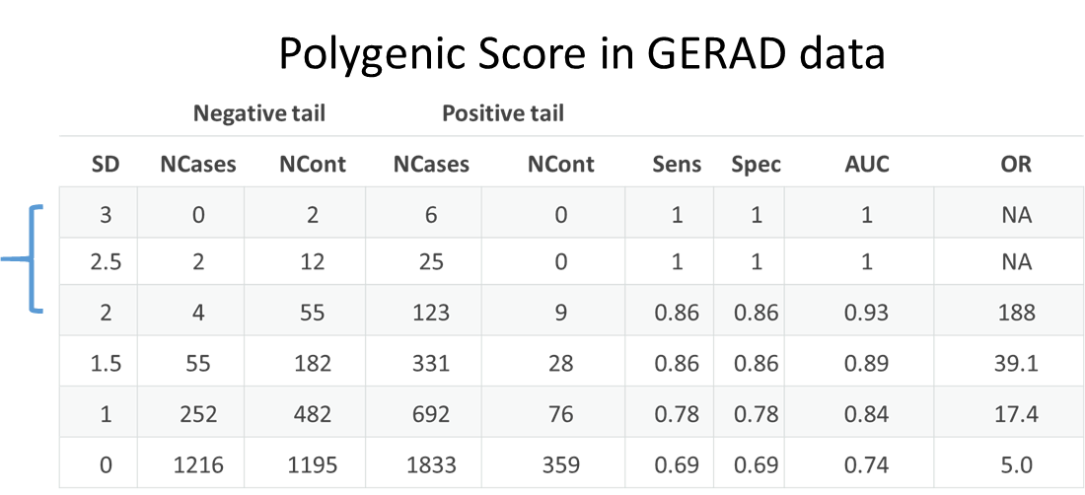
Methodology
WP2. Polygenic risk score calculations
WP1. Genotyping & immune phenotyping
F-PACK
- Cognitively normal at inclusion (50-80y)
- 2-yearly neuropsychological follow-up
- Structural MRI, amyloid PET (2x), serum+plasma
Standardization
ARCK
- Biomarker-proven AD cases + spouse controls
- Neuropsychological testing, MRI
Identification of cohort extremes (+/- 2SD)
Immunephenotyping on PBMCs
BD FACSymphony – 28 markers / cell
Quantification of 1500+ parameters
OR>32 (Leonenko et al. 2021 Nat Comm)

Slide 7
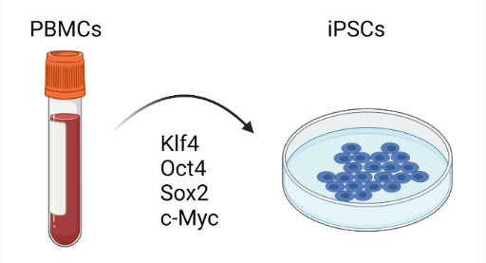
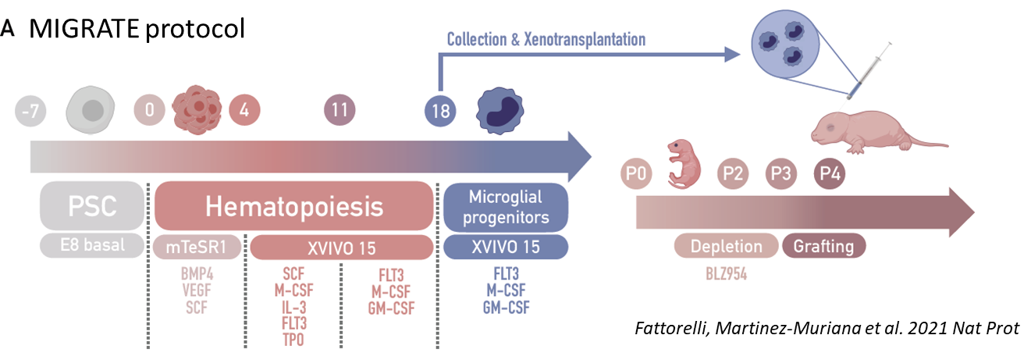
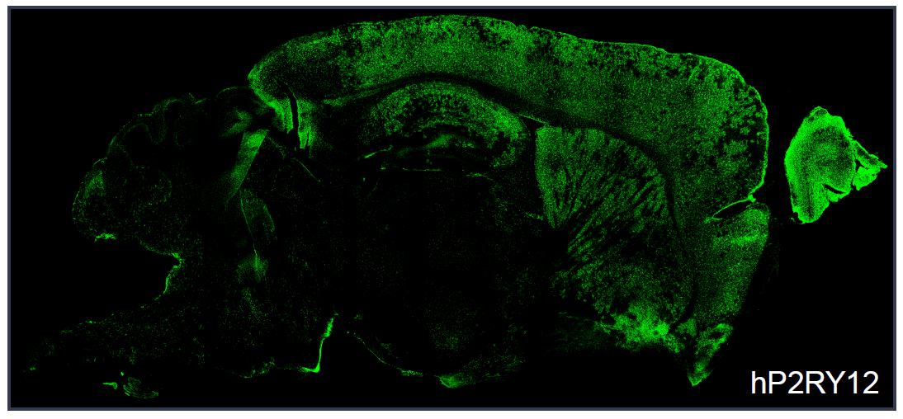
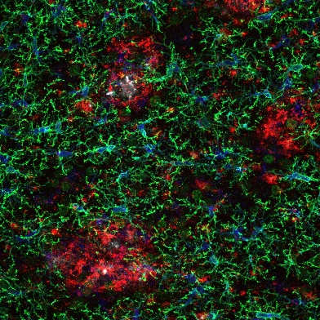
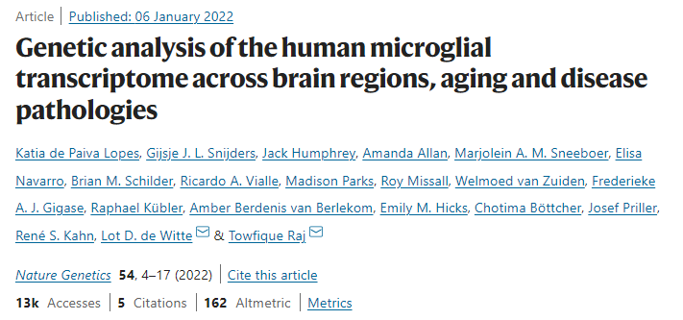
Methodology
WP5.Cerebral organoids
WP3. iPSC generation (n=6)
Ormel et al. 2018 Nat Comm
Innately developing microglia
Injected microglia in Aβ producing organoid
In house / Service provider
WP4. Microglia xenotransplantation
WP6. scRNAseq, bioinformatics & validation
Genotype-phenotype relations
WP7. Coordination, project management & dissemination

Slide 8
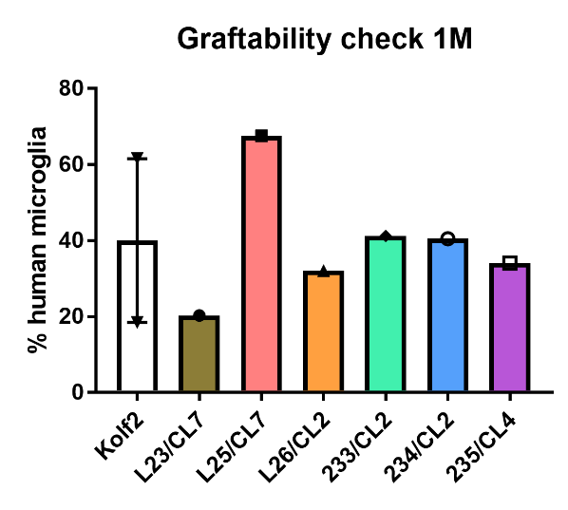
Progress
Immunephenotyping to be finalized in summer 2022
Genotyping & PRS calculations completed
Selection of 15 individuals with high/low polygenic risk
iPSC generated for n=6, 4 more underway
Setting up multiple collaborations to increase the iPSC collection
iPSCs distributed across consortium
Xenotransplantation & aging ongoing
Organoid development ongoing
First scRNAseq results expected in July 2022
>>>Can genetic variability shape the microglial response to amyloid-β pathology?
>>> Can we leverage this data to stratify AD patients?

Slide 9
Public & patient engagement
Close collaboration with a healthcare consultancy company
Specializes in health care economics and market access
Setting up exploitation board to explore:
the market potential & needs for genetic screening in AD
The potential of a stratification tool in AD (clinical trials, diagnostics, treatment)
Potential future partners
Exploitation board: business developers, clinicians, patient organizations

Slide 10
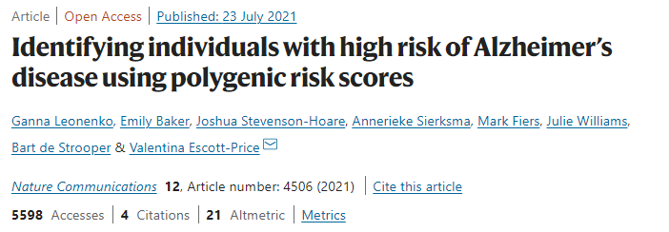
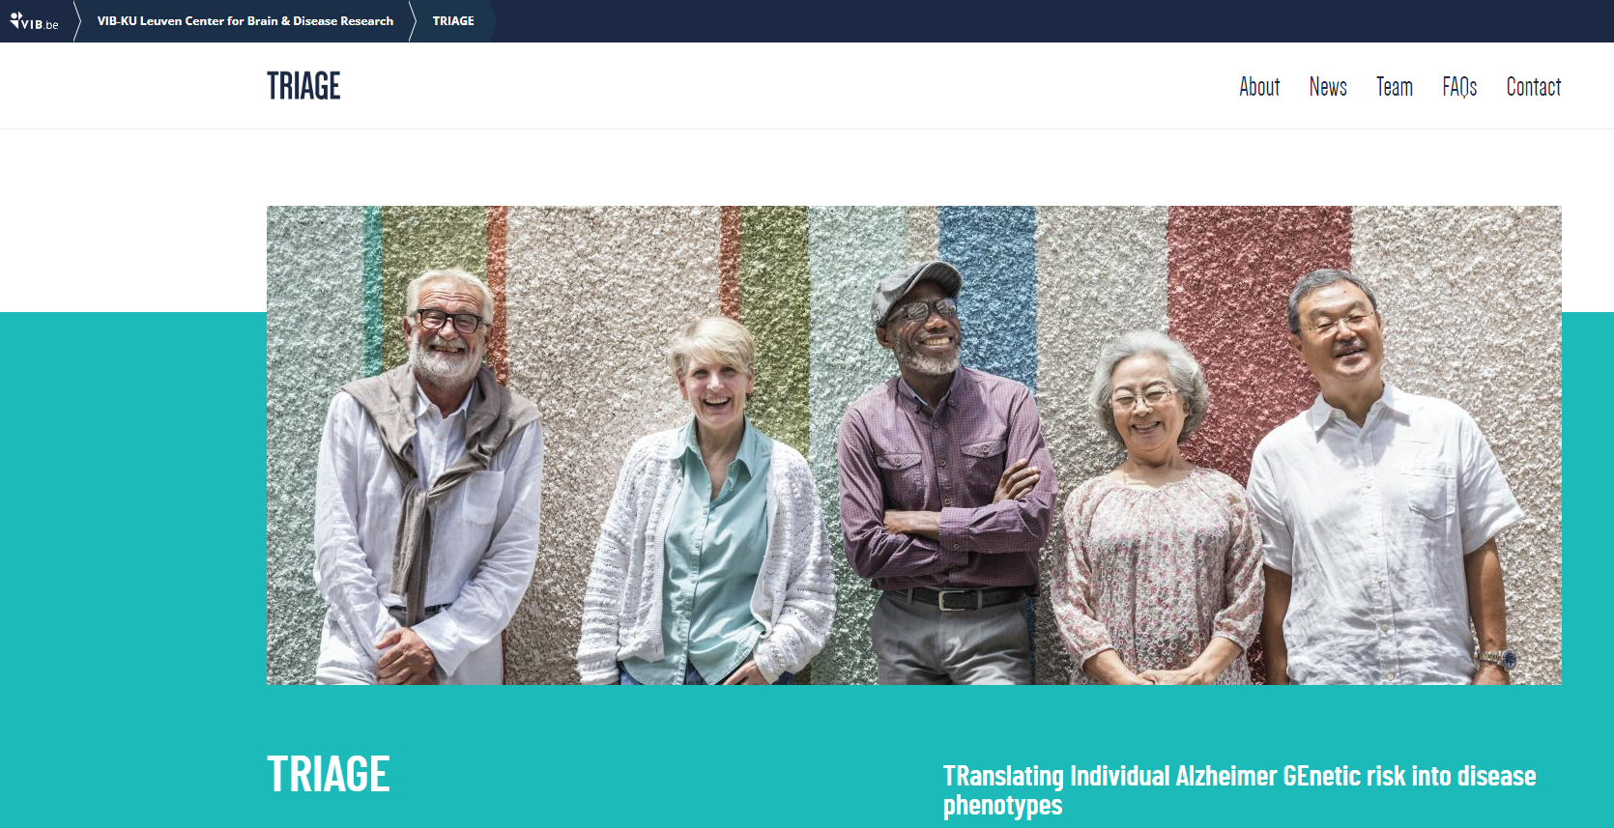
Dissemination
Expert audience:
Scientific articles in peer reviewed journals
Posters / oral presentations at international meetings
Lay audience:
Website
Social media: LinkedIn, Twitter, Facebook

