Slide 1
DIagnostic and Prognostic Precision medicine Algorithm for FTD
DIPPA-FTD
JPND/Jpco-fuND2 Midterm Symposium
April 28 2022
Sterre de Boer, PhD Student Alzheimercentrum Amsterdam.

Slide 2
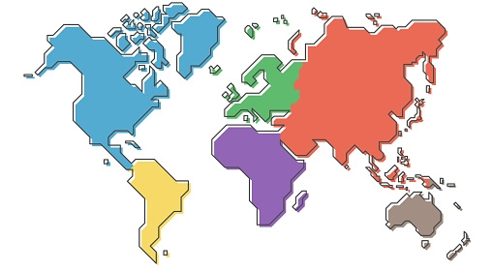

Slide 3
Background DIPPA-FTD
Behavioural variant of FTD (bvFTD) is heterogeneous with respect to clinical presentation, underlying neuropathology, and genetics
About 70-80% of bvFTD is genetically sporadic¹
Reliable biomarkers to identify sporadic bvFTD or its pathological subtypes are currently lacking
bvFTD is often misdiagnosed, and there is an average delay of 6 years to diagnosis²
In particular, due to large clinical overlap, the differential diagnosis with primary psychiatric disorders (PPD) forms a dilemma^{3,4}
1. Mol, M.O., et al. Neurobiol Aging 2020;97;148.e9-148.e16, 2. van Vliet D, et al. Psychol Med 2013;43:423-32;, 3. Woolley JD, et al. J Clin Psychiatry 2011;72:126-33;, 4. Vijverberg EG, et al. J Alzheimers Dis 2016;53:1287-97;

Slide 4
Aims
Our goal is to provide an early, accurate diagnosis and a prognosis to patients presenting with adult onset behavioural changes
Create a diagnostic paradigm to differentiate sporadic bvFTD from PPD
Create a prognostic paradigm for sporadic bvFTD and PPD
Develop biomarkers to differentiate between the main pathological subgroups of bvFTD

Slide 5
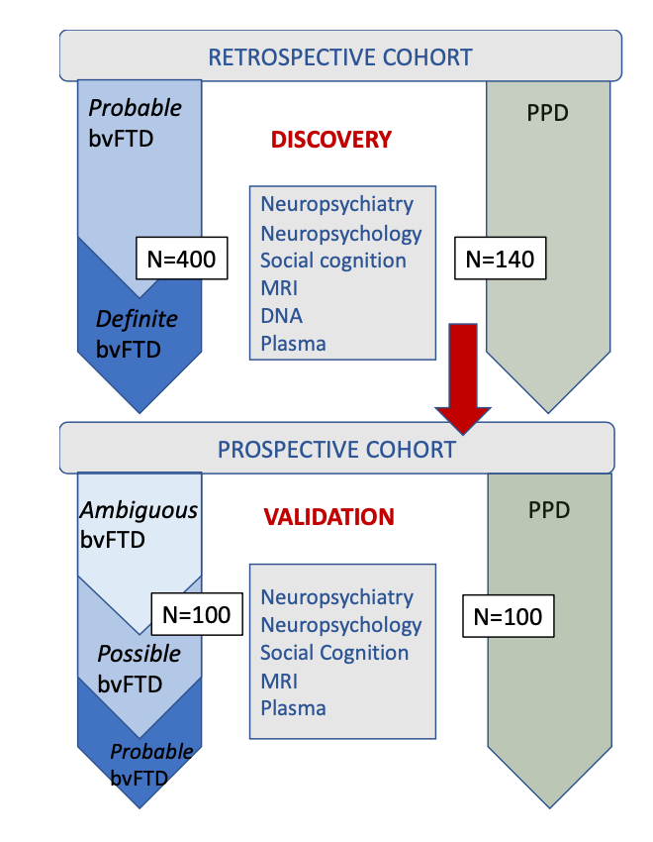
Design
Poster presentations of colleagues
Lina Riedl: harmonization retrospective database
Federica Sorrentino: methods biomarkers characterization

Slide 6
Expected Outcomes
Clinical markers
Biomarkers
DIagnostic and Prognostic Precision medicine Algorithm for FTD
Online tool for the diagnosis and prognosis of sporadic bvFTD for professionals
An animation movie for patients and layman depicting the main outcomes of our study

Slide 7
Impact results
DIPPA-FTD will contribute towards an early and accurate diagnosis of bvFTD and PPD
Knowledge dissemination to professionals, patient and their caregiver(s)
In collaboration with AFTD we will look on how our recommendations can be put into practice
Early PPD identification: appropiate psychiatric treatment
Trial enrolment for sporadic bvFTD
Predict rate of progression in sporadic bvFTD
Patient stratification
Trial design
Personalized treatment

Slide 8
Challenges
Successes
Delays due to covid pandemic
Different time zones
Harmonization retrospective data in 5 different languages
No LIVE Patient and Public involvement (PPI) due to pandemic
International research group
Automated import of local database
Prospective study (CRF and database) in 5 languages
Hosted virtual FTD talks for layman and FTD patient groups
Manuscript in preparation: “how to establish an international medical consortium”
NIC-FTD

Slide 9
DIPPA-FTD team
The University of Sydney
Olivier Piguet
Glenda Halliday
Ramon-Landin Romero
Zac Chatterton
Dean Southwood
Sophie Matis
Sarah Carnemolla
The University of Milan
Daniela Galimberti
Giorgio Fumagalli
Federica Sorrentino
Chiara Fenoglio
Vittoria Borracci
Alzheimercentrum Amsterdam - AmsterdamUMC
Yolande Pijnenburg
Sterre de Boer
Marie-Paule van Engelen
Jay Fieldhouse
McGill University
Simon Ducharme
Ishana Rue
Teodoroa Yankova Yaneva
Technical University of Munich
Janine Diehl-Schmid
Lina Riedl

