Slide 1
COGNISANCE (Co-designing dementia diagnosis and post-diagnostic care)
Presented by:
Isabelle Vedel, MD-PhD, McGill University, Canada
On behalf of Henry Brodaty and the Cognisance team

Slide 2
COGNISANCE - 5 Countries, 5 Phases
The COGNSIANCE project is part of a large international project.
Participating countries include
Australia,
the Netherlands,
the UK,
Poland,
and Canada (3 Provinces: New Brunswick, Ontario, Quebec).
Each country is a ‘lead’ for one of the five phases.

Slide 3
Countries and work packages
WP 1 Needs Assessment
Surveys and focus groups to explore current experiences of dementia diagnosis and support (barriers and facilitators)
WP2 Co-design
Develop internationally applicable toolkits supporting guideline implementation
WP3 Implementation
Devise and delivery behaviour change campaigns to related to the tool kits
WP4 Evaluation
Evaluate the campaign
WP5 Sustainability and scaling-up
Develop and implementation playbook to delivery campaigns in other countries

Slide 4
COGNISANCE - Progress to date (1)
Phase 1: Needs Assessment – Data collection (interviews, focus groups, surveys); analysis and reports. Completed
Phase 2: Co-design – Four ‘co-design’ meetings and several rounds of user testing were completed; ‘stories’ were created with co-design members; ‘Forward with Dementia’ chosen as preferred website/campaign title. Completed

Slide 5
COGNISANCE - Progress to date (2)
Phase 3: Implementation – Website/campaign was launched in October 2021 and runs until spring 2022.
Phase 4: Evaluation – Data collection (surveys, interviews, focus groups, web analytics). Ongoing.
Phase 5: Sustainability – An ‘implementation playbook’ (how to guide) will be developed and a plan for sustainability will be created post-implementation and evaluation. Ongoing.

Slide 6
Results of WP1 (Need assessment)
When a diagnosis of dementia is made, people living with dementia & family care partners have shared:
Not often given a sense of hope about living with dementia
More supports are needed following diagnosis
It can be difficult for health care providers to share
a diagnosis of dementia
The Forward with Dementia initiative aims to:
Provide suggestions on communicating a diagnosis
Enhance the supports provided following a diagnosis
Provide hope that persons with dementia can live well

Slide 7
Results of WP 2&3 (co-design)
Designed FOR
- Persons with dementia
- Family & friend care partners
- Health & social care providers
Designed BY
&
&

Slide 8
Forward with Dementia
Forward with Dementia includes a website & a campaign
The website includes:
Articles about dementia
Practical resources (e.g., checklists, worksheets)
Stories from people living with dementia and family care partners
The campaign raises awareness of the website & living well with dementia:
Webinars and presentations
Media (e.g., newspapers, radio)
Social media

Slide 9
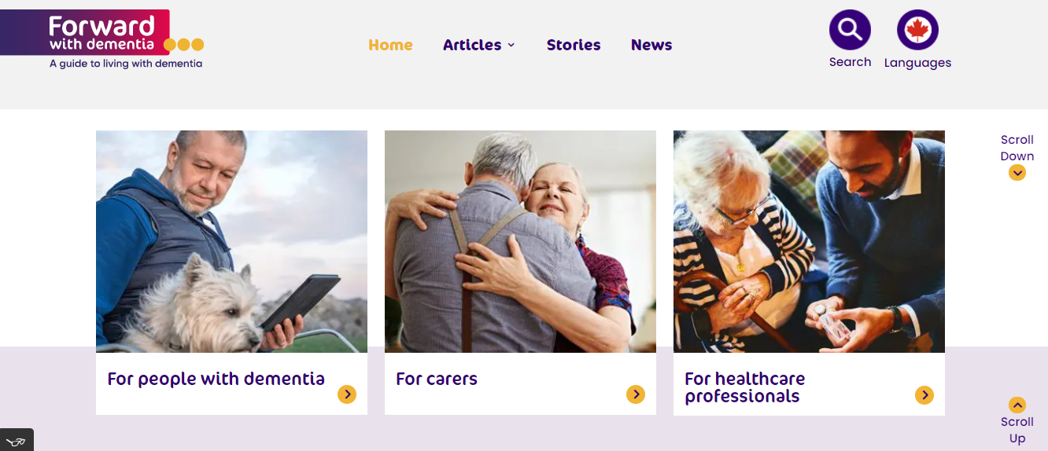
Forward with Dementia website

Slide 10
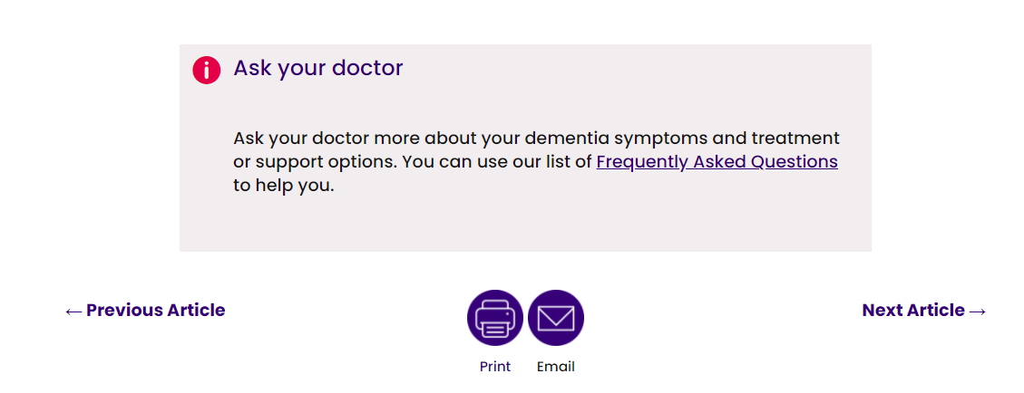
Examples of ‘Forward with Dementia’ website
* This is an example of a ‘practical action’ that would appear at bottom of an article on the website. Also positioned at the end of articles are ‘print’ and ‘email’ buttons.

Slide 11
Thank you for your time today. We are always happy to make new connections! Henry Brodaty : h.brodaty@unsw.edu.au Isabelle Vedel : isabelle.vedel@mcgill.ca
http://forward-avancer.ca/

