Slide 1
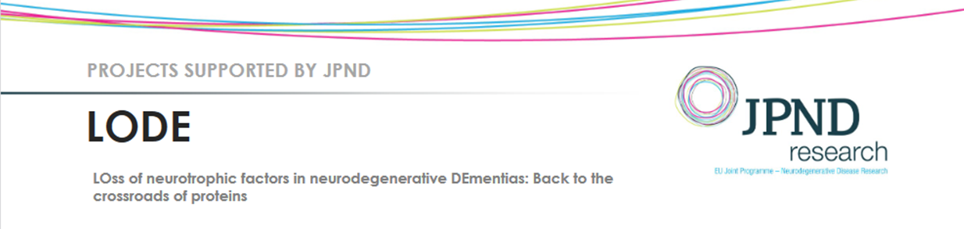

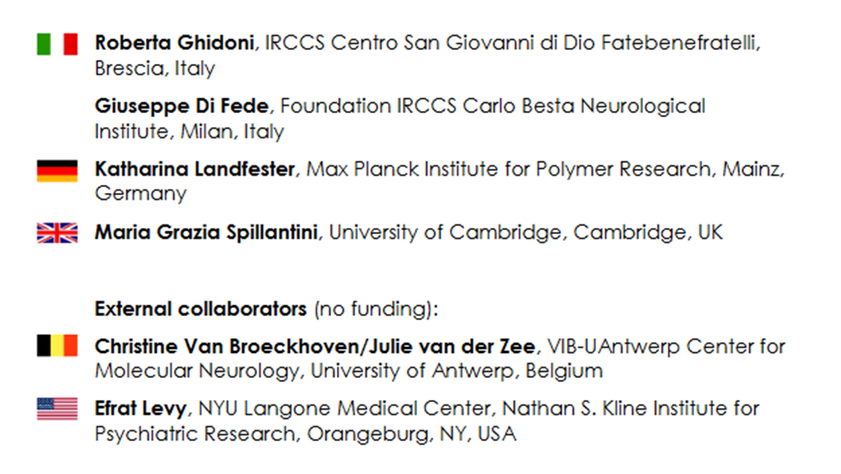
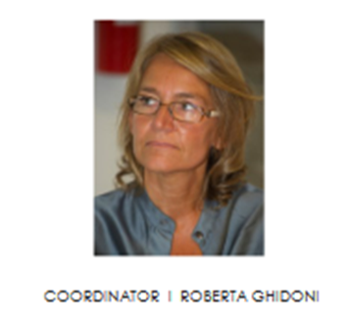
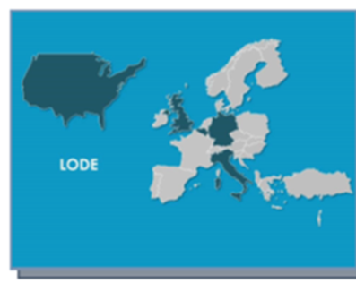
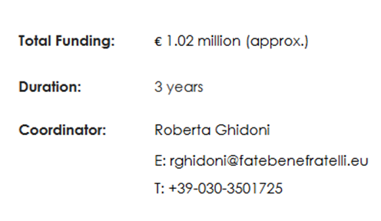

Slide 2
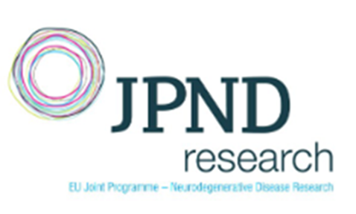
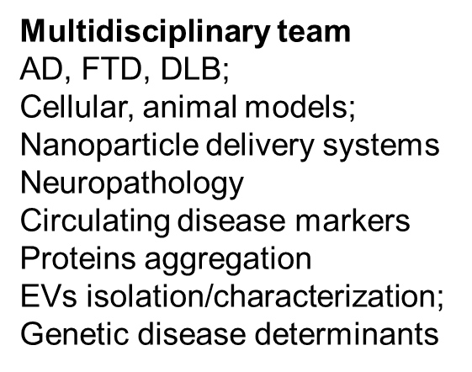
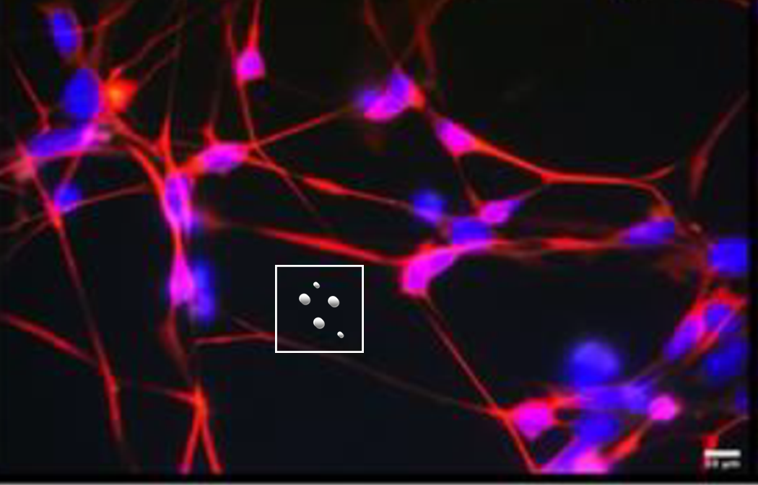
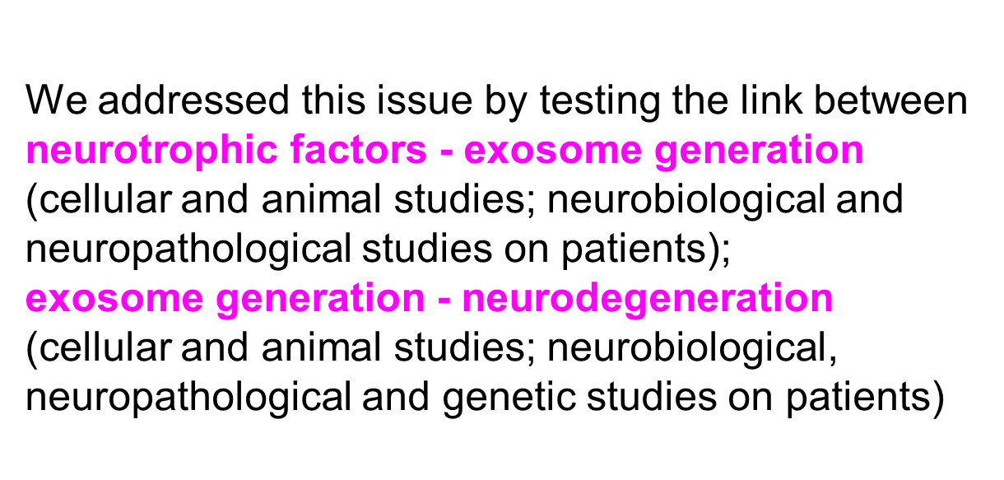
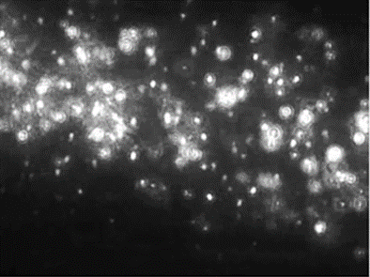
The recognition that non-monogenic as well monogenic forms of dementia result substantially in the same disease, suggests that fundamental, simple mechanisms may underlie the apparent complexity of observed human neurodegenerative disorders (Ghidoni R. Med Hypotheses 2009)
Key common pathological mechanism across AD, FTLD, DLB
Our WORKING HYPOTHESIS is that, during conditions characterized by progressive loss of neurons, exosomes (EVs) could become the key player of neuronal communication and the crossroads of proteins: accordingly, survival of neurons could be easily affected by factors modulating exosome release and/or composition.

Slide 3
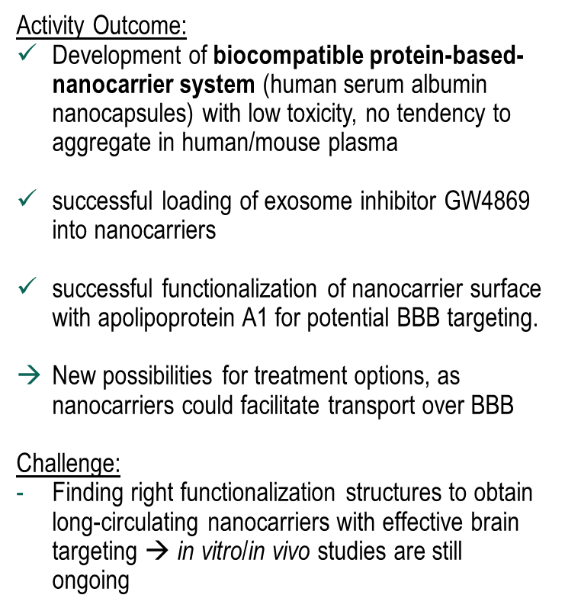
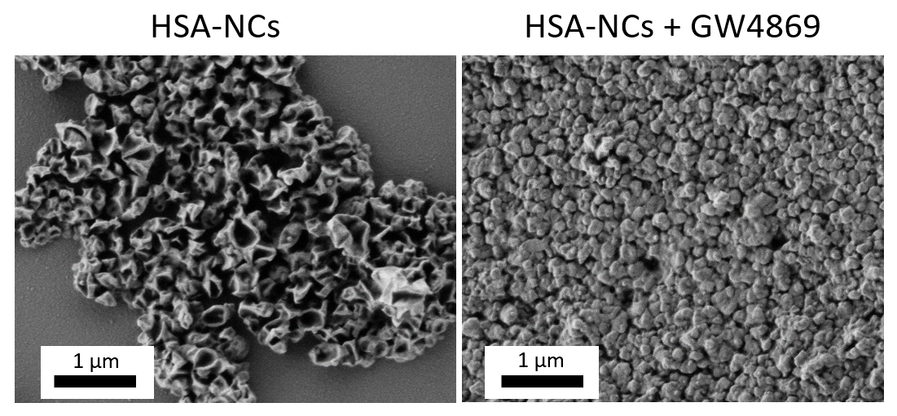
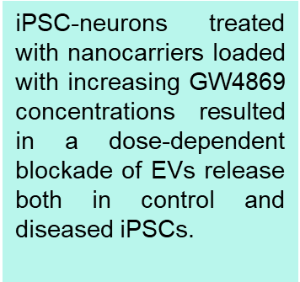
WP1 Development of delivery system (nanocarriers) – MPIP Landfester group
Figure 1. Exemplary scanning electron microscopy (SEM) micrographs of dried HSA nanocapsules without cargo (left) and HSA nanocapsules with loaded GW4869 (right)
(unpublished data)

Slide 4
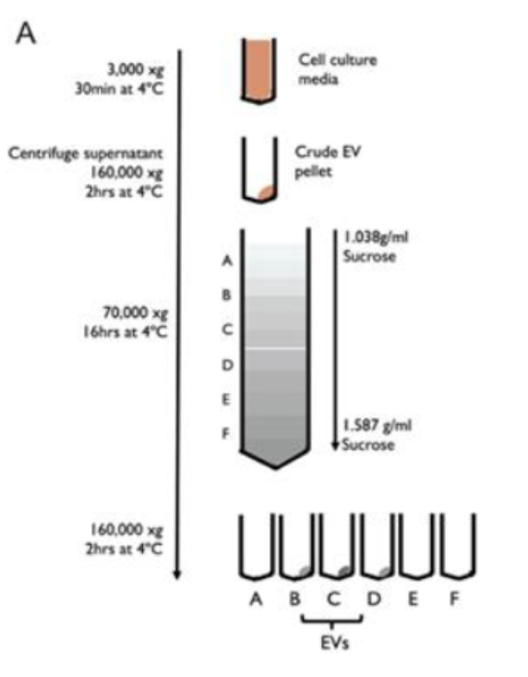
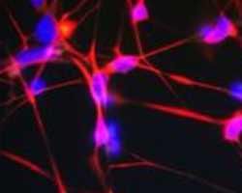
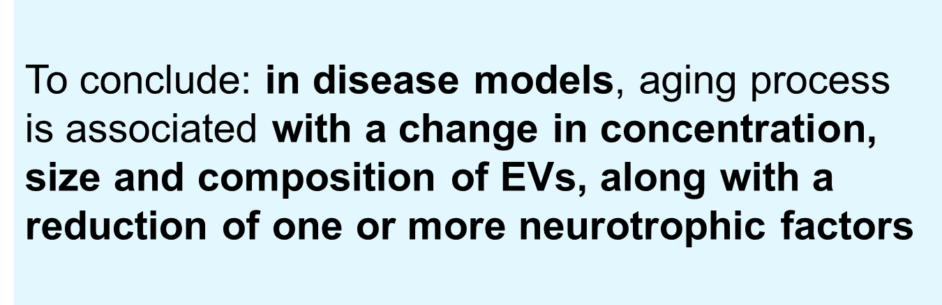

WP2 SHARED MOLECULAR MECHANISMS TRIGGERED BY LOSS OF NEUROTROPHIC FACTORS AND BLOCKADE OF EXOSOME GENERATION
iPSC-neurons
Mice models
(unpublished data)

Slide 5
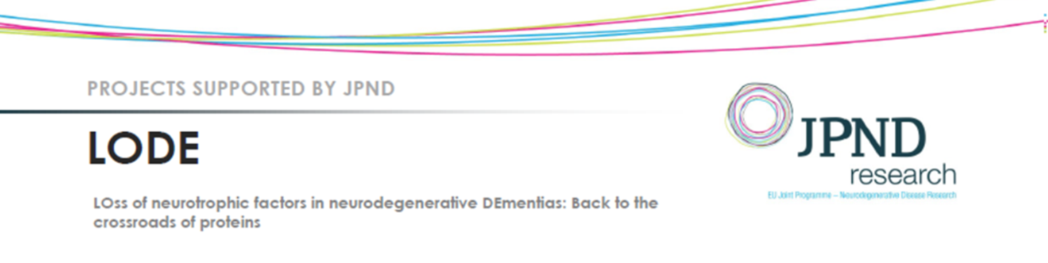
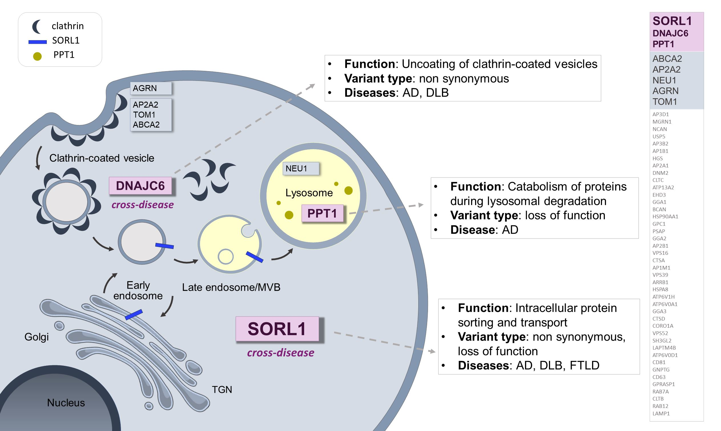
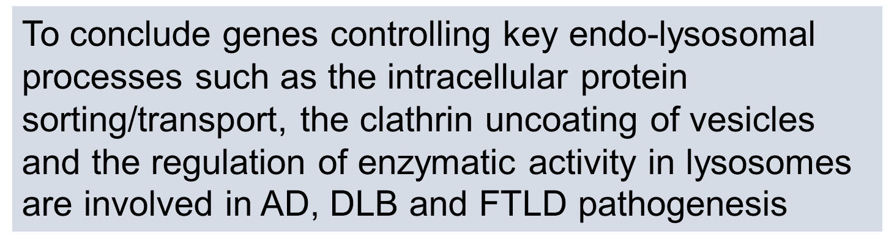
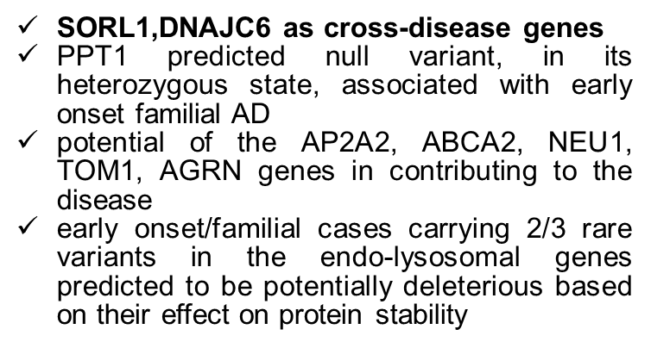
WP3 Shared genetic features in endo-lysosomal genes across dementias (AD, FTD, LBD)
Targeted deep sequencing (NGS, WES, WGS) of the top 50 genes belonging to the endo-lysosomal pathway highly expressed in at least two brain regions
n=948 subjects
(282 AD, 114 DLB, 301 FTLD, 251 controls).
Benussi L & Longobardi A, et al., Int J Mol Sci. 2021;22:13633.; Ciani et al Int J Mol Sci 2019

Slide 6
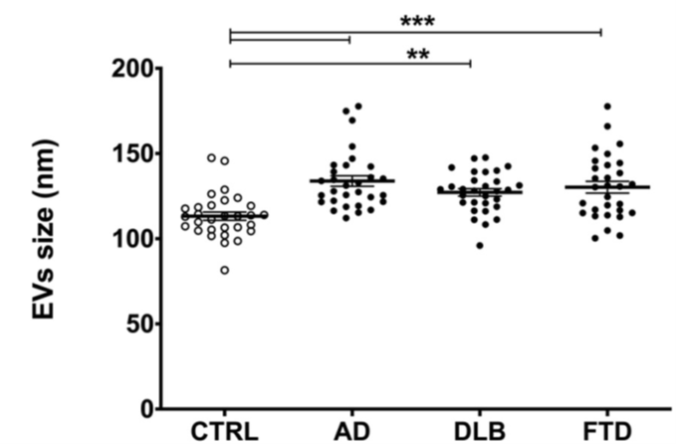
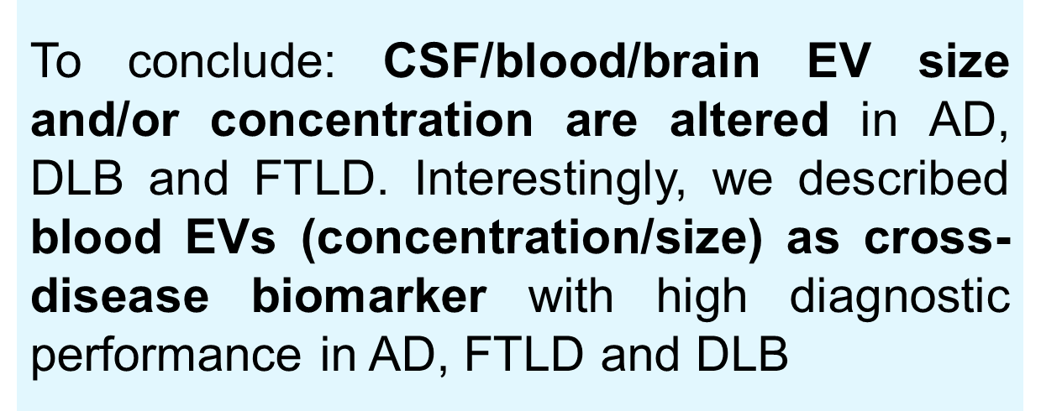
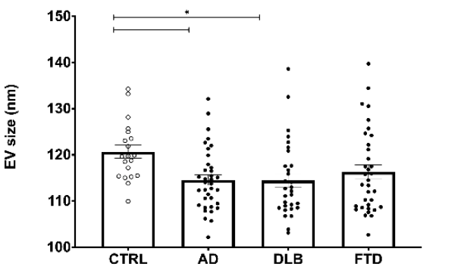
WP4 - SHARED NEUROBIOLOGICAL AND NEUROPATHOLOGICAL FEATURES ASSOCIATED WITH LOSS OF NEUROTROPHIC FACTORS ACROSS DEMENTIAS (AD, FTLD, DLB)
Human plasma EVs
AUC=0.86,
83.3% sensitivity
86.7% specificity
Human CSF EVs
Blood CysC positively correlated with EVs
Reduction of neurotrophic factors in human brain and CSF samples
Longobardi A et al., Front Cell Dev Biol 2021; doi:10.3389/fcell.2021.667369
Longobardi A et al., Cells 2022; doi:10.3390/cells11030462 ,

Slide 7
How does the project contribute to tackling the societal challenge of neurodegenerative diseases?
Clinical phenotypes alone seem insufficient to provide an understanding of the underlying mechanisms involved, and to be the sole basis for prognosis, diagnosis and treatment of neurodegenerative diseases
Results from cellular and animal studies, genetic studies on large patients’ cohort, studies on human biofluids and brain tissues carried out by the LODE Consortium Partners, highlighted the key role of the endo-lysosomal pathway in AD, FTLD and DLB and suggest the existence of cross-diseases mechanisms involved in these major neurocognitive disorders
Alterations of different key processes of the endo-lysosomal pathway could be equally relevant and alternatively involved in the occurrence of dementias under distinct phenotypes and on disease onset and/or progression

Slide 8
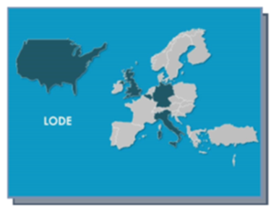
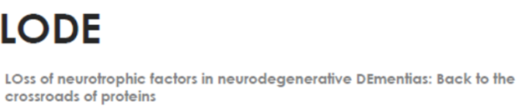
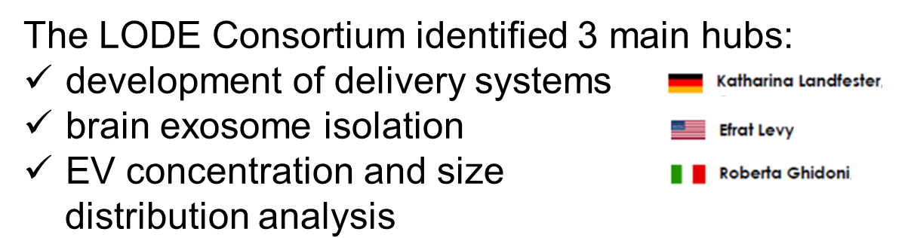
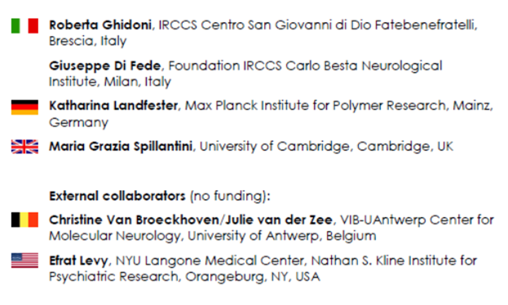
Effective collaboration between synthetic work and the corresponding application studies of nanocarriers for new treatments in vitro and in vivo
Continuative interactions between Partners and External Collaborator allowed to perform an integrated approach to address several objectives of the project, especially those concerning the levels of EVs and neurotrophic factors in brain tissue and biofluids of patients
Clinical partners made available to the projects well characterized AD, FTLD and DLB cohorts (DNA, plasma, CSF and brain tissues) essential for the success of the project
Regarding the genetic studies, the coordinator and External Collaborators defined together a bioinformatic strategy tailored to the JPND cross-disease call and thus selected genes highly expressed in more than two brain areas.
WORKING TOGETHER

Slide 9
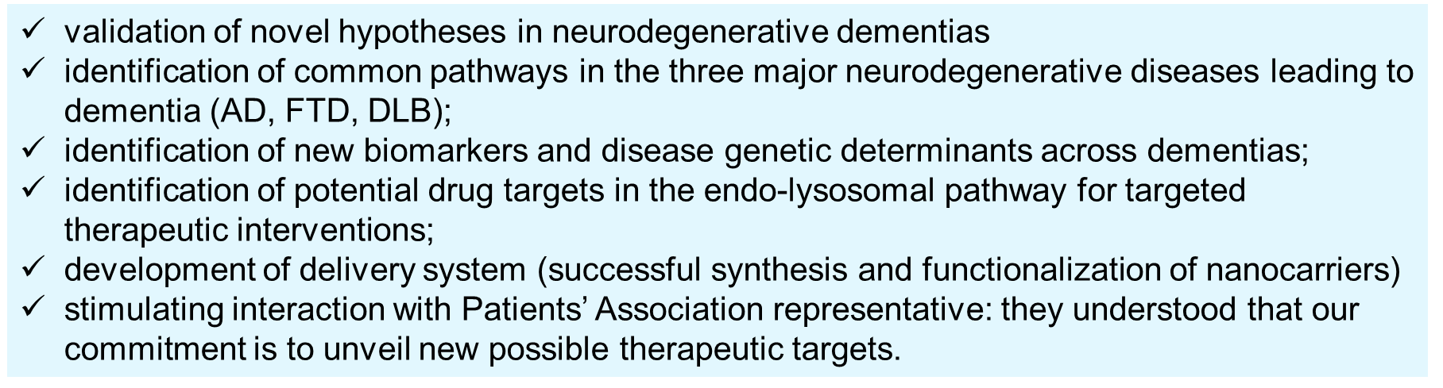
SUCCESSES AND CHALLENGES
Covid 19 pandemic
The start date of the project that can differ among the different countries

Slide 10
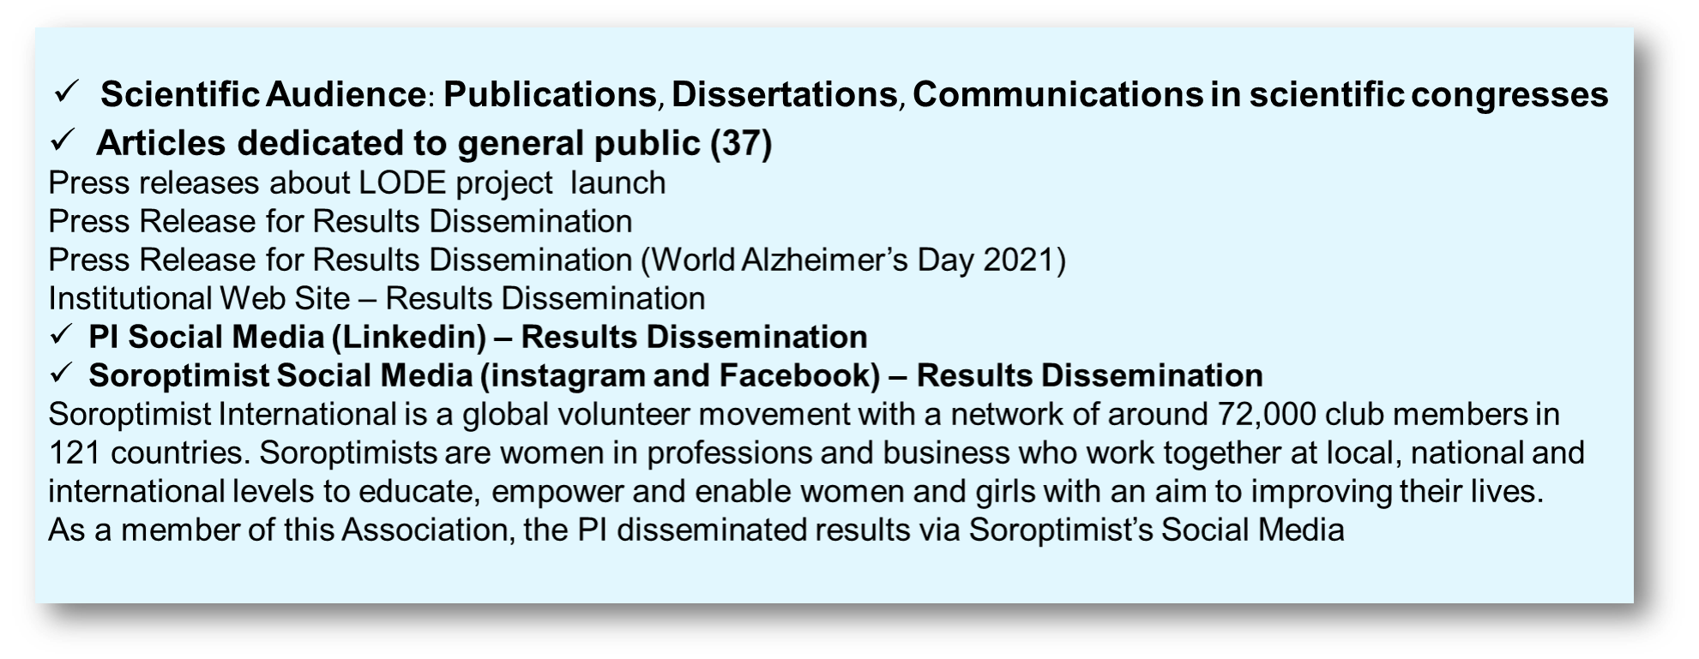
PPI INVOLVEMENT AND DISSEMINATION
The PI contacted the President of the Italian Frontotemporal Disease Association (AIMFT) - a voluntary organization founded in Brescia (Italy) in 2010 – to disseminate results (specifically those obtained from WP3 and WP4, on patients cohorts). We chose the AIMFT since i) the President is part of the local Ethics Committee; ii) the Association is based in Brescia, the city where the Coordinating Institute is located; iii) the Association is devoted to frontotemporal dementia (a less known form of dementia with respect to Alzheimer’s disease).
The AIMFT disseminated the JPND LODE results via institutional Website and Facebook web pages
http://www.frontotemporale.it/2022/01/05/il-progetto-jpnd-lode-coordinato-dalla-dr-ssa-ghidoni-ha-approfondito/
https://es-es.facebook.com/pg/frontotemporale/posts/?ref=page_internal
https://it-it.facebook.com/pg/frontotemporale/posts/

