Slide 1

Marta del Campo, PhD
BarcelonaBeta Brain Reserach Center, Fundacion Pascual Maragall.
NEUROFAN lab, San Pablo CEU University.
Prof. Charlotte Teunissen
Neurochemistry Lab, VUmc, Amsterdam UMC

Slide 2
Dementia: different biological processes involved
Teunissen et al, The Lancet Neurol. 2021
Biomarkers depicting the specific biological processes
(early and specific diagnosis, prognosis, monitoring, treatment effect)
The early we can detect them, the better!

Slide 3
How do we identify and develop protein biomarkers?
Challenge Translation of discovery findings into optimal assays

Slide 4
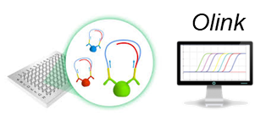
New technologies to overcome the challenge
Measure proteins in blood and CSF
Analysis of many samples / proteins
Covers different biological processes
Same reagents discovery - validation
Novel technologies!
Proximity Extension Assay (antibody/qPCR)
Can not measure all human proteins
(but protein library of >1000 proteins)
Optimal technology to develop novel biofluid biomarkers
Smooth translation discovery findings?! The PRIDE study

Slide 5
PRIDE: Protein identification to discriminate dementias
PART 1
?
PART 2

Slide 6
PRIDE: CSF proteins for specific diagnosis of AD
AD vs. non-AD dementias
(9-CSF marker panel)
n = 552
Discovery cohort
Protein levels
AUC = 0.873 [0.812-0.927]
We can detect specific AD biomarkers in CSF that reflect the diverse biology!

Slide 7
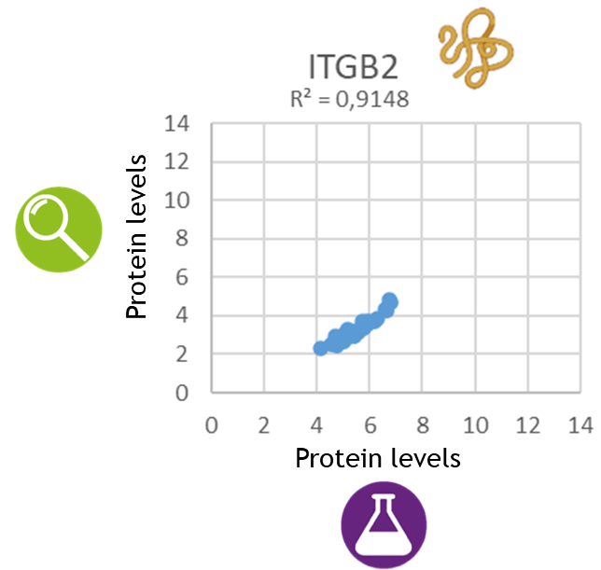
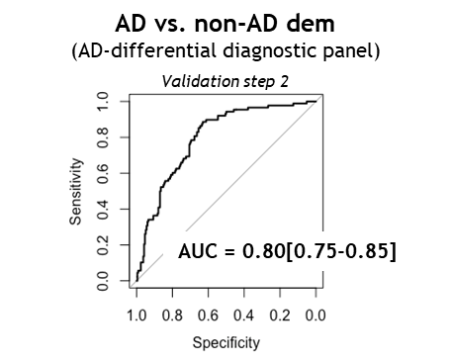
PRIDE: Optimal assay development
We can overcome the translation biomarker challenge!

Slide 8
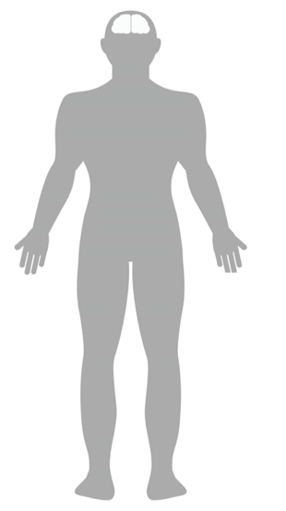
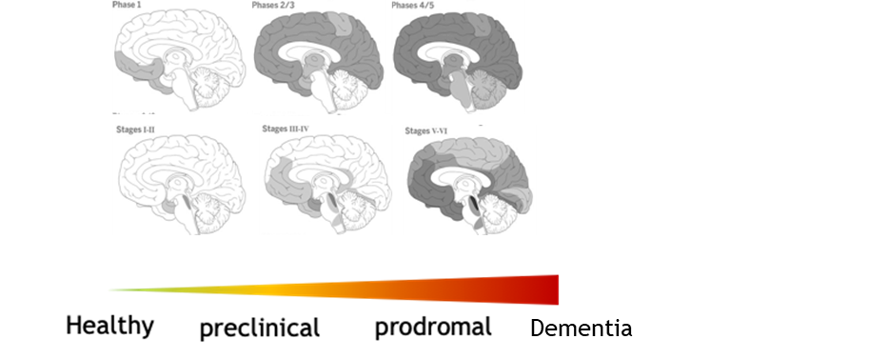
Cerebrospinal fluid (CSF)
Blood?
Alzheimer’s disease
(AD)
Dementia with Lewy bodies (DLB)
Frontotemporal dementia (FTD)
>1500 samples!

Slide 9
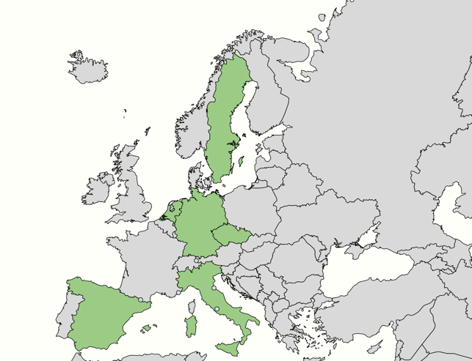
How can we perform bPRIDE?: Patient’s samples!
Same biobanking conditions
Great collaboration across specialized memory units!

Slide 10

bPRIDE workflow
1
2
3
4
Co.
CON
P2
AD
DLB
P3
PEA platform
FTD
P4
P5
P6
Simoa
Dementia proteome mapping
Diagnostic protein panels
Translation diagnostic assay
Independent validation

Slide 11
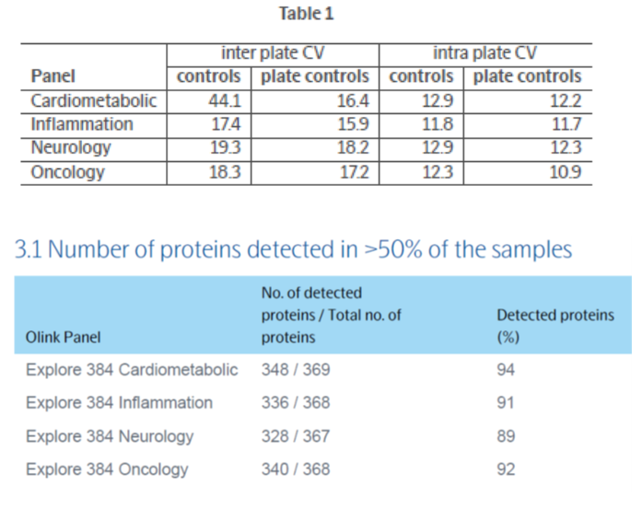
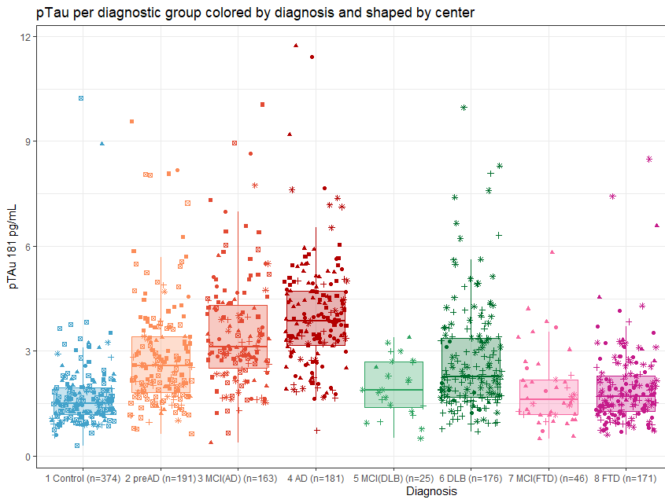
bPRIDE WP1: protein measurements
Quality check PEA proteomic platform
Preliminary Simoa data (pTau)
FTD
AD
DLB
> 1200 proteins optimally measured!
S. in´t Veld / I. Hanskamp / L. Vermunt

Slide 12
You never work alone….
NL, Dept of Clinical Chemistry
Charlotte Teunissen
Yanaika Hok-A-Hin
Lisa Vermunt
Lynn Boonkamp
Sjors in ' t Veld
Iris Hanskamp
…
Sant Pau Memory unit
Alberto Lleó
Daniel Alcolea
University of Melbourne
Colin Master
Christopher Fowler
Lund University
Oskar Hansson
Niklas Mattsson
Charles University
Jakub Hortz
Katerina Cechova.
Alzheimer Center, VUmc
Wiesje van der Flier
Yolande Pijnenburg
Afina Lemstra
Pieter Jelle Visser
Betty Tijms
Philip Scheltens
Perugia University
Lucilla Parnetti
Silvia Paciotti
Giovanni Bellomo
University of Ulm
Marcus Otto
Steffen Halbgebauer

