Slide 1
Optimization of community resources and systems of support to enhance the process of living with Parkinson’s Disease: a multisectoral intervention
Prof MC Portillo on behalf of Optim Park Consortium
28th April 2022
Brussels.

Slide 2
What is the focus of the Optim Park project?
What are participants’ needs, knowledge, attitudes, towards community resources and systems of support for better PD management?
Can an intervention involving different agents, sectors and levels of care be developed across countries to improve the access to resources in the community and the wellbeing of people with Parkinson’s Disease and family carers?
What could this intervention consist of?
Will the intervention be feasible?
How could the intervention benefit people with Parkinson’s Disease, family carers and other agents involved?
4 Countries involved: Denmark, Norway, Spain, UK

Slide 3
Multisectoral approach: collaboration between various stakeholder groups
macro (society structures at national or governmental levels),
meso (middle groups of organisations like communities, voluntary sector or neighbourhoods)
micro (local individual level e.g. personal networks) societal levels of action to achieve policy, health and practice related outcomes.
The foundations of this collaboration will be based on the principles of assistance, support, sharing and link, benefiting from the strengths of working together towards the promotion of better living with Parkinson´s Disease (Portillo et al 2017).
LIVING WITH LONG TERM CONDITIONS (LTC)
i.e. Parkinson´s Disease (PD)
SOCIAL SUPPORT AND COMMUNITY RESOURCES FOR PEOPLE WITH LTCs
MULTISECTORAL ACTION & OPTIMISING RESOURCES IN THE COMMUNITY BETTER LIVING WITH PD

Slide 4
The project at a glance
WP2 – Exploring what is know about the systems of support, and care available. Systematic literature review
WP3 – Examining and exploring the roles and working relationships and partnerships between sectors
WP4 - Feasibility trial and integrated care pathway for multisectoral action
WP5 – Sharing the study results and communicating with important stakeholders (dissemination and commuication)
WP1 – Establishing patient and public involvement in the research
WP 6 – Project Management

Slide 5
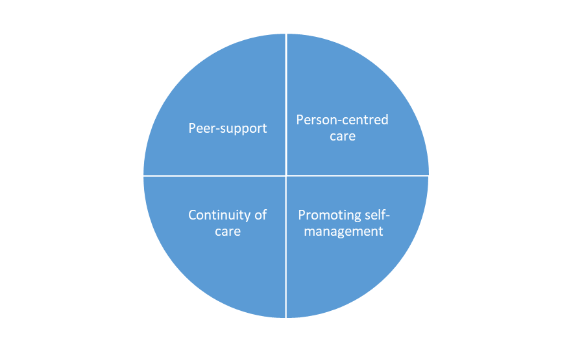
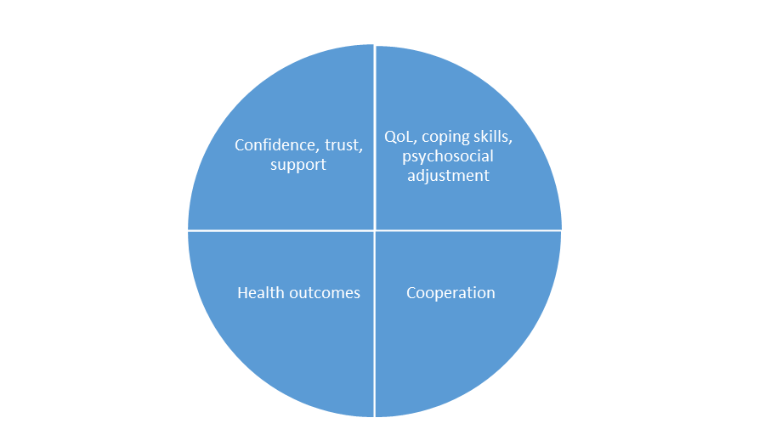
-Characteristics of disadvantaged populations and area -Specific policy. The Environmental Factors SERVICES, SYSTEMS AND POLICIES -SCOPING REVIEW. Multi-sectoral and integrated care initiatives for people with Parkinson’s Disease and their family carers: A scoping review
WP2

Slide 6
WP3- Clinical strategies and mechanisms to sustain a more connected system of care for better PD management in the community. Qualitative research
 | DK | NW | SP | UK | TOTAL
FC | 10 | 9 | 10 | 10 | 39
PwPD | 11 | 15 | 10 | 11 | 47
HCP | 10 | 10 | 11 | 10 | 41
STK | 9 | 9 | 10 | 11 | 39
 |  |  |  |  | 166

Slide 7
Successes and challenges. Lessons learnt
SUCCESSES
Adjustment to Covid-19 limitations and progress made.
Pre-doctoral, doctoral and post doctoral grants (2 Spain (Postdoc visits UK), 2 UK, 2 Norway)
Establishing basis for continuation and further implementation. Partners Project Applied Research Collaboration. Continuation Implementation project and also funding from Integrated Care Systems UK for coordinator role.
PPI
CHALLENGES
Covid, data management, agreements for intervention across countries, understanding of cultural differences and health/social care systems, working and supporting new researchers in the team remotely.
Notes:
What are/were the successes and challenges of your project? Lessons learned from working together across institutions.

Slide 8
How and to whom do we disseminate results?
WP5
The news: Consortium meeting hold in Madrid (Nov 2021) was shared in the webpage of the Autonomous University of Madrid: https://www.uam.es/uam/noticias/optim-park-2021
Local newspapers, websites.
An oral communication with findings from the cross-country analyses of the interviews in PwPD and FC was presented to the 25th International Virtual Nursing Research Conference, 15th- 19th Nov 2021.
Characteristics of vulnerable/disadvantaged populations in four European countries regarding health literacy and use of health care and social services. A document analysis. Under review. Parkinson´s Disease Journal.
Exploring Health and Social Services in Denmark, Norway, Spain and United Kingdom for the Development of Parkinson´s Care Pathways: a Document Analysis". Health and Social Care in the Community. Under review
Working title: Multi-sectoral integrated care initiatives for people living with Parkinson’s Disease and their caregivers: A review. Almost ready for submission
Soilemezi D, Palmar A, Navarta Sánchez MV, Roberts H, Pedraz-Marcos A, Kildal Bragstad L, Haahr A, Gabrielsen Hjelle E, Bjørnsen Haavaag S, Sorensen D, Portillo MC. 2022. Understanding systems of support for Parkinson’s Disease management: a cross-national qualitative study. International Journal of Nursing Studies. Submitted.
Soilemezi D, Roberts HC, Navarta-Sánchez MV, Kunkel D, Ewings S, Reidy C, Portillo MC (2022). Managing Parkinson’s during the COVID 19 pandemic: Perspectives from people living with Parkinson’s and health professionals. Journal of Clinical Nursing. Under second review.
The Minister of Health, Finance and Labour"- A Scandinavian Perspective on Living with a Partner with Parkinson’s Disease (Journal: Scandinavian Journal of Caring Sciences)
“The modern patient” – A Scandinavian perspective of how people with Parkinson disease perceive the meetings with the health care services” (Journal: International Journal of Qualitative Studies on Health and Well-being)
Portillo MC & Riverol Fernández M (eds) (2021) Convivir con la Enfermedad de Parkinson: un abordaje centrado en la persona (Living with Parkinson´s Disease: a person centred approach). Eunsa: Spain. Book. Published.

