Slide 1

28th April 2022
Integrated Parkinson Care Networks:
addressing complex care in Parkinson disease in contemporary society
2019 - 2022
JPND/JPco-fuND-2 Symposium
Project pitch session - Health and Social Care
28th April 2022

Slide 2
WHY iCARE-PD
Parkinson disease (PD) is a non-curable neurodegenerative disease with complex motor and non-motor care needs.
PD is the second most common neurodegenerative disorder and its incidence is expected to double by 2030.
PD is one of the top 10 most costly brain disorders in EU.
The need for services will increase and consequently the burden for healthcare systems.
HOW CAN WE ADDRESS COMPLEX CARE DELIVERY IN A MANNER THAT IS COST-EFFECTIVE AND SUSTAINABLE NOW?

Slide 3
iCARE-PD proposition
Shift from “(in)outpatient care” to “home-based community centred integrated health care”
Built from and by patients and care partners
Sustainability

Slide 4

Research Questions
A) ASSESSING NEEDS AND BARRIERS for CARE in PD:
# 1- WHAT are the views and needs of PwP, caregivers in a care delivery model based at home/community?
# 2- HOW can the implementation of care delivery model based at home/community be successful in different social geographies and health-economical contexts?
B) DEVELOPING TOOLS TO ADDRESS NEEDS AND OVERCOME BARRIERS:
#3 - How can state-of-the-art TEC optimize complex care delivery in PD?
#4 - How do we capture the overall impact of care in the lives of PwP?
C) IMPLEMENTING THE RESULTING PD CARE DELIVERY MODEL IN REAL LIFE:
# 5 - What is the real-life feasibility of a patient-centred multi-national integrated care delivery model

Slide 5
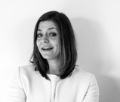
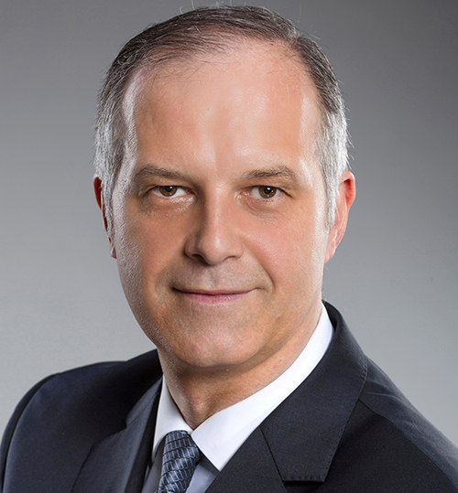
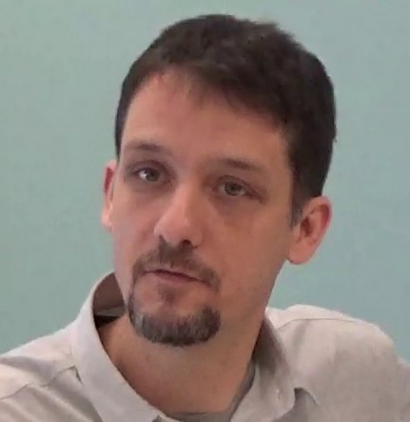
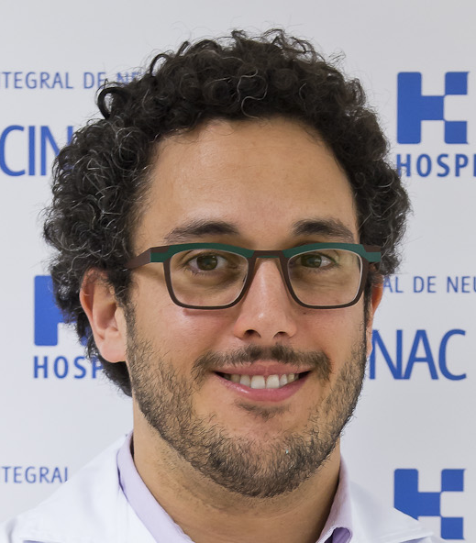
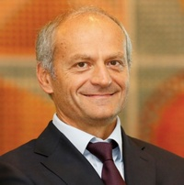
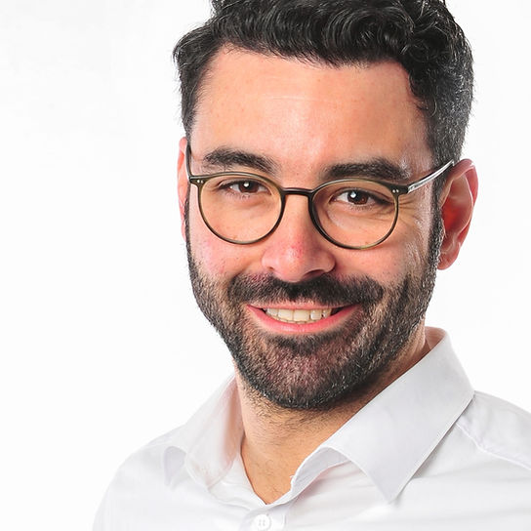
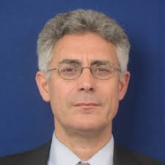
Work Packages
A) ASSESSING NEEDS AND BARRIERS for CARE in PD:
B) DEVELOPING TOOLS TO ADDRESS NEEDS AND OVERCOME BARRIERS:
C) IMPLEMENTING THE RESULTING PD CARE DELIVERY MODEL IN REAL LIFE:
HEALTH
ECONOMY
Nadége Costa
Richard
Dodel
HEALTH
GEOGRAPHY
Eric
Crighton
TEHCNOLOGY ENABLED CARE
Álvaro
Sanchez-Ferro
Angelo
Antonini
HOLISTIC MEASURES
Carsten
Eggers
CARE MODEL EVALUATION
Tiago
Mestre
Olivier
Rascol
Notes:
Multidisciplinary team of internationally recognized PD researchers, social scientists, health geographers, health economists, engineers, computer scientists, experts in law/ethics, patient-centred design, and complex interventions

Slide 6
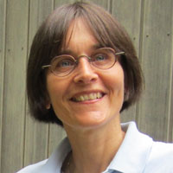
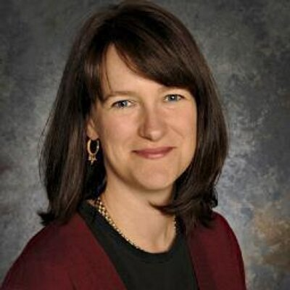
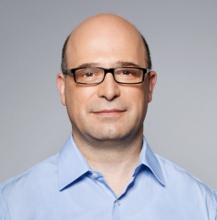
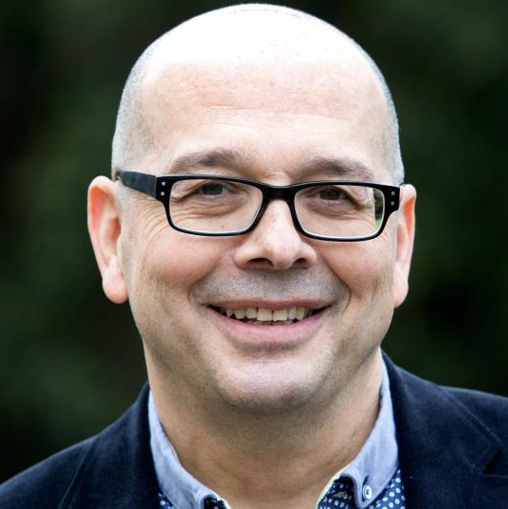
Matrix-based organization
WORK
PACKAGES
HEALTH –ECONOMY
HEALTH –
GEOGRAPHY
TECHNOLOGY ENABLED CARE
HOLISTIC MEASURE
CARE MODEL EVALUATION
CROSS-CUTTING GROUPS
CO-DESIGN
Sylvie
Grosjean
ETHICAL/LEGAL
Jennifer
Chandler
Bjorn Schmidt-Lund
TRAINING AND MENTORING
Joaquim
Ferreira
Evžen
Růžička
INTERNATIONAL
ADVISORY BOARD
STEERING
COMMITTEE
COORDINATOR SITE (CANADA)

Slide 7


Expected deliverables
Toolkit to develop and sustain Integrated Parkinson Networks for home-based community-centered care delivery
Development of a formal iCARE-PD nurse training program
Integrated digital health technologies validated by end-user
Comprehensive white paper on ethical issues and legal principles

Slide 8
Successes and challenges
Building a pan European-Canadian multi-disciplinary research network
Virtualization of research practices with COVID-19 pandemic
Care model implementation in COVID-19 pandemic
Notes:
● What are/were the successes and challenges of your project?
● Lessons learned from working together across institutions

Slide 9



Knowledge dissemination
INTERNATIONAL
ADVISORY BOARD
Advocacy within national research networks and Governmental/EU representatives

Slide 10
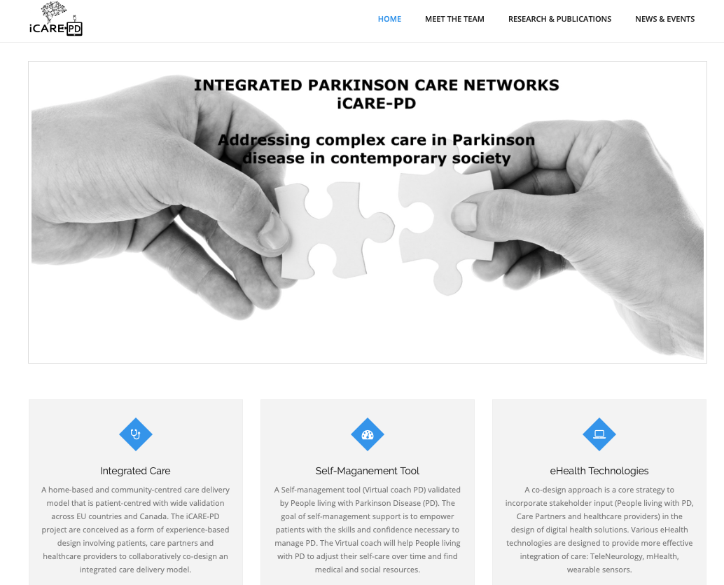
www.icare-pd.ca

Slide 11
iCARE-PD Annual Meeting

