Slide 1


PMG-AD: Personalized medicine approach for novel microglia-associated genetic variants in AD
Mikko Hiltunen
Professor of Tissue and Cell Biology
Director of UEF Neuroscience Research Community (NEURO-RC)
Institute of Biomedicine, University of Eastern Finland (UEF)
Kuopio, FINLAND

Slide 2
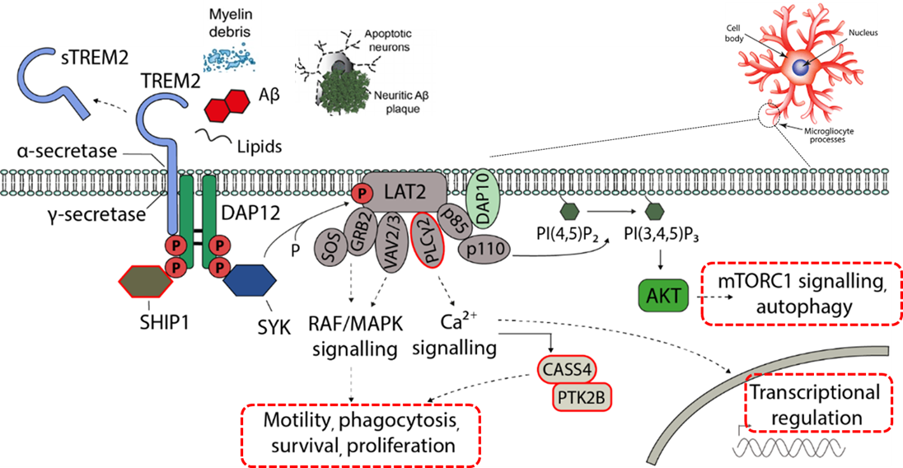
Rationale
Recent genetic and functional findings in Alzheimer’s disease (AD) strongly suggest an essential role for the innate immune system in the onset and progression of AD, underscoring the involvement of disease–associated microglia in the early stages of AD pathogenesis
Microglia
PMG-AD aims to establish a personalized medicine-based approach for identification of early biomarkers and therapeutic targets in AD by focusing on AD-associated genetic variants in ABI3 (S209F) and PLCG2 (P522R) genes

Slide 3
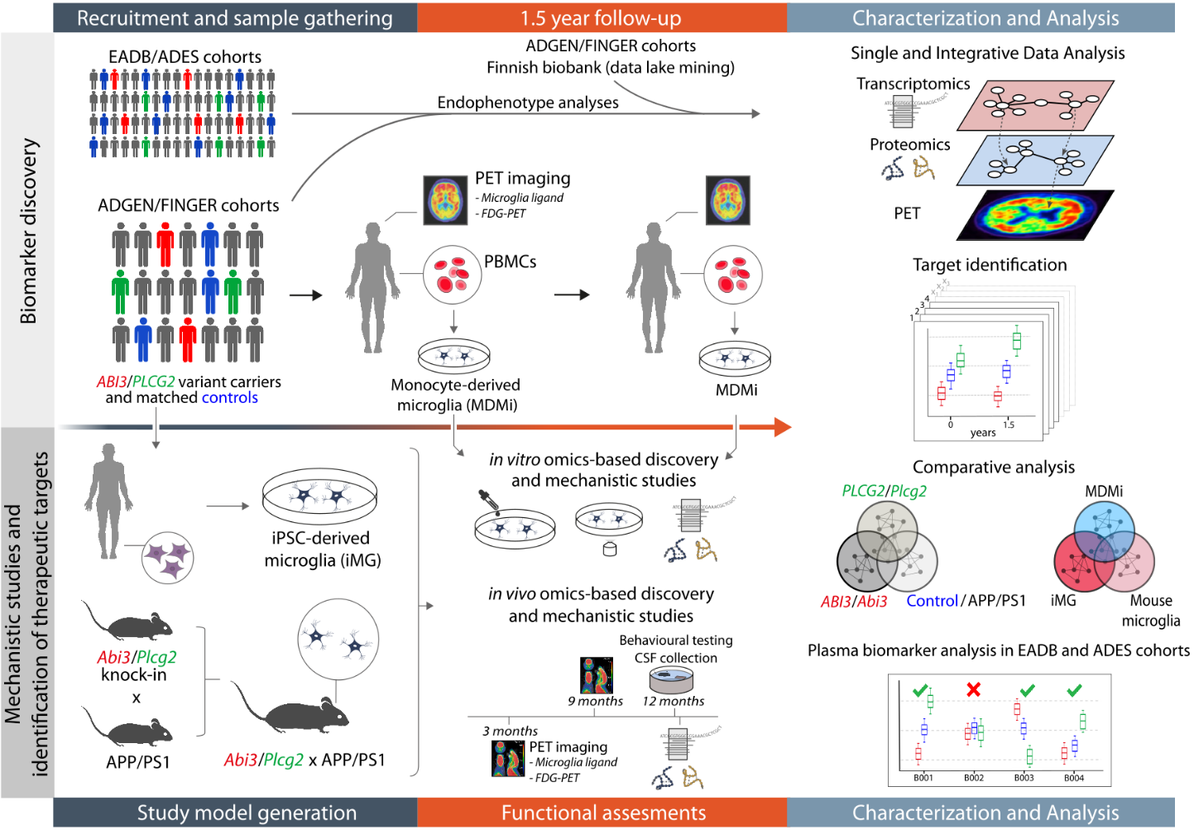
PMG-AD: Personalized medicine approach for novel microglia-associated genetic variants in AD, JPND-CO-Fund project (2020-2023)
Coordinator | FINLAND: Prof. Mikko Hiltunen, Institute of Biomedicine, University of Eastern Finland (UEF)
Partner 2 | FRANCE: Prof. Jean Charles Lambert, INSERM UMR 1167, Institut Pasteur de Lille (IPL)
Partner 3 | GERMANY: Prof. Christian Haass, Ludwig-Maximilians University Munich (LMU)
Partner 4 | FINLAND: Prof. Jari Koistinaho, Helsinki Institute for Life Science, Neuroscience Center, University of Helsinki (UH)
Partner 5 | GERMANY: Prof. Stefan Lichtenthaler, Technical University Munich (TUM)
*Academic collaborator: Prof. Juha Rinne,
Turku PET Center, Turku, FINLAND

Slide 4
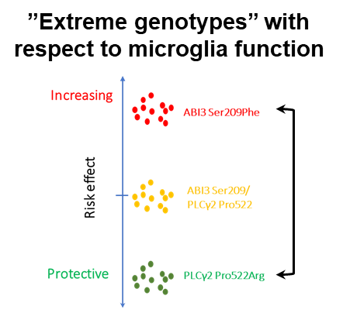
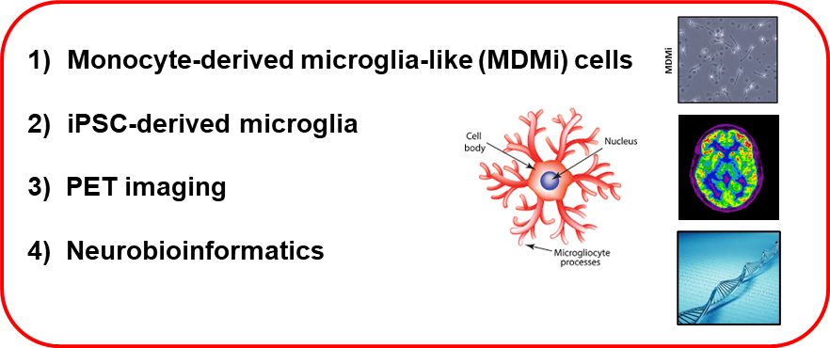
Aims in the translational part of PMG-AD
1) To determine the translational applicability and feasibility of novel AD-associated
microglia-specific risk gene variants
2) To evaluate similarities/dissimilarities between the different human microglial models
to be later applied in the personalized medicine approaches (MDMi vs. iPSC-derived microglia)
3) To uncover the capacity of PET-imaging to identify individuals in the asymptomatic phase
by focusing on microglia-specific disease-mechanisms

Slide 5
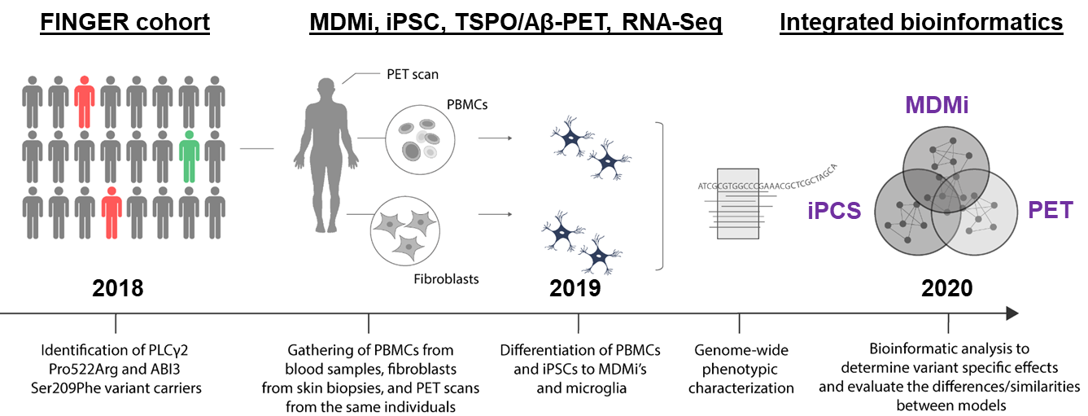
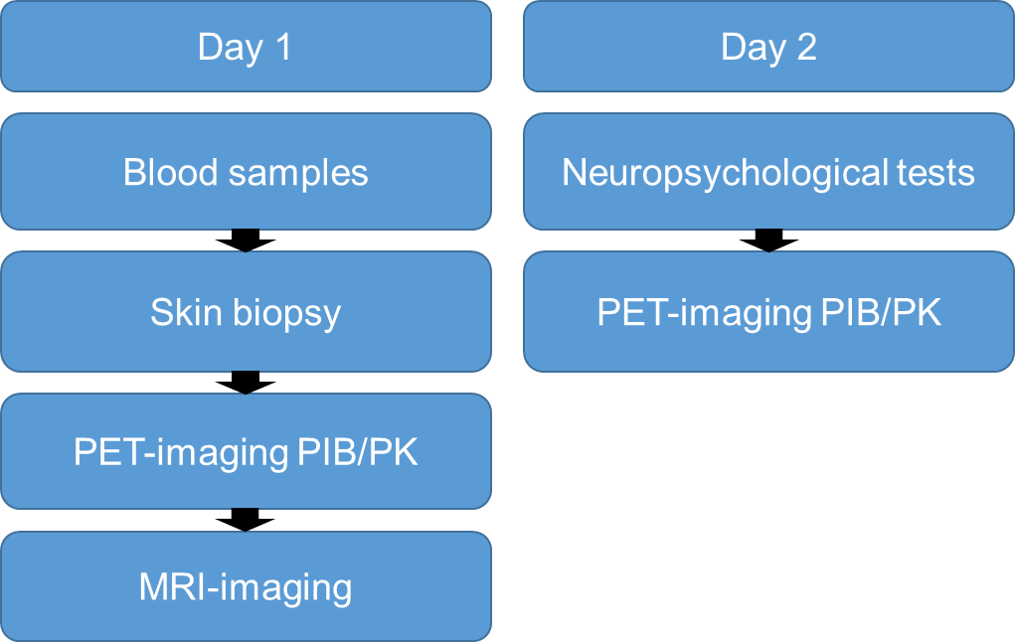
Sampling and analysis strategy in the translational part
Finnish Biobanks
Logistics at the Turku PET Centre
2018
THL, UEF, IPL
Auria Biobank
Turku PET Centre, UEF, UH,
TUM, IPL, LMU
Ethical approvals, legal issues with the Finnish biobanks, recruitment of study subjects, and logistics have been successfully resolved = Personalized medicine platform for translational research established!

Slide 6
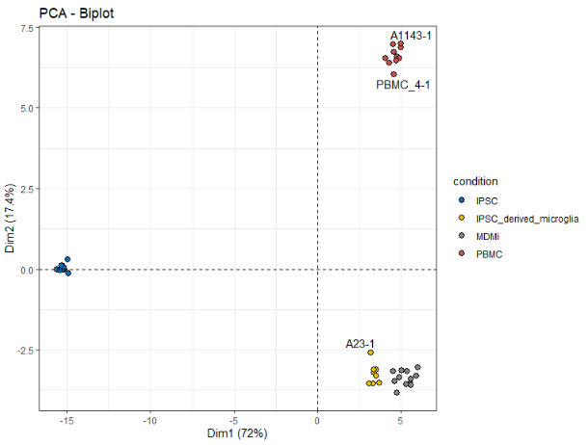
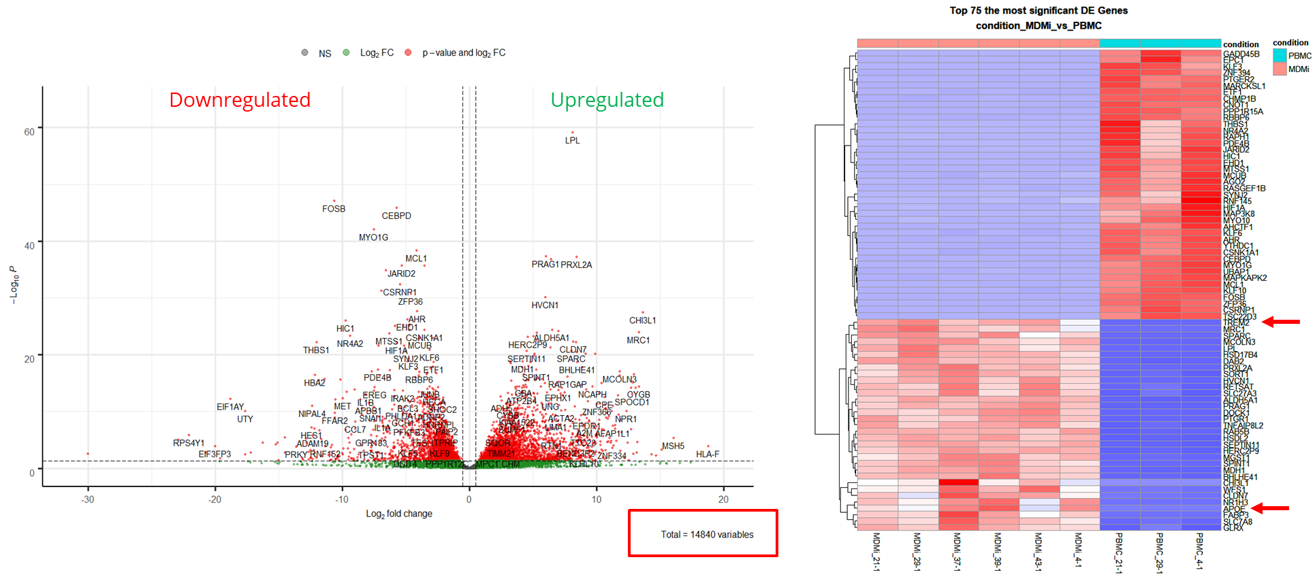
Chracterization of human monocytes vs. monocyte-derived microglia (MDMi) vs. iPSC-derived microglia (iMG)
Clustering of monocytes, iPSC, MDMi and iMG according to RNA-seq data
MDMi vs. monocytes: Consistent expressional changes of expected targets in MDMi cells (e.g. TREM2, LPL, APOE)
Monocytes
iPSC
MDMi/iMG
MDMi and iMG cells cluster similarly in terms of the global expression profiles
Takalo/Martiskainen et al., unpublished

Slide 7
Aims in the mechanistic part of PMG-AD
To characterize the microglia-specific mechanism(s) of ABI3 and PLCG2 variants in molecular, cellular, and functional processes relevant for AD in Abi3-S209F and Plcg2-P522R knock-in mouse models crossed with transgenic AD mice (APP/PS1 mice) as well as in human MDMi and iMG cells from genetically defined ABI3 and PLCG2 individuals
Abi3 x APP/PS1 part is ready → Key findings were successfully replicated in MDMi and iMG cells (Khojasteh-Fard et al., manuscript in preparation)
Plcg2 x APP/PS1 mice have been analyzed and sacrificed → IHC, biochemical and omics-based analyses will be ready at the end of 2022

Slide 8
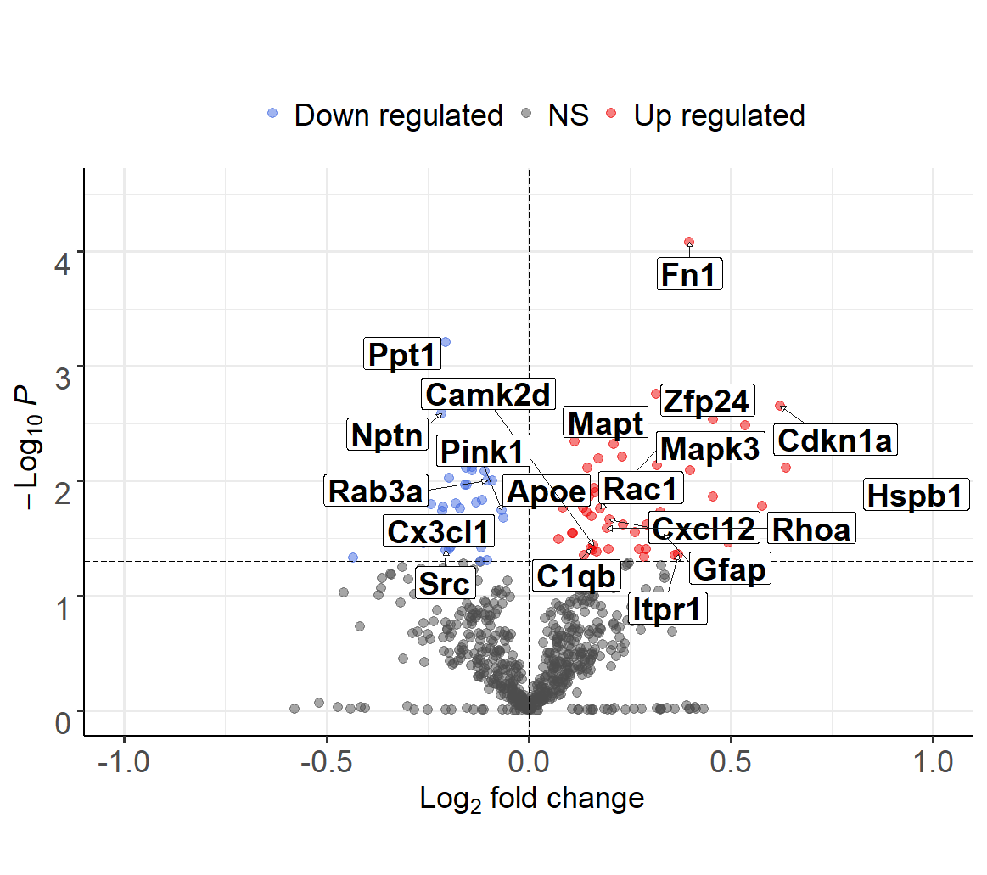
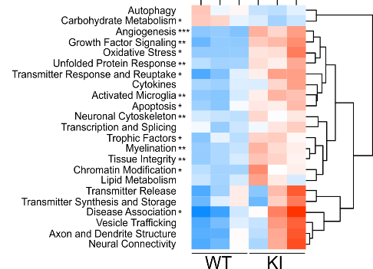
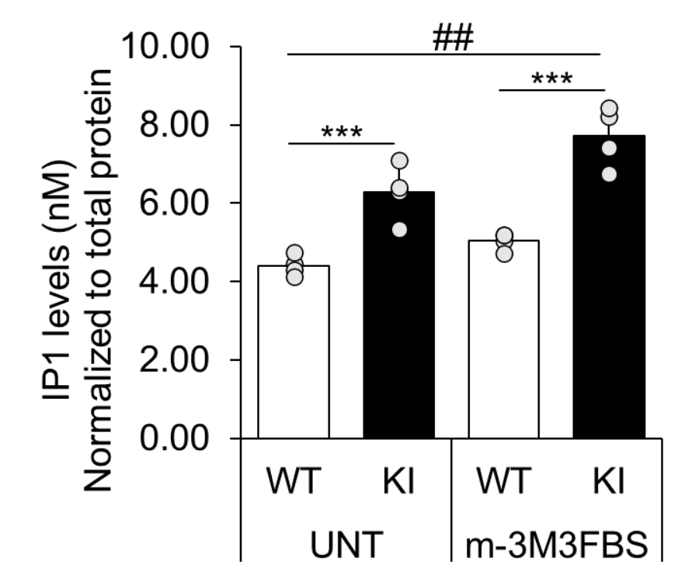
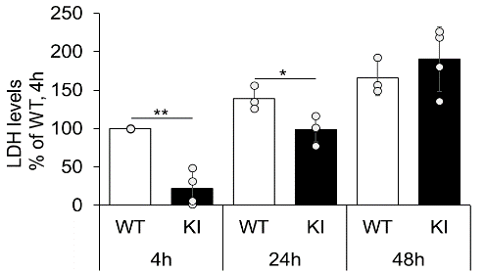
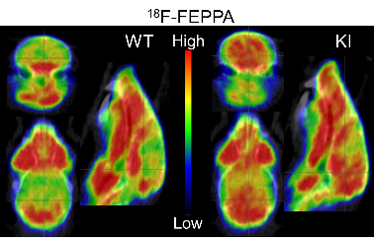
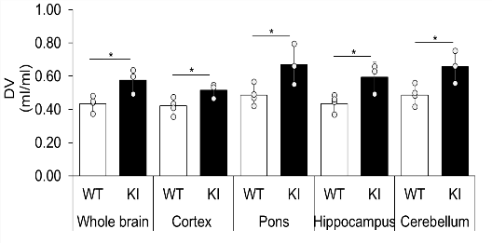
AD-associated protective Plcγ2-P522R variant enhances immune cell functions and promotes microglia activation (UEF and LMU)
Homozygous knock-in (KI) mouse line expressing the Plcγ2-P522R variant
Nanostring-based expression analysis in the brain of Plcγ2-P522R KI mice
Functional assessments in macrophages from Plcγ2-P522R KI mice
Microglia-specific PET analysis of Plcγ2-P522R KI mice
Takalo et al., Molecular Neurodegeneration 2020

Slide 9
Dissemination, PPI activities and challenges
PMG-AD has organized regular meetings (every ∼3 months), in which the PIs and early-stage researchers (ESRs) have presented the progression reports, potential problems and results → Objectives/collaboration activities for forthcoming months have been outlined accordingly
PMG-AD organized remotely on 8th of June 2021 a one-day mid-term meeting, focusing on both 1) scientific progress of the subprojects given by ESRs and 2) patient and public involvement (PPI) activities → PMG-AD invited clinicians working in the field of neurodegenerative diseases, medical geneticists as well as researchers working on the field of neuro-ethics and law from the participating countries
PMG-AD will organize a side event exclusively focusing on PPI activities related to different EU-funded projects during the 9th Kuopio Alzheimer’s disease Symposium (August 23rd, 2022) → Event includes participants from patient organizations, clinicians, students, patients, and companies
Due to COVID19 lock-down in 2020 and the subsequent restrictions, recruitments and further analyses of ABI3-S209F and PLCG2-P522R variants carriers and respective controls have been significantly slower than initially planned → Translational part has been delayed

Slide 10
Outcomes and the added value of PMG-AD
PMG-AD has determined the translational applicability of novel AD-associated microglia-specific risk gene variants by assessing the effects of PLCG2 P522R and ABI3 S209F on microglia function and activity → Novel variant-specific mechanisms and biomarker targets have been already discovered!
PMG-AD has set up a translational research platform for assessing microglia-specific genetic risk variants in AD, which is unique in the global scale → Scientific renewal by promoting movement away from the neuron-centric view in aiming to understand molecular mechanisms in AD
PMG-AD has significantly promoted international collaboration between researchers, clinicians and patient organizations as well as established best practices in the personalized medicine by combining basic research, clinics and biobanks
It is expected that results obtained from PMG-AD will be used to develop tangible applications and personalized medicine-based tools, which will be integrated to patient care and prediction in the clinics and biobanks

Slide 11







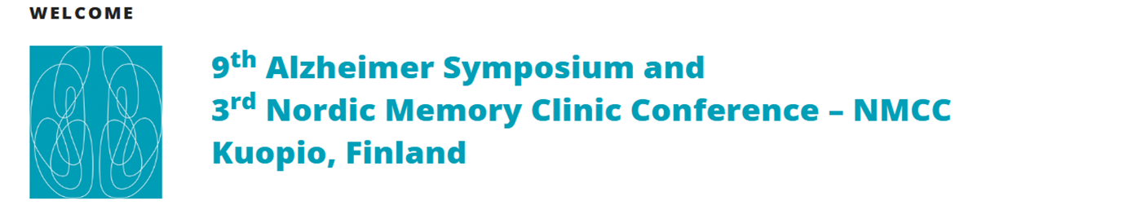

Mari Takalo
Henna Martiskainen
Susanna Kemppainen
Petra Mäkinen
Mikko Hiltunen
Devrim Kilinc
Jean Charles Lambert
Maryam Khojasteh-Fard
Christian Haass
Taisia Rolova
Jari Koistinaho
Stephan Mueller
Stefan Lichtenthaler
Mikko Koivumäki
Juha Rinne
Contact information:
Mikko Hiltunen, Professor
Institute of Biomedicine, UEF, Kuopio, FINLAND
mikko.hiltunen@uef.fi, 0403552014,@HiltunenLab
23-25th of August, 2022
https://blogs2.uef.fi/kuopioadsymposium/
@KuopioAD

