Slide 1
GBA – personalised medicine for Parkinson disease: clinical and therapeutic stratification (GBA-PaCTS)
JPND/JPco-fuND2 Midterm Symposium
Brussels, April 28th 2022
Dr Elisa Menozzi

Slide 2
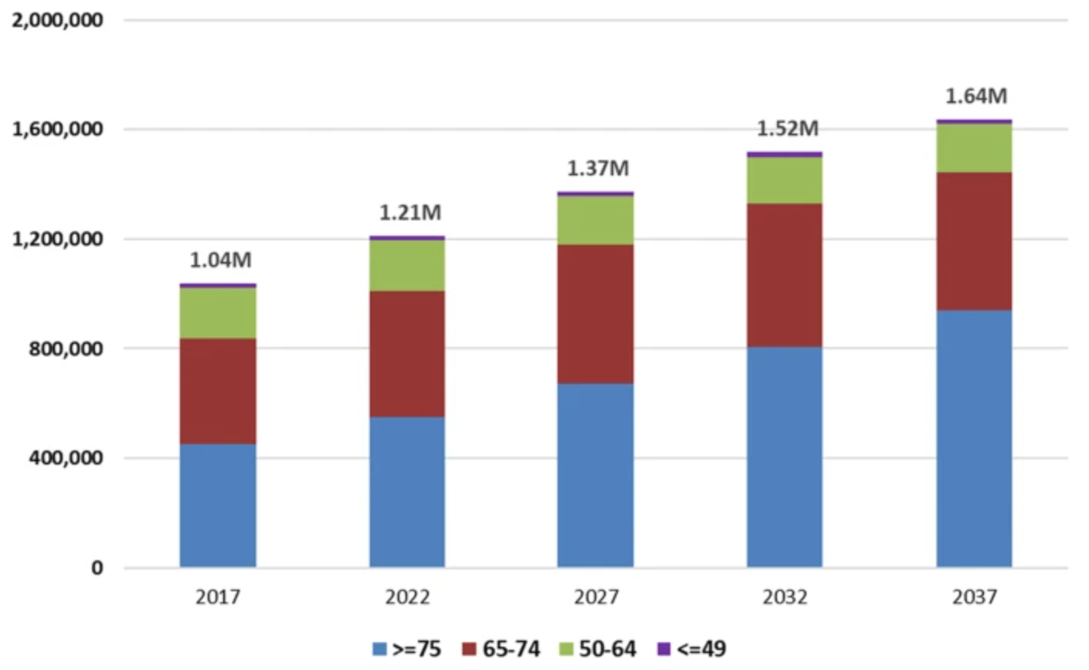
Social burden of Parkinson disease (PD)
PD has a lifetime risk of 4%
Approx. 60,000 new cases/year in EU
Between 1990 and 2015, the number of people with PD doubled to over 6 million
By 2040, over 12 million people will be affected
Vossius, 2009; Savica, 2016; Weir, 2018; Yang, 2020
Notes:
Yang, W., Hamilton, J.L., Kopil, C. et al. Current and projected future economic burden of Parkinson’s disease in the U.S.. npj Parkinsons Dis. 6, 15 (2020). https://doi.org/10.1038/s41531-020-0117-1

Slide 3
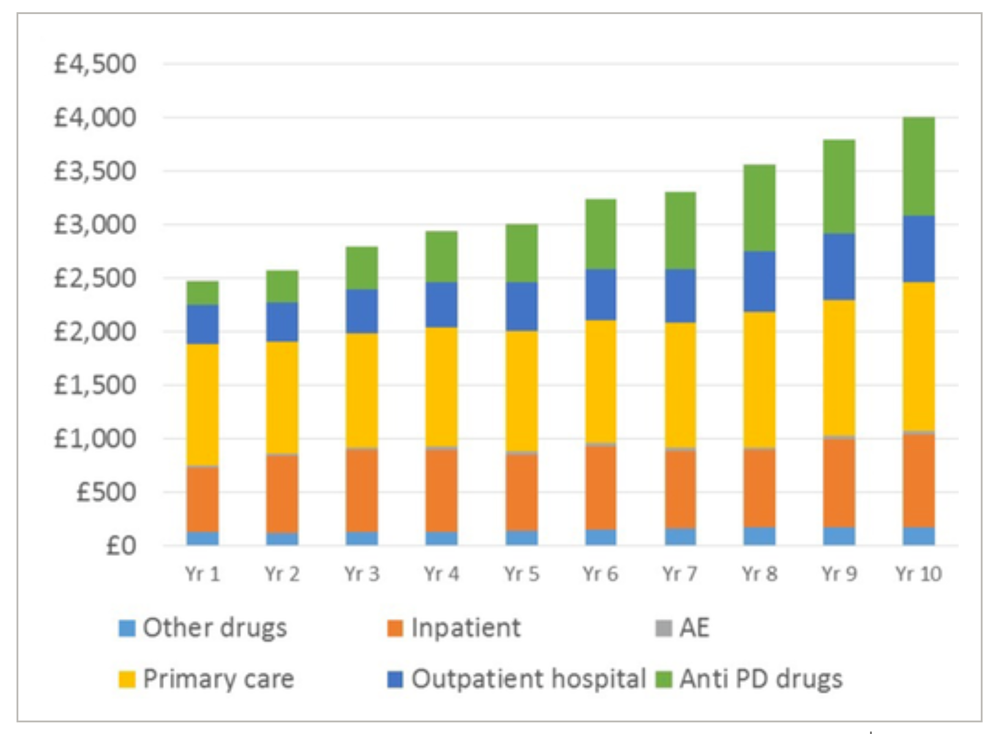
Economic burden of PD
PD-related costs in the EU ~13 billion euros/year
Patients with PD cost ~5 times more for nursing home care and ~4000 euros more for general health care than average population
3 months delay in PD progression could cover the cost of 1 patient drug treatment for their lifetime
Vossius, 2009; Weir, 2018; Yang, 2020
Notes:
Yang, W., Hamilton, J.L., Kopil, C. et al. Current and projected future economic burden of Parkinson’s disease in the U.S.. npj Parkinsons Dis. 6, 15 (2020). https://doi.org/10.1038/s41531-020-0117-1

Slide 4
Aims of the project
Recruit and harmonise assessment strategies of GBA1-PD patients and GBA1 carriers across different countries (UK, Italy, Germany, Spain)
Collect multiple samples from participants (saliva, blood, fibroblasts) to evaluate biochemical and inflammatory markers
Use in vitro (human iPSc, 3D organoids, primary neuronal cultures) and in vivo models to study biochemical consequences of GBA1 variants on α-synuclein spread, mitochondrial and immune function
Evaluate effect of GBA1 targeted therapies (Ambroxol) to reverse pathological events that can precipitate PD pathology
Notes:
3. To use cell (human iPS, 3-D organoids, primary neuronal cultures) and animal models to study the biochemical consequences of GBA1 mutations on A-SYN levels, aggregation and spread, innate immune function, exosome and mitochondrial function and free radical metabolism.
4. To examine the effects of ambroxol as an archetypal GBA1 chaperone to reverse the downstream biochemical events that participate in and accelerate the PD pathogenetic pathway.

Slide 5
Consortium
WP1: Clinical cohorts
UCL, UK
Mondino Foundation, Italy
DZNE,Tubingen, Germany
Instituto de Investigacion Sanitaria de Navarra, Spain
WP2: Inflammatory & biochemical markers
Mondino Foundation, Italy
University of Milan, Italy
Instituto de Investigacion Sanitaria de Navarra, Spain
WP3: iPSCs & 3D organoids
DZNE,Tubingen, Germany
DZNE, Bonn, Germany
UCL, UK
WP4: Mouse models
UCL, UK
DZNE, Bonn, Germany
WP5: Ambroxol studies
UCL, UK
Mondino Foundation, Italy
University of Milan, Italy
DZNE,Tubingen, Germany
DZNE, Bonn, Germany
Instituto de Investigacion Sanitaria de Navarra, Spain
Notes:
Work packages are integrated and interconnected.

Slide 6
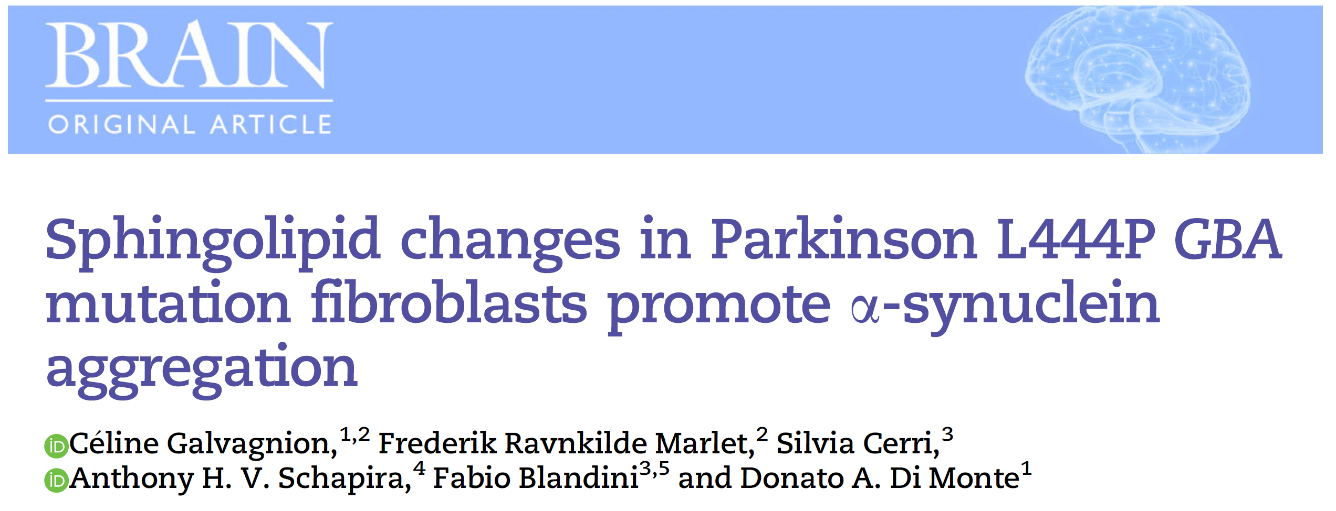
How the Consortium works: an example from real-life
Mondino (Italy),
UCL (UK)
Fibroblast collection
DZNE (Germany)
Cell culture exp
DZNE (Germany), UCL (UK)
Ambroxol studies
Lipidomics

Slide 7
Challenges
Not all GBA1-PD are the same; they differ from both a clinical and biochemical perspective
Characterisation of genetic, clinical and biochemical phenotypes is crucial to understand the impact of different genetic variants
Knowledge of the cascade of biochemical events in PD pathogenesis is required to identify disease-modifying mechanisms

Slide 8
Expected outcomes of the project
Recruit and comprehensively phenotype an international, EU cohort of GBA1 carriers and GBA1-PD
Detect shared and variant-specific clinical features in GBA1 carriers (different geographical and genetic background)
Establish a combined clinical-biochemical biomarker to identify GBA1 mutant carriers at higher risk of developing PD
Expand available preclinical evidence of Ambroxol as both disease-modifying and preventive treatment
Notes:
Ambroxol: understand drug more completely, understand which could be better molecular target, also for clinical trails (outcome).

Slide 9
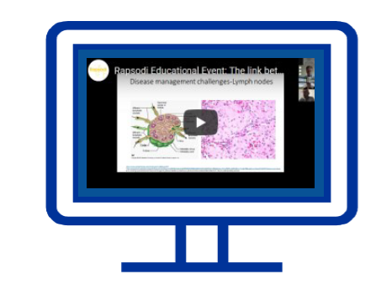
Patients/Public Involvement: UK experience
https://www.youtube.com/channel/UCdsOHwDsn_yaunfAxAnkM7A
https://cureparkinsons.org.uk/2021/11/pd-frontline/
Webinars
RAPSODI Educational Events (yearly)
Cure Parkinson’s Research Updates
Online platform and newsletter
Social media platform
@RapsodiRFH, @PDFrontline
https://rapsodistudy.com/en
https://pdfrontline.com/en
Involvement of Jewish community across the UK
Feedback from our patients
"If there was anything I could do to help in this research programme I would be there like a shot"

Slide 10
Thank you for your attention
C Galvagnion, et al. Sphingolipid changes in Parkinson L444P GBA mutation fibroblasts promote α-synuclein aggregation. Brain. 2022.
SY Yang, et al. Ambroxol reverses tau and α-synuclein accumulation in a cholinergic N370S GBA1 mutation model. Hum Mol Genet. 2022.
M Gegg, et al. Glucocerebrosidase-associated Parkinson disease: Pathogenic mechanisms and potential drug treatments. Neurobiol Dis. 2022.
AL Higgins, et al. The remote assessment of parkinsonism supporting the ongoing development of interventions in Gaucher disease. Neurodegener Dis Manag. 2021.
E Brunialti, et al. Inhibition of microglial β-glucocerebrosidase hampers the microglia-mediated antioxidant and protective response in neurons. J Neuroinflammation. 2021.
Consortium publications to date on this grant

