Slide 1

Joint Programming in
Neurodegenerative Disease Research (JPND) toward a brain health partnership
JPND / JPco-fuND mid-term Symposium
28 April 2022, Brussels
Prof. Philippe Amouyel, MD, PhD
JPND Chair
France

Slide 2
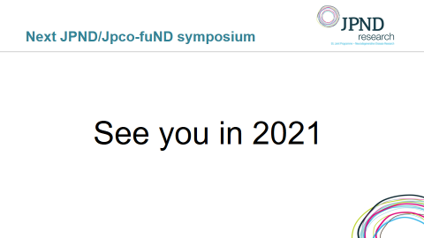
JPND / JPco-fuND Symposium,
27-28 November 2019, Brussels

Slide 3


Slide 4
JPND / JPco-fuND Symposium
Showcase and dissemination of up-to-date research achievements of JPND-supported projects to all relevant stakeholders.
Networking and knowledge exchange between JPco-fuND projects and other JPND-supported projects, as well as among other conference attendees.
Train young scientists from the JPND-funded projects.

Slide 5
JPND / JPco-fuND2 mid-term Symposium
Plenary sessions (Auditorium)
  Research infrastructure for Neurodegenerative Diseases
  JPND global approach
  Audience discussion
Parallel scientific sessions on 30 JPND/JPco-fuND-2 projects’ progress and achievements
  1. Health and Social Care (Room S / a.m. & p.m.)
  2. Personalised medicine (Auditorium / a.m.)
  3. Personalised medicine (Room U / a.m. & p.m.)
  4. Pathway Analysis (Auditorium / p.m.)
Poster exhibition (foyer) and award ceremony (Auditorium)

Slide 6
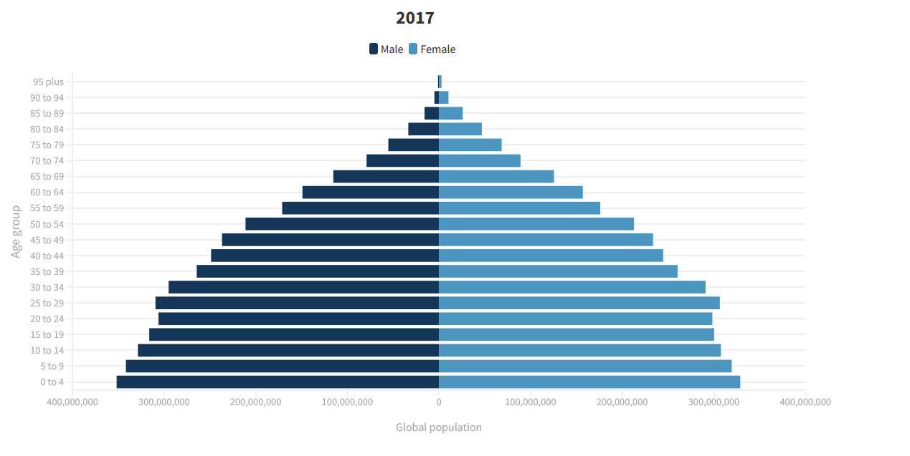
Global population age structure
Global Burden of Disease 2019, Lancet, 2020

Slide 7
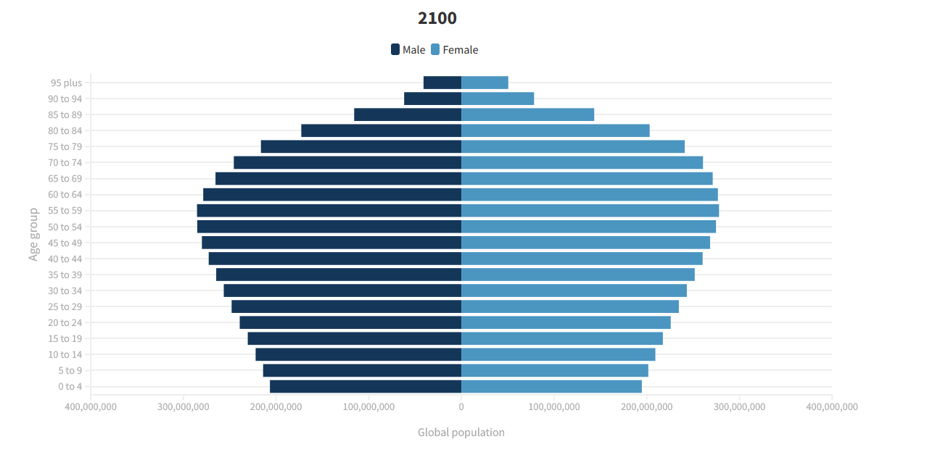
Global population age structure
Global Burden of Disease 2019, Lancet, 2020

Slide 8
The size of the problem is always the same
380 million patients
800 billion Euros annually
in Europe alone

Slide 9
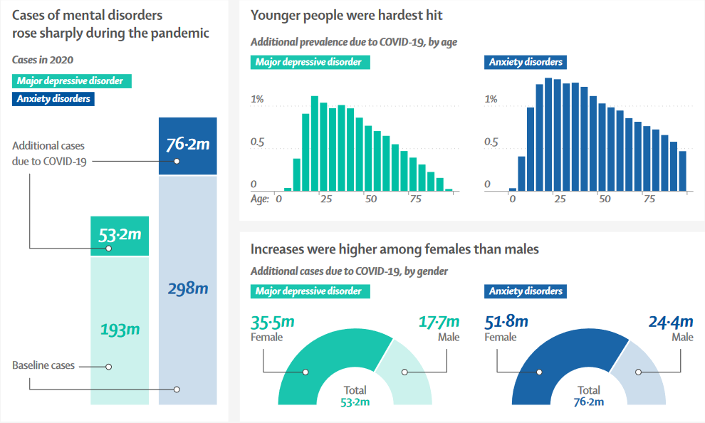
Increase in the cases of mental disorders during the pandemic
Santomauro DF et al., Lancet, 2021

Slide 10
How can Europe address the challenge of brain health?
Capitalising on existing international initiatives
Facilitating access to infrastructures and resources
Structuring the brain research area
Reinforcing public patient involvement
Accelerating research transfer and innovation

Slide 11
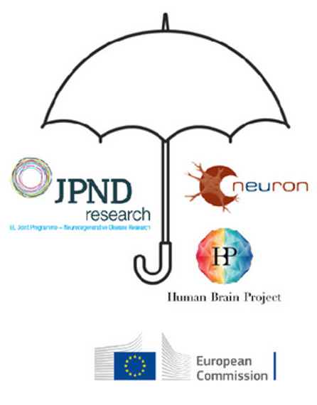
Bringing all brain research initiatives under one umbrella

Slide 12



Improving access and sustainability to infrastructures and resources
European Medical Information Framework
European Bank for Ipsc
European Brain Research infrastructure
Creation of the European Health Data Space
….

Slide 13


Strengthening collaborations within initiatives
Developing a common research agenda for brain research in Europe
Identifying strengths and gaps
Accelerating the transfer from bench to patient
Favouring public-private partnerships

Slide 14
Fostering public patient involvement in brain health research
Acculturation of scientists and physicians to PPI
Training public, patients and patient advocates
Active participation of public and patients in research projects
Call topics encouraging public and patient involvement

Slide 15
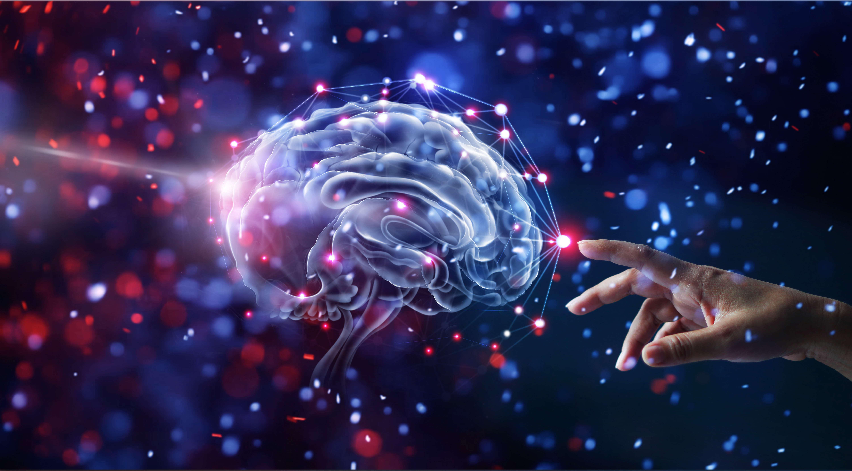

Toward a future partnership on brain health in the 2nd strategic programme of Horizon Europe (2025)

Slide 16

Practical information
Visit the posters in the foyer
Poster award ceremony at 5:20 pm
After the concluding remarks you are invited to a networking and refreshment opportunity in the foyer
Tweets about our symposium
  #jpnd
  #jpndsymposium2022
  #neurodegeneration
@JPNDEurope

