Slide 1
multi-DOMain Lifestyle Targets for Improving ProgNOsis in Huntington’s Disease
Cardiff, UK
Ireland
Switzerland
Poland
Germany
Spain
RAND, USA
EHA
DOMINO-HD is funded though the EU joint program for Neurodegenerative Disease Research as part of the JPND funding call in to Health and Social Care (2019) with funding from Alzheimer’s Society, Secretary of State for Health and Social Care, Health and Care Research Wales, Public Health Agency Northern Ireland, Jacques and Gloria Gossweiler Foundation, Bundesministerium für Bildung und Forschung, Narodowe Centrum Badań i Rozwoju, Swiss National Science Foundation (SNF), 32ND30_185548 and Health Research Board (JPND-HSC-2018-003).

Slide 2
Tackling the societal challenge of HD?
HD is progressive and life-limiting with devastating consequences for the individuals living with HD and their families.
No current treatment to modify the course of the disease exists.
DOMINO-HD is working towards a comprehensive understanding of modifiable lifestyles that may be responsive to targeted interventions.
DOMINO-HD is integrating prospective longitudinal physical activity and sleep tracking with nutrition assessments and novel as well as more commonly used clinical assessments and outcomes to explore the interplay between multi-domain environmental factors and HD outcomes.
This emerging information has the potential to inform the development of personalised multi-modal environmental interventions.
Notes:
How does your project contribute to tackling the societal challenge of neurodegenerative diseases?

Slide 3
DOMINO-HD Primary objective
Original primary objective: Determine whether lifestyle factors and their interplay with genetic risk are linked to Huntington's Disease (HD) progression.
Severely impacted by COVID-19 (new end date 31 August 2023); unable to achieve initial longitudinal recruitment targets (including for genetic studies) but have capitalised on the exploratory studies for new learning.
Revised primary objective: Explore the feasibility of linking lifestyle data with clinical indices of the severity of HD through the conduct of a 12-month longitudinal observational study.

Slide 4
DOMINO-HD Secondary and exploratory objectives (sub-studies)
Explore views across the HD community on using wearable activity trackers to monitor lifestyle behaviour.
Validate Fitbit activity trackers for measurement of physical activity and sleep in people with manifest HD.
Characterise speech and fine motor control in HD.
Develop methods to compute dietary intake using currently available instruments (FFQ).
Propose a feasible lifestyle index for HD (LIFE-HD).

Slide 5
Outcomes to date: Longitudinal study
HD participants (n=101) across 4 clinical sites have performed baseline lifestyle assessments (nutrition, physical activity, and sleep). RECRUITMENT CLOSED; in follow-up. Extension to 31 August 2023.
Fitbit data collected ongoing over 12-months (13,860 days and 9432 nights of sleep).
Mean step count 8783.07 steps per day; mean total sleep time: 378.9 minutes 97.43 mins; mean sleep efficiency: 87.8; mean sleep fragmentation index: 3.08 awakenings/hour.
Strong correlations between step count and heart rate metrics; no correlation between sleep and activity metrics.
Linkage of lifestyle dataset to clinical data available via Enroll-HD global observational study https://enroll-hd.org/.

Slide 6
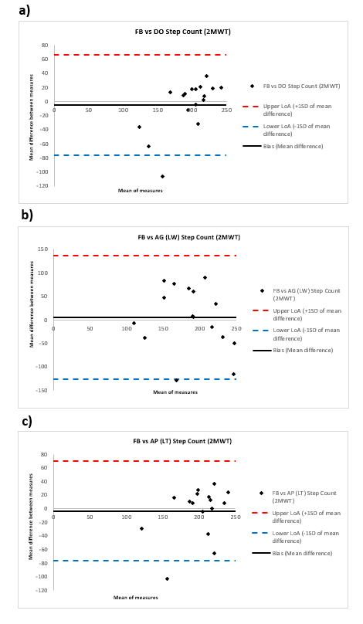
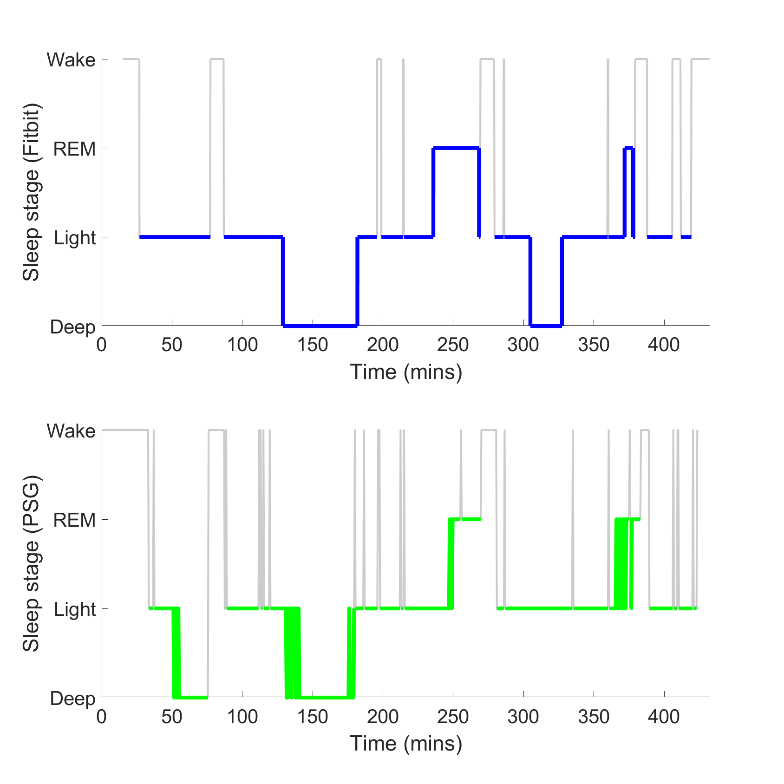
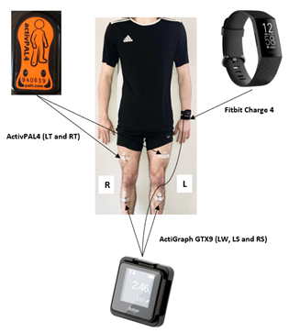
Outcomes to date: Sub-studies
Activity tracker acceptability study highlighted importance of compatibility, accuracy and data security.
Overnight sleep assessment in a supervised clinical environment: Fitbit compared to polysomnography (PSG) suggests that Fitbit Charge 4 provides a valid sleep staging evaluation.
7-day in-home and in-clinic step count validation studies indicate good to excellent reliability of Fitbit Charge 4.
Fitbit Charge 4 found to overestimate energy expenditure when compared to gold standard indirect calorimetry.

Slide 7
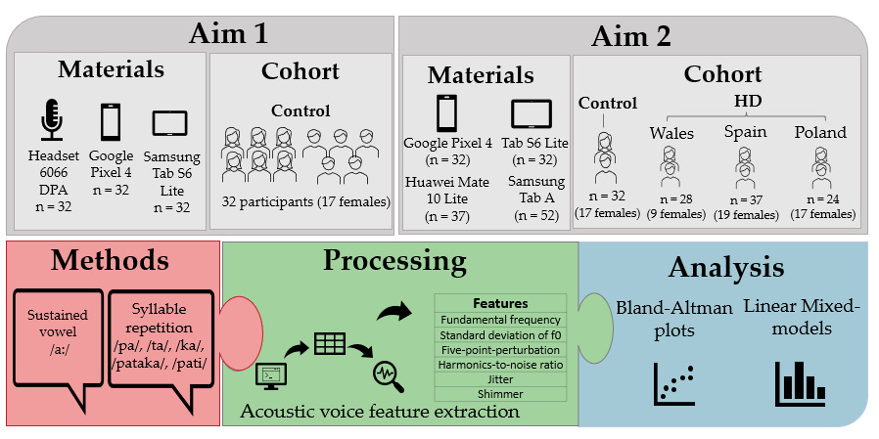
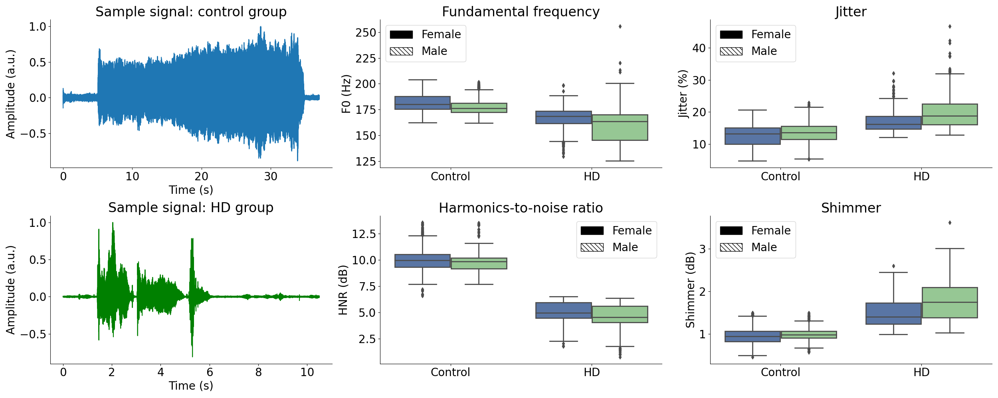
Outcomes to date: Sub-studies
Preliminary results show a significant difference in fundamental frequency across English-speaking groups.
Language-matched control groups for Spanish and Polish speakers are currently being recruited.
Mobile devices were validated for assessment of speech in clinic settings with frequency-based acoustic voice features for structured voice tasks, such as vowel phonation and syllable repetition.

Slide 8
Next steps and expected outcomes: what does this mean for the HD community?
Rigorous validation studies in controlled settings in patient-specific population are essential in advance of clinical application of wearable sensors to aid interpretation of lifestyle data and provide unique insights in HD.
Analyses of baseline data to propose a novel HD lifestyle index (LIFE-HD).
LIFE-HD score may be useful in exploring lifestyle associations with HD progression.
Focus groups to discuss emerging data for the generation of lifestyle interventions.
Online Delphi process among health professionals working in HD settings to agree on key components of a multi-domain lifestyle intervention for HD.
Clinical and lifestyle data to be made accessible to researchers upon scientific request.

Slide 9
Successes, challenges & lessons learned
Successes. Progress and novelty across multiple work packages despite many challenges not least Covid-19. Linkage to Enroll-HD provides critical platform for longitudional follow up. The largest dataset of its kind is to be made available to the HD community. Patient and Public Involvement Award.
Challenges. Consortium and individual partner requirements for funding, contracting, governance (EU, Switzerland, and the UK); Technical challenges (physical activity and sleep measurements); Data protection impact assessment (dealing with Fitbit data provided to a central cloud-based system); Staffing; ECR mobility and delays; protocol amendments to mitigate for Covid-19; Recruitment challenges; limited GWAS sample.
Lessons learned. Partnership working is valuable in seeking solutions to problems. Excellent opportunities for ECRs within a consortium such as DOMINO-HD. Ensuring a minimum dataset and early planning for mitigation of risk is essential in large consortia.

Slide 10
Dissemination and Public Involvement
Consortium publication policy in place agreeing authorship criteria for primary study as well as all validation studies; various manuscripts in draft or in submission.
Public meetings Bucharest (European Huntington’s Association).
Public and Patient Involvement workshops Amsterdam, Cardiff, Burgos, Warsaw.
Extensive representation from ECRs at the European Huntington’s Disease Network virtual meeting in September 2021; planned attendance at EHDN 2022.
ECR abstracts: International Society of Electrophysiology and Kinesiology 2022; Royal Statistical Society Conference 2021; Annual International Conference of the IEEE Engineering in Medicine and Biology Society 2022.
DOMINO-HD blog for Rare Diseases day 2022: https://blogs.biomedcentral.com/on-medicine/2022/02/24/rare-disease-day-2022-how-can-we-improve-research-in-rare-diseases-isrctn/

