Slide 1











SORLA-FIX consortium
Henne Holstege Amsterdam UMC Coordinator of the Consortium
Olav Andersen Aarhus University
Dáša Bohačiaková Masaryk University Brno
Arne Möller Max-Planck-Institute für Biophysik
Ádám Dénes Hungarian Academy of Sciences
Spokesperson:
Giulia Monti, MSc, PhD
gm@biomed.au.dk
Andersen lab, Aarhus University

Slide 2
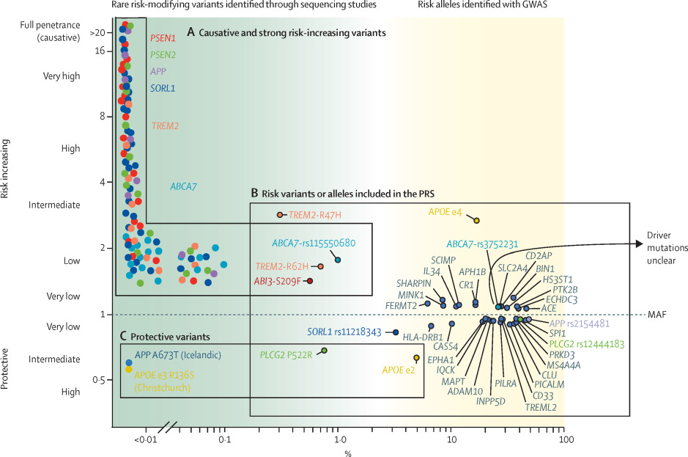
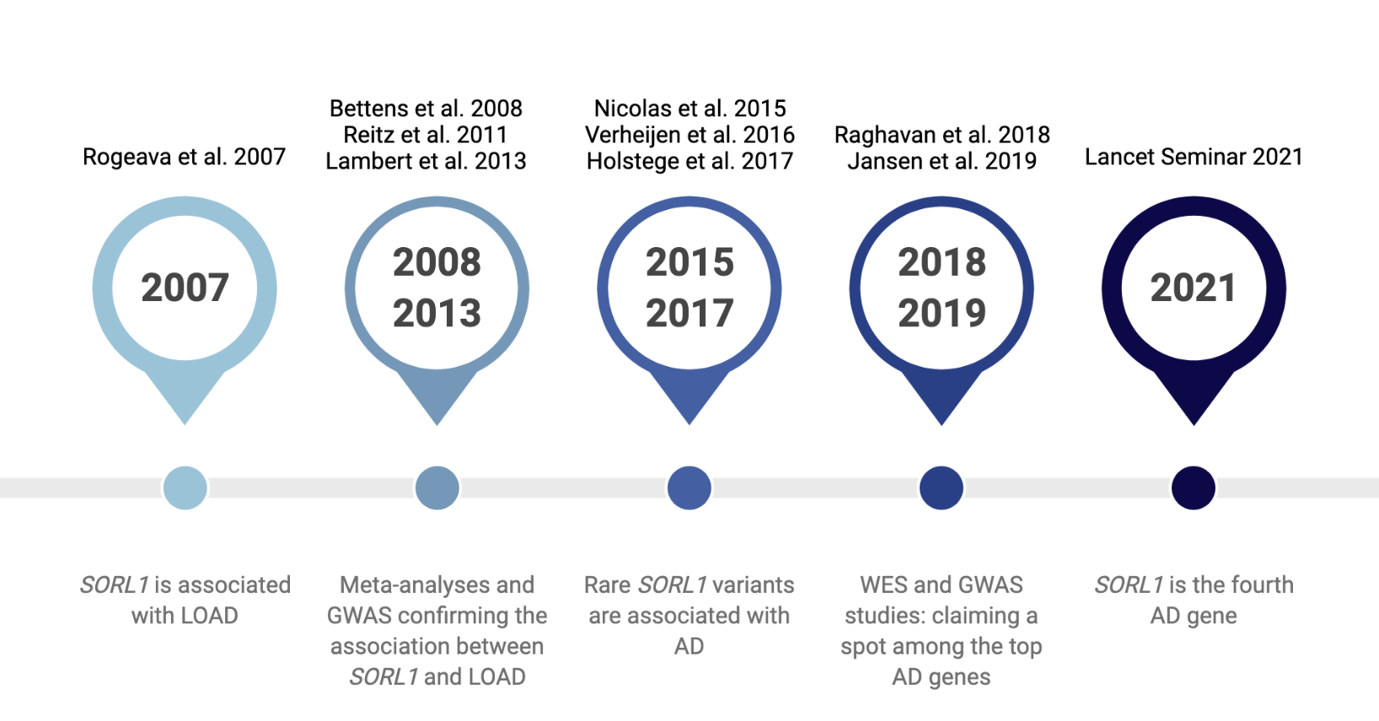
SORL1
The fourth Alzheimer´s disease gene
Strongly associated with AD pathology (LOAD and EOAD)
Variants occurring in heterozygous manner in patients
Co-segregation of SORL1 variants with ApoE4
pathogenic
SORL1
Holstege et al. 2020
Zhang et al. 2020
Wightman et al. 2020
benign
Rare pathogenic SORL1 variants exert large effects on AD
Notes:
Can you please indicate:
1) rare genetic variants have the highest impact, and rare SORL1 variants can have a high effect on AD risk.
2) Of all rare genetic variants in SORL1, some are benign and others may be causative of AD: we need to be able to distinguish between them

Slide 3
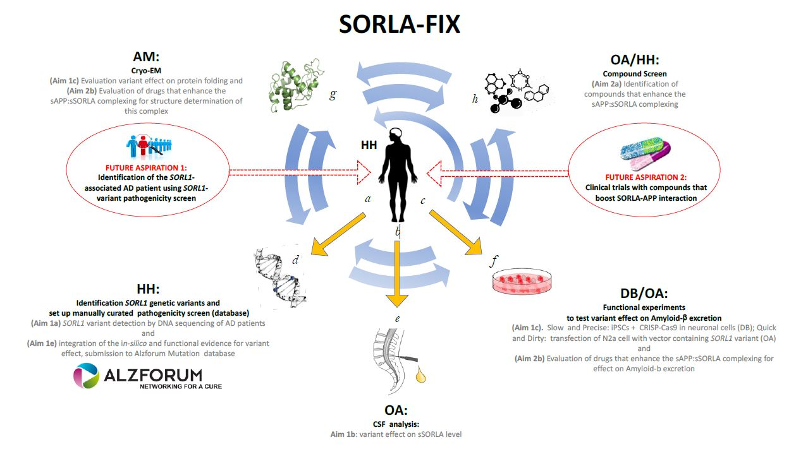

Slide 4
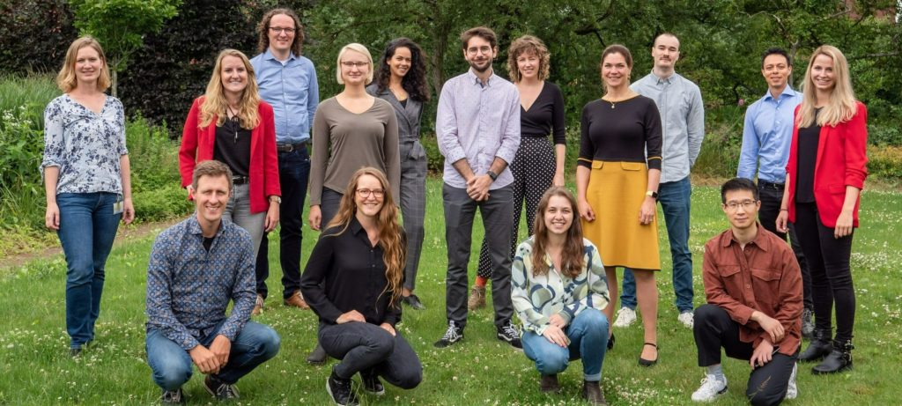
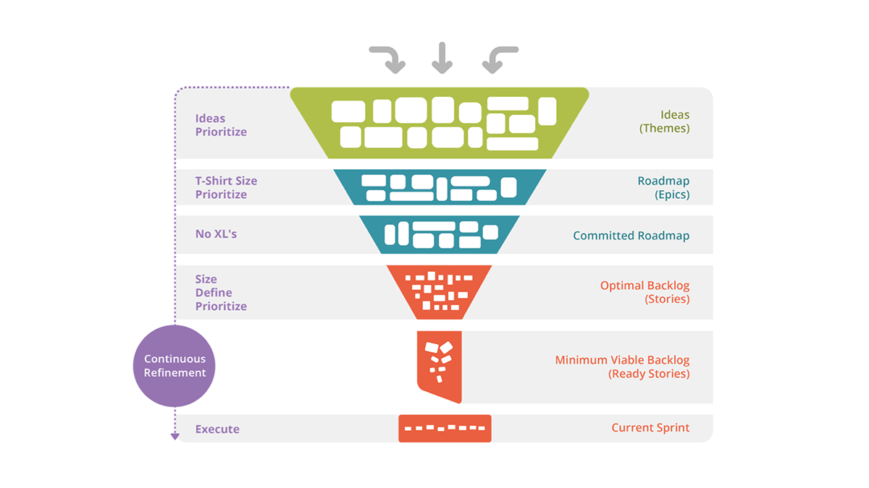

Department of Human Genetics, Amsterdam UMC
Identification of the effect of rare SORL1 genetic variants
www.holstegelab.eu
CSF
Prioritization of
pathogenic variants
CSF-assay set-up
rare variants
Common variants
Milestones
1) Generation of a pathogenicity screen of rare SORL1 genetic variants
2) Generation of an assay to test the effect of a rare genetic variant on SORLA-shedding in CSF
Notes:
Can you please indicate:
2) Of all rare genetic variants in SORL1, some are benign and others may be causative of AD: we need to be able to distinguish between them
3) Based on a large set of rare variants, we are identifying features that allow us to identify pathogenicity.
4) Some pathogenic variants will have an effect on the shedding of SORLA in the CSF, we are setting up an assay to measure SORLA levels in CSF.

Slide 5
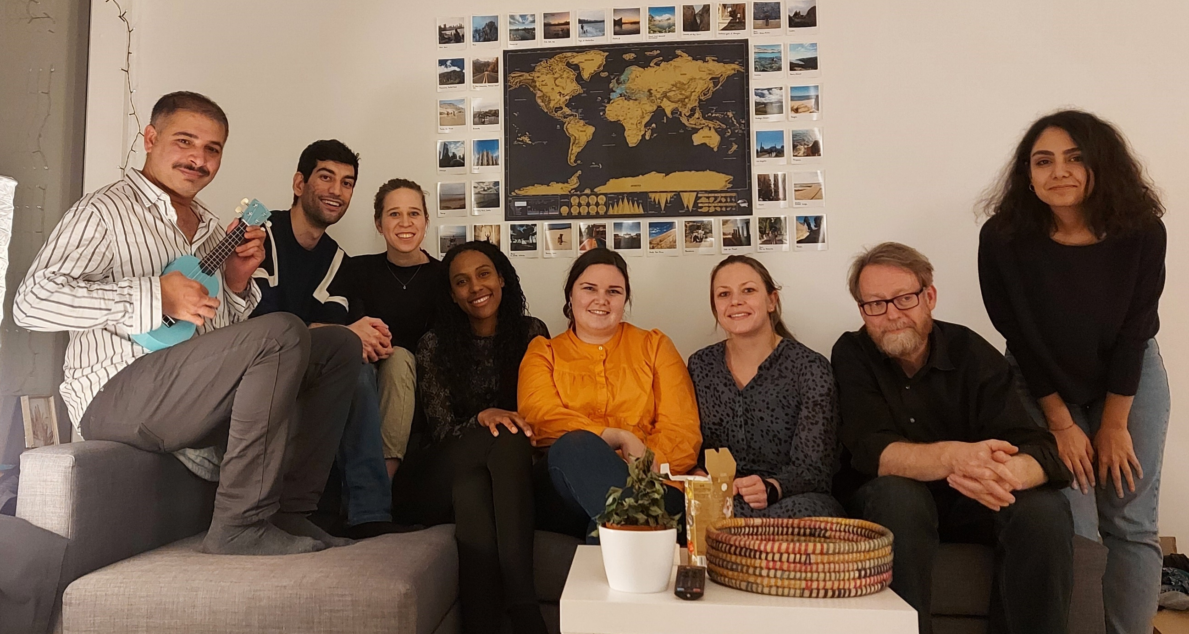
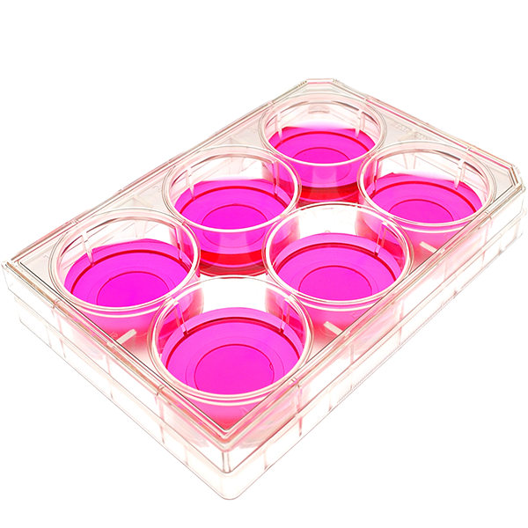

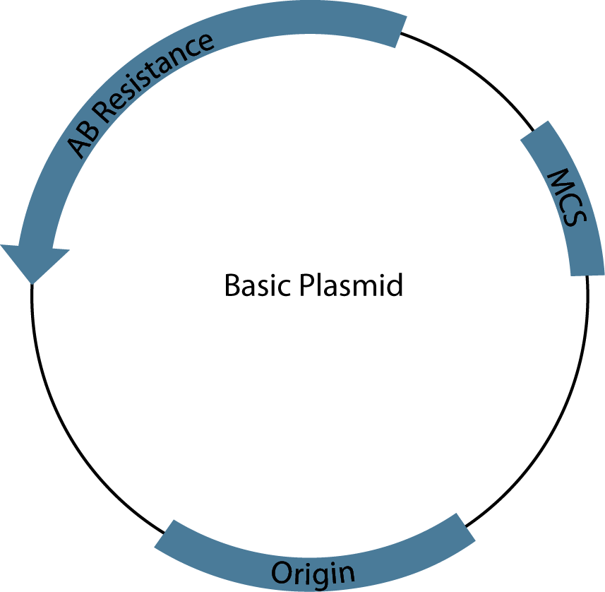
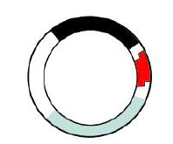

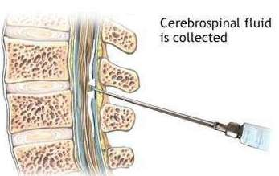
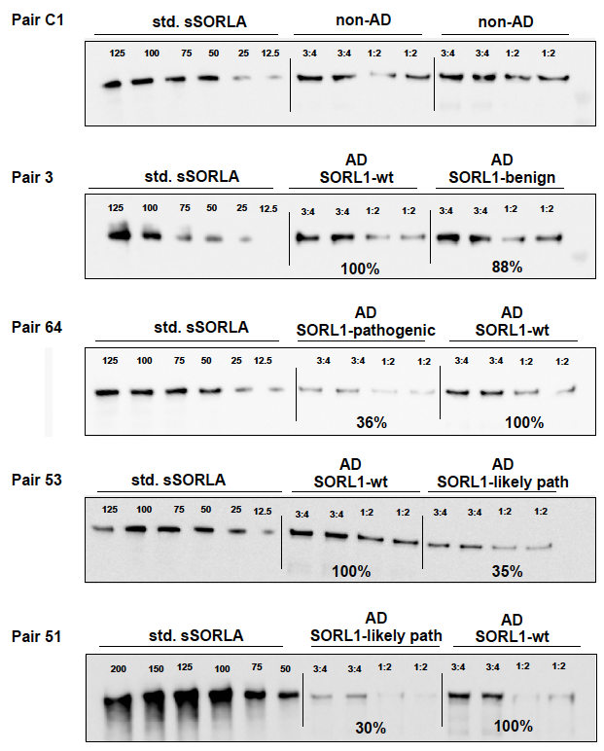
Olav Andersen lab – characterization of SORL1 variants
In vitro studies
WT
WT
Mut
Mut
Lysates
SORLA
APP
24 hs
24 hs
WT
WT
Mut
Mut
Conditional medium
sSORLA
N2a cells
Media
sAPP
CSF analyses
Pairwise approach of AD patients
Carriers of SORL1 variant
Carriers of SORL1 WT
VS
Matched for:
Age at AD onset
Gender
ApoE genotype

Slide 6
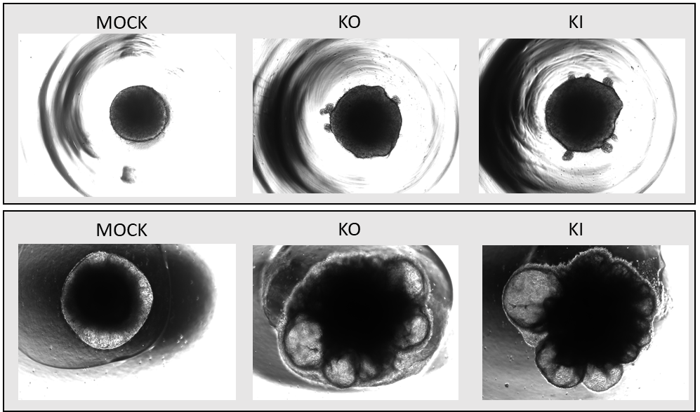



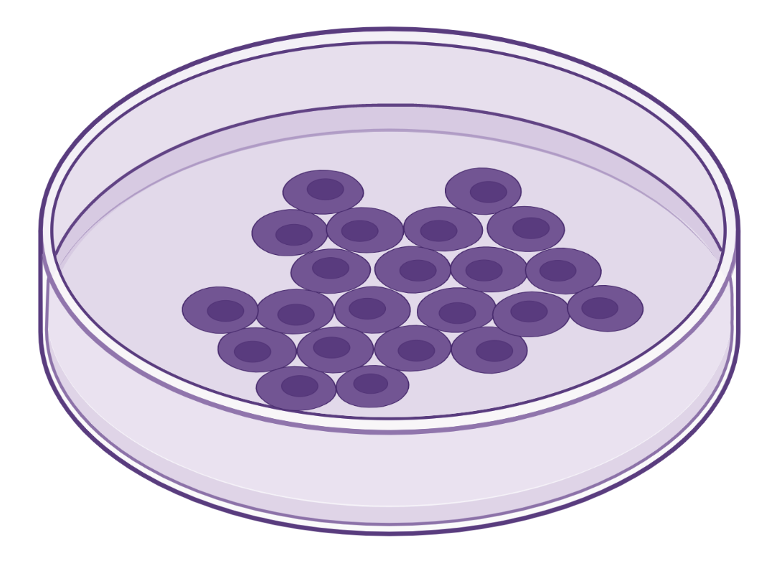
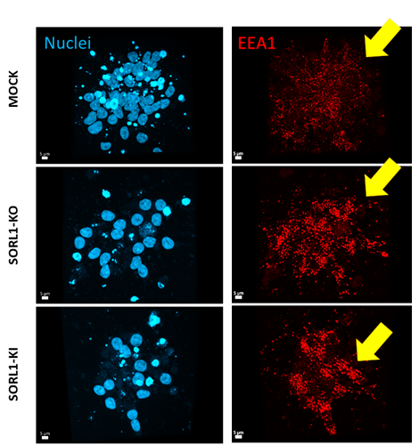
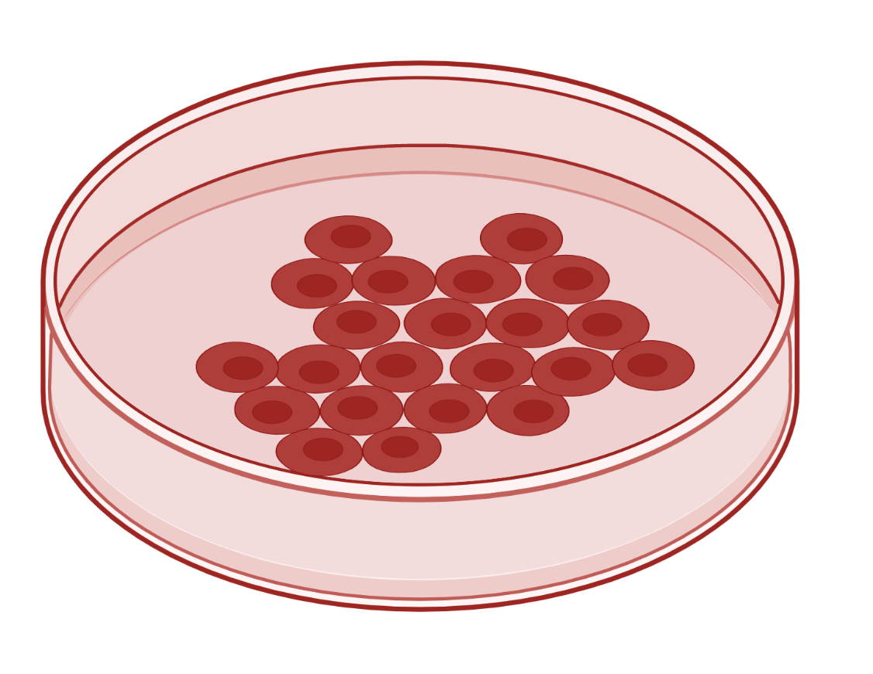

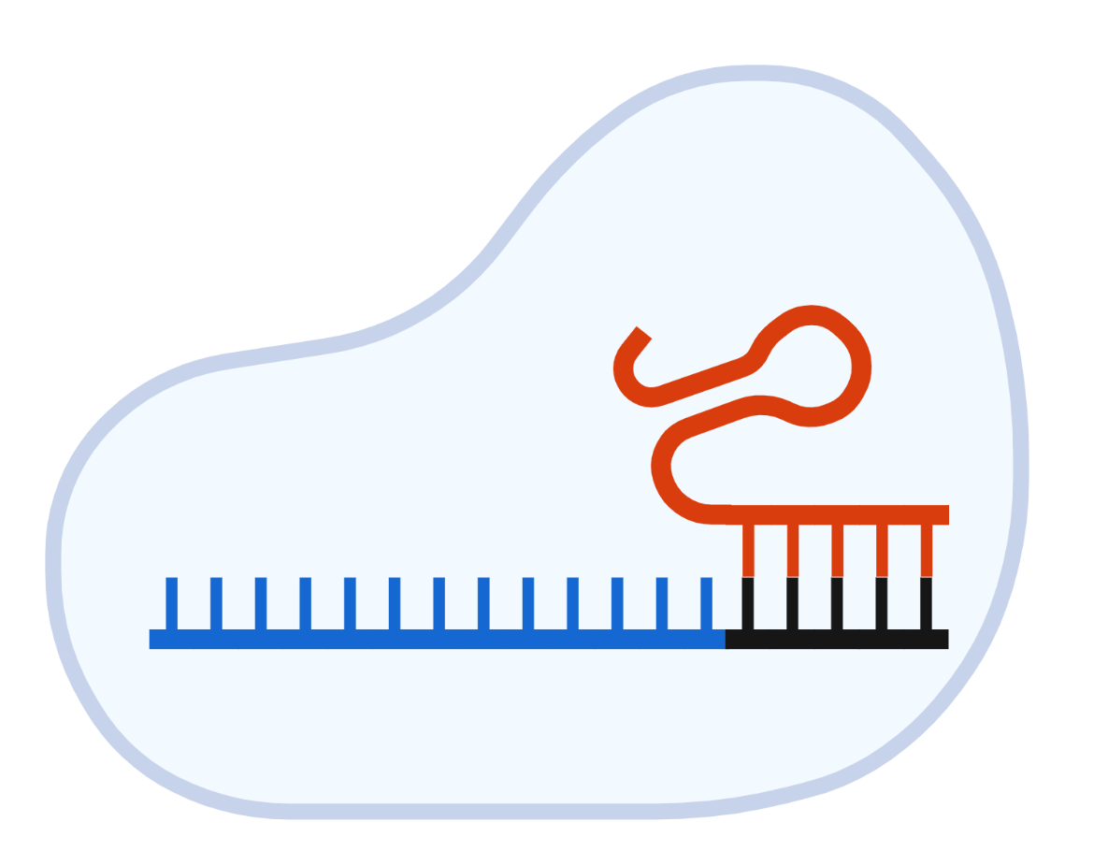
Dáša Bohačiaková lab – in vitro AD modeling
AD patient with SORL1 mutation
D9
reprogramming
D14
cerebral organoids (3D)
iPSCs line with SORL1 mutation
CRISPR-Cas9
Established iPSCs line
inducible neurons (2D)
Endosomal swelling

Slide 7
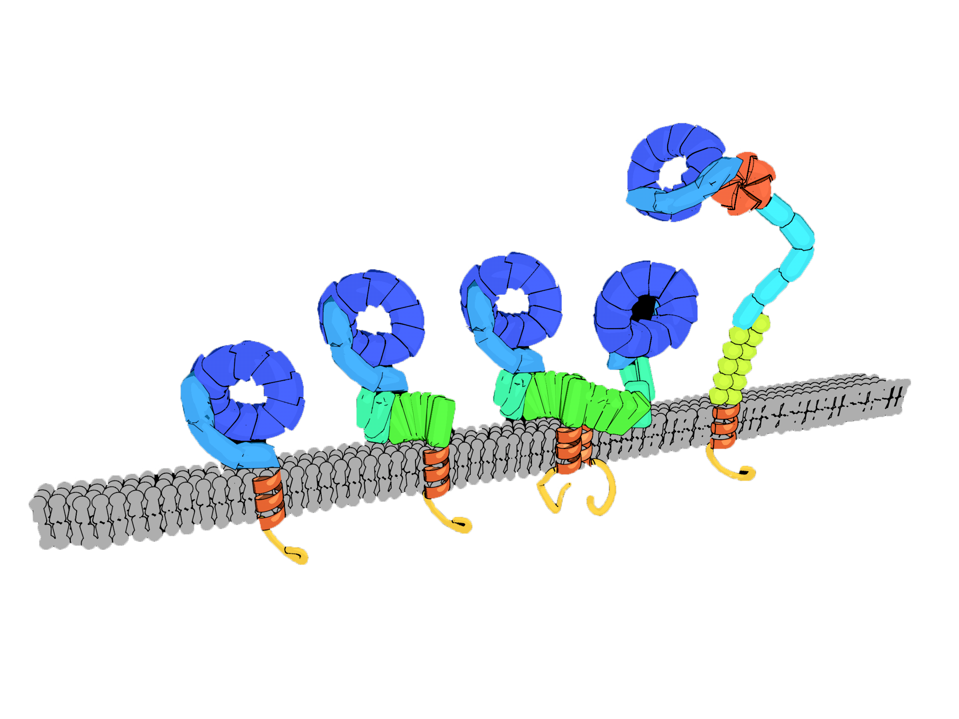
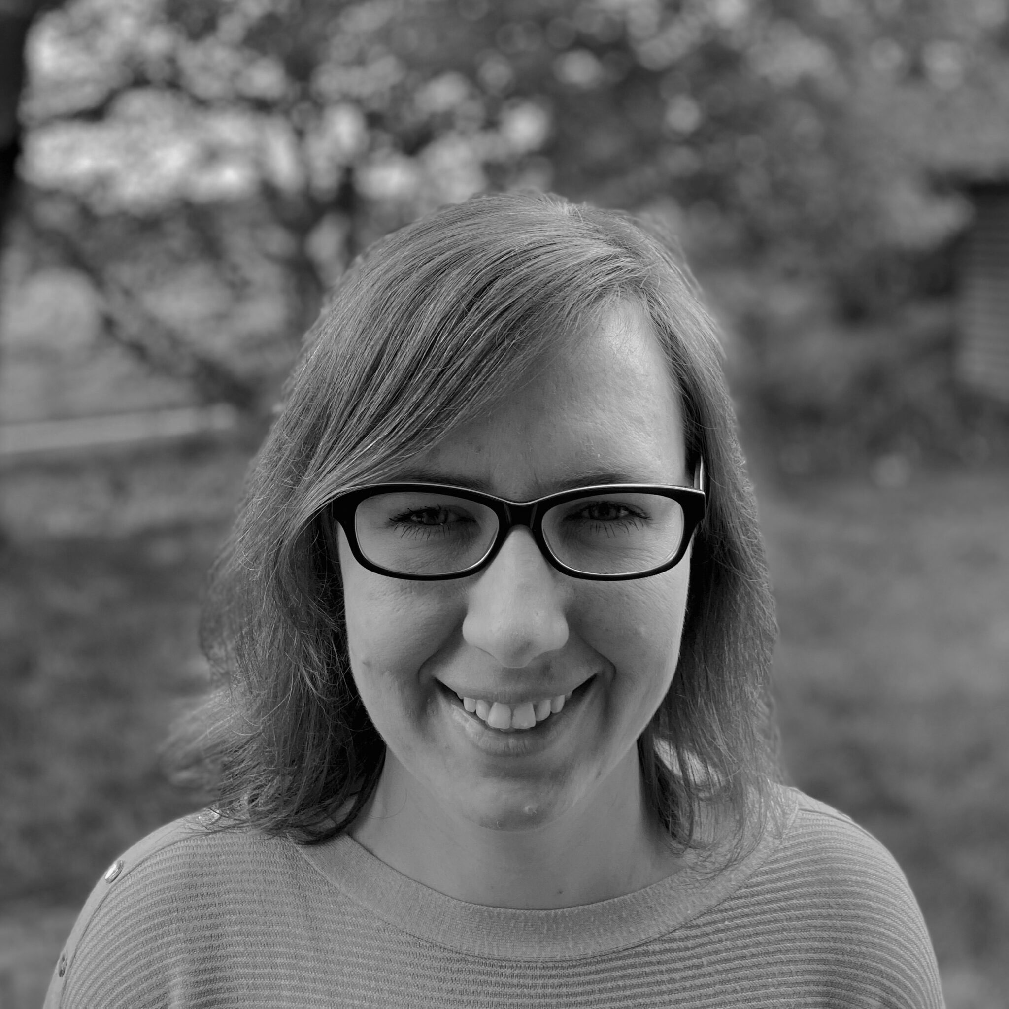
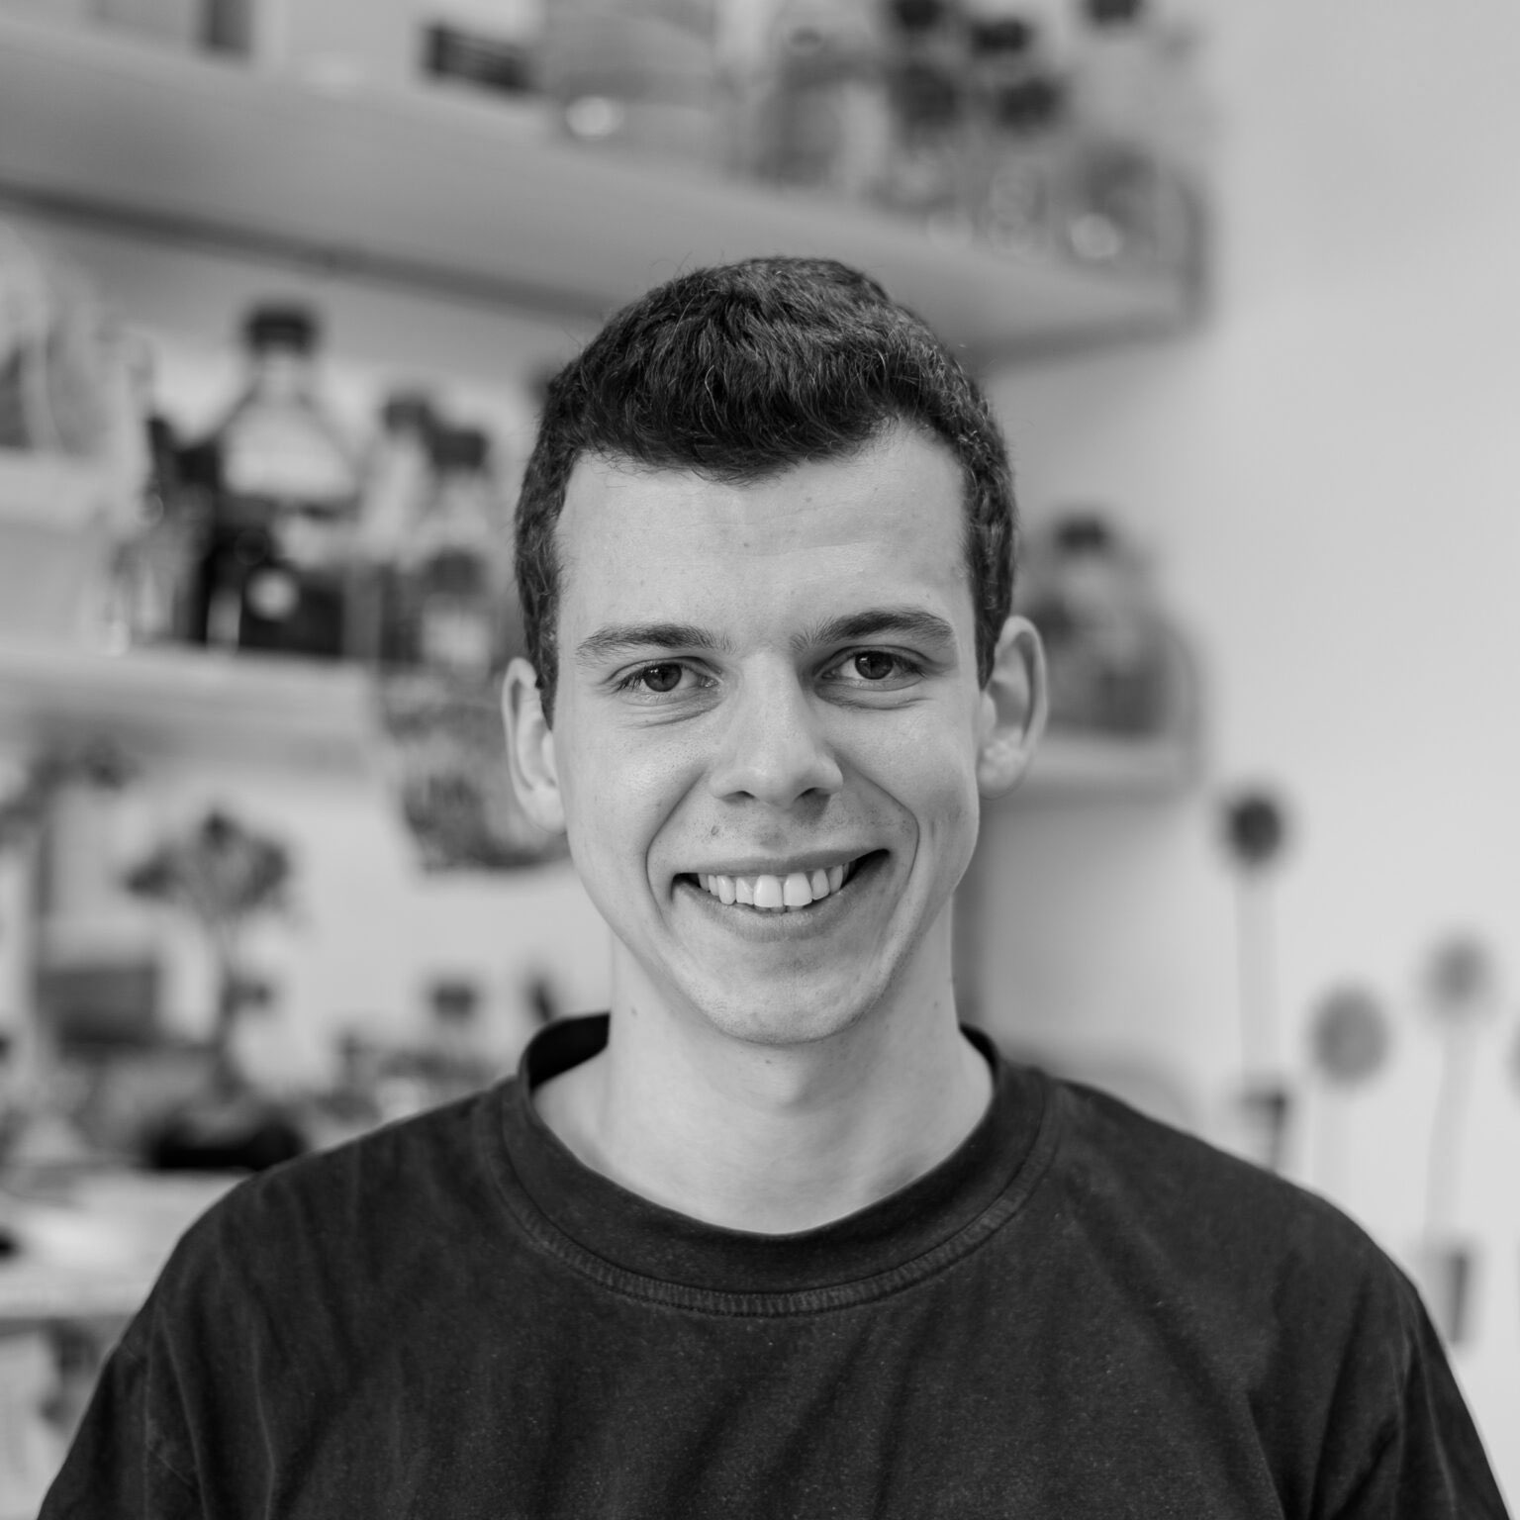
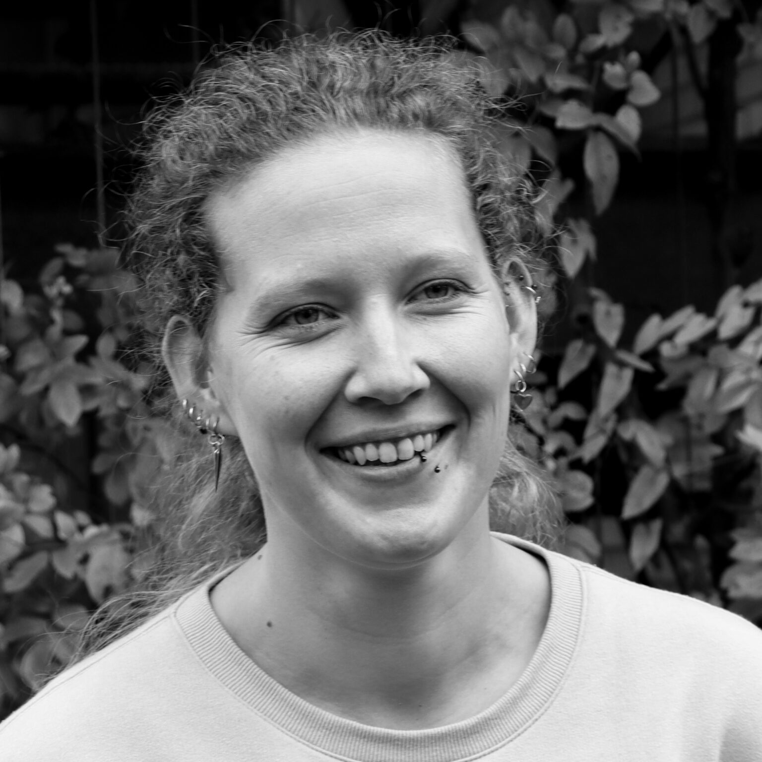
Division of Structural Biology, University of Osnabrück (Germany)
SorLA
Milestones
1) Structural evaluation variant effect on protein folding using Cryo-EM
2) Evaluation of drugs that boost the sAPP:sSORLA complexing for structure determination

Slide 8
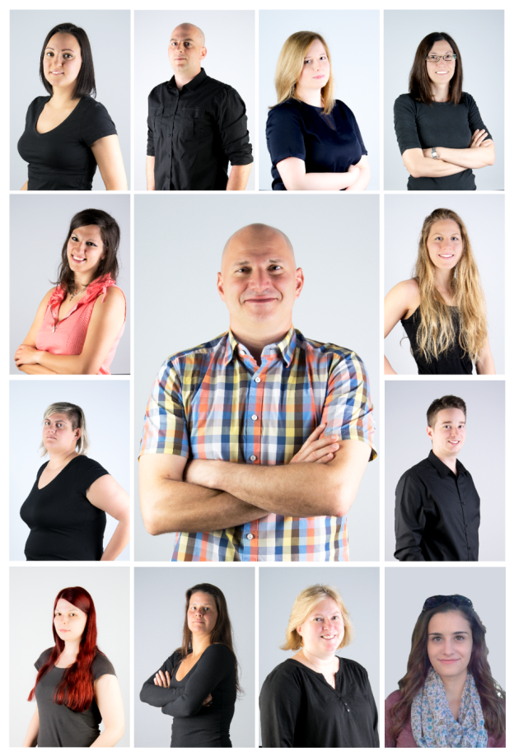

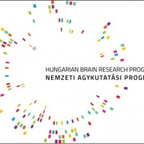

AIMs:
                SORL1 mutations and sSORLA levels as predictors for inflammatory changes in the brain
                Molecular anatomy of SORLA at the microglia-neuron and microglia-vascular interface and changes in AD
Laboratory of Neuroimmunology, Institute of Experimental Medicine (Hungary)
SORLA
Kv2.1
DAPI
SORLA
Iba1

Slide 9
and challenges
Successes
Prioritization of SORL1 variants
Establishment of in vitro protocols for functional characterization of SORL1 variants
Introduction of advanced stem-cell based models for SORL1-associated AD modeling
In vitro models: 80 days of differentiation of iPSCs into neurons
Good source of SORLA protein production for methodologies (e.g. SORLA structure, drug screening)
Expected outcomes
Being able to confirm pathogenicity of SORL1 variants using our new pathogenicity screening.
Integrate the evidence for a variant functional effect and made public as variant annotations in the Alzforum database.
Identify drugs that stabilize the APP:SORLA complexing → possible drug for SORL1-associated AD (personalized medicine).

Slide 10
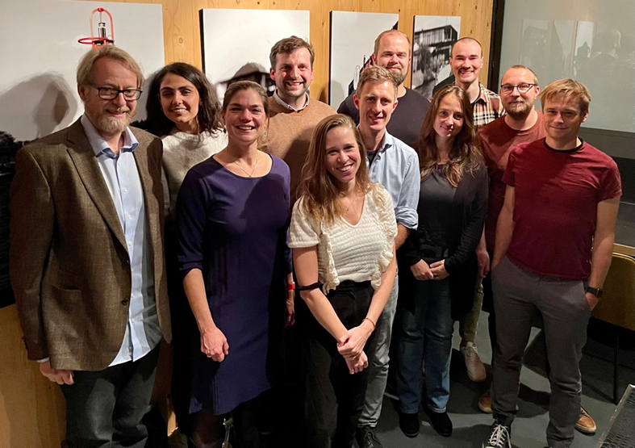
Acknowledgments
Visit our poster n.21 ☺
Henne Holstege
Sven Van Der Lee
Matthijs van der Wall
Olav Andersen
Giulia Monti
Dáša Bohačiaková
Jan Raska
Petr Fojtík
Simona Vochyanova
Arne Möller
Jonas Schäfer
Ádám Dénes
Balasz Posfai

