Slide 1
HOMESIDE Home-based family caregiver-delivered music and reading interventions for people living with dementia: A randomised controlled trial
JPND Mid-term Symposium, 28 April 2022
Dr Kjersti Johansson, Norwegian Academy of Music
Jodie Bloska, Cambridge Institute for Music Therapy Research
Notes:
Jodie

Slide 2
Partners
Notes:
Jodie

Slide 3
Background
Challenging aspects of caring can lead to negative physical and mental health including fatigue, depression, burnout and illness for carers (O-Dwyer, Moyle and van Wyk, 2013; Papastavrou et al., 2007)
Personalised care at home for people living with dementia
Support for both person with dementia and informal family carers
Previous research has shown music therapy sessions to be effective for minimising behavioural and psychological symptoms of dementia (BPSD) (Fusar-Poli et al. 2017; Hsu et al. 2015; Zhang et al. 2017; Ridder et al. 2013)
Indirect music therapy approach: developing carers’ skills in using non-pharmacological interventions
Notes:
Jodie
-
How does your project contribute to tackling the societal challenge of neurodegenerative diseases? nonpharma investigation reading, ot, MT, reminiscence. Helping with daily life, intergenerational, relationships, reducing BPSD, competence/support for carers/resilience. Improve QOL, prevent early admission to hospital
Estimated 670,000 unpaid primary caregivers of people with dementia in the UK (Alzheimer’s Society, 2014).
Caregivers often find caring satisfying and rewarding, however, coping with some of the more challenging aspects of caring can lead to negative physical and mental health including fatigue, depression, burnout and illness (Papastavrou et al., 2007; O-Dwyer, Moyle and van Wyk, 2013). --- can have a knock on effect on PWD’s symptoms and societal costs, institutionalisation etc.

Slide 4
Aims
Primary aim: Investigate the effects of the music intervention on behavioural and psychological symptoms of dementia (BPSD) for people living with dementia at home, with support from an informal carer.
Other secondary objectives are as follows:
► effects on levels of depression and quality of life of the participant with dementia
► effects on levels of depression, resilience, sense of competence and quality of life of the carer
► effects on participants’ quality of relationship
► cost-effectiveness of the intervention
Notes:
jodie
What is/was the aim of your research project?

Slide 5
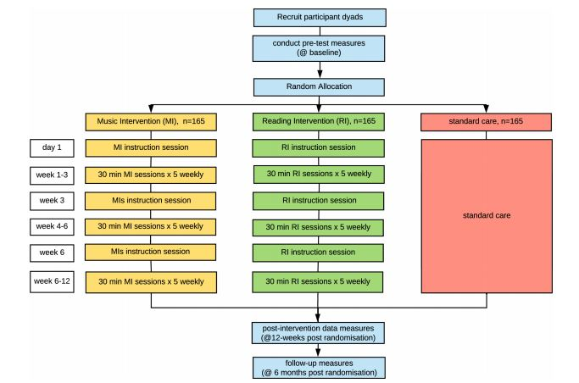
Design
3-arm randomised controlled trial
Single-masked (data collectors)
Notes:
jodie
Primary end point post intervention (12 weeks), secondary 6 months

Slide 6
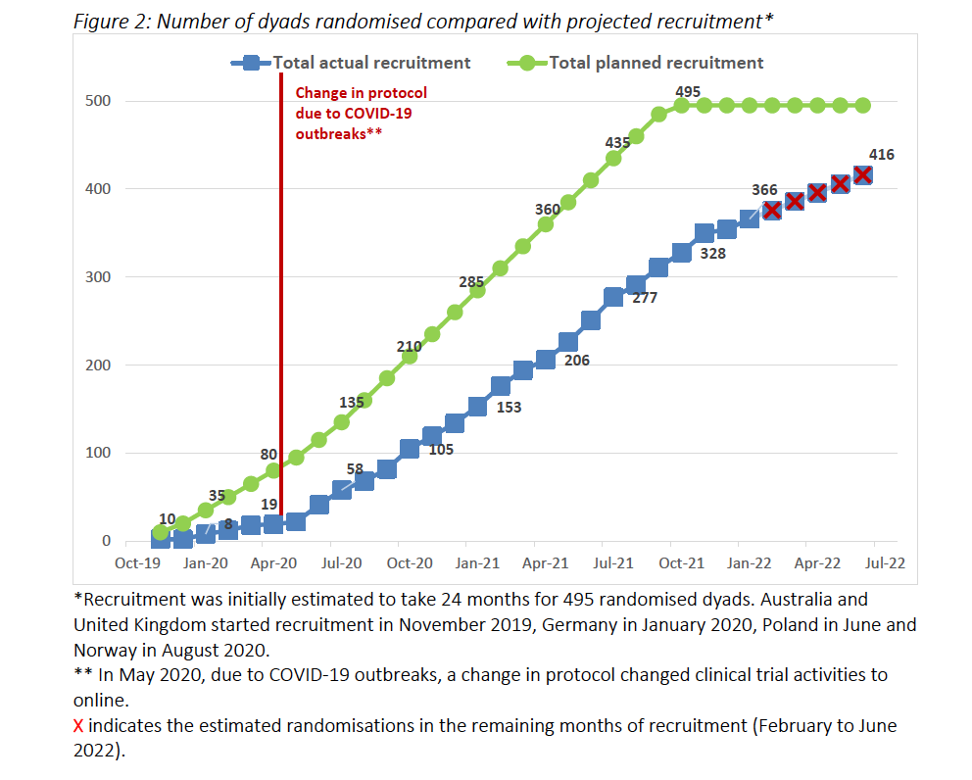
Current status
Total randomised=388 as of April 18th
Expressions of interest=1043
Discontinuation to the trial – 13.5% (as of March 23)
6
Notes:
Kjersti
As of April 18th, we have randomised 388 dyads. We will cease recruitment at the end of June 2022 and data collection will be completed by December 2022.

Slide 7
Challenges and successes
COVID-19 – moving from in-person to online delivery (a challenge and a success)
Finding the right recruitment methods in different countries
Positive feedback from study participants
Drop out rates fairly low
Ensuring long-term PPI involvement (from development of bid to implementation)
MATCH App
Notes:
Kjersti lead
What are/were the successes and challenges of your project?
Cultural differences in attitudes to research and approaches to social care, health care system and activity offers.
PPI group input
Covid: input from all PPI groups, they supported us in moving online.
PPI groups involved in recruitment: assisting in developing and adjusting recr. Material + media apparances. Feedback to researchers about how to present the project, different chanels/groups for recr. Etc. Been very useful.
PPI: Feedback from individual members that they missed the opportunity to influence the intervention development. Challenge when the process is long and you create new PPI groups as you get funding.
MATCH app developed with assistance/feedback from PPIs?

Slide 8
Working across institutions
Strong collaboration
Language barriers – particularly working across PPI groups; managing data in different languages
Different rules and regulations surrounding ethics
Differences in resources across institutions
Clinical supervision across disciplines and across countries
Supporting PhD students – 7 across partner universities – and early career researchers
Notes:
Kjersti lead
Strong collaboration: Regular meetings both in the leader group and CTM, interventionists...
Lessons learned from working together across institutions.

Slide 9
Dissemination
Media and public events – raising profile of psychosocial interventions
Publications across medical journals and Allied Health Professional journals
Quantitative, qualitative and mixed methods results
Publications:
HOMESIDE: home-based family caregiver-delivered music and reading interventions for people living with dementia: protocol of a randomised controlled trial - BMJ Open (Baker et al. 2019)
Strategies for recruiting people with dementia to music therapy studies: Systematic review – Journal of Music Therapy (Baker et al. 2021)
Notes:
Kjersti lead
How and to whom do you disseminate your project results?
To each funder in each country.
rolling out the clinical interventions after research—developed new approaches.

Slide 10
Thank you!
Please visit our website at www.homesidestudy.eu
Notes:
Patient and Public Involvement (PPI) in your research
When addressing the questions above, and where appropriate, it is crucial that you refer to the roles, challenges and successes of having Patients and Carers (PPI) involved in your unique research.
Please use real-life example(s) from your experience and that of Patiens/Carers involved in your particular project. Avoid generic answers and theoretical approaches (guidelines, etc) when referring to PPI in your research.

Slide 11
References
Baker, F.A., Bloska, J., Braat, S., Bukowska, A., Clark, I., Hsu, M.H., Kvamme, T., Lautenschlager, N., Lee, Y.-E.C., Smrokowska-Reichmann, A., Sousa, T.V., Stensaeth, K.A., Tamplin, J., Wosch, T. and Odell-Miller, H., 2019. HOMESIDE: home-based family caregiver-delivered music and reading interventions for people living with dementia: protocol of a randomised controlled trial. BMJ open, [online] 9(11), p.e031332. https://doi.org/10.1136/bmjopen-2019-031332.
Baker, F.A., Pool, J., Johansson, K., Wosch, T., Bukowska, A.A., Kulis, A., Blauth, L., Stensæth, K., Clark, I.N. and Odell-Miller, H., 2021. Strategies for recruiting people with dementia to music therapy studies: Systematic review. Journal of music therapy. [online] https://doi.org/10.1093/jmt/thab010.
Papastavrou E, Kalokerinou A, Papacostas SS, et al. Caring for a relative with dementia: family caregiver burden. J Adv Nurs. 2007;58: 446-57.
O'Dwyer S, Moyle W, van Wyk S. Suicidal ideation and resilience in family carers of people with dementia: A pilot qualitative study. Aging Ment Health. 2013;17:753–760. doi:10.1080/13607863.2013.78900
Hsu MH, Flowerdew R, Parker M, et al. Individual music therapy for managing neuropsychiatric symptoms for people with dementia and their carers: a cluster randomized controlled feasibility study. BMC Geriatr 2015;15:84-015-0082-4. doi.org/10.1186/s12877-015-0082-4
Fusar-Poli L, Bieleninik Ł, Brondino N, et al. The effect of music therapy on cognitive functions in patients with dementia: a systematic review and meta-analysis. Aging Ment Health 2017;1–10. doi.org/10.1080/13607863.2017.1348474
Zhang Y, Cai J, An L, et al. Does music therapy enhance behavioral and cognitive function in elderly dementia patients? A systematic review and meta-analysis. Ageing Res Rev 2017;35:1–11. doi.org/10.1016/j.arr.2016.12.003
Ridder HM, Stige B, Qvale LG, et al. Individual music therapy for agitation in dementia: an exploratory randomized controlled trial. Aging Ment Health 2013;17(6):667-678. doi:10.1080/13607863.2013.790926.

